Slide 1
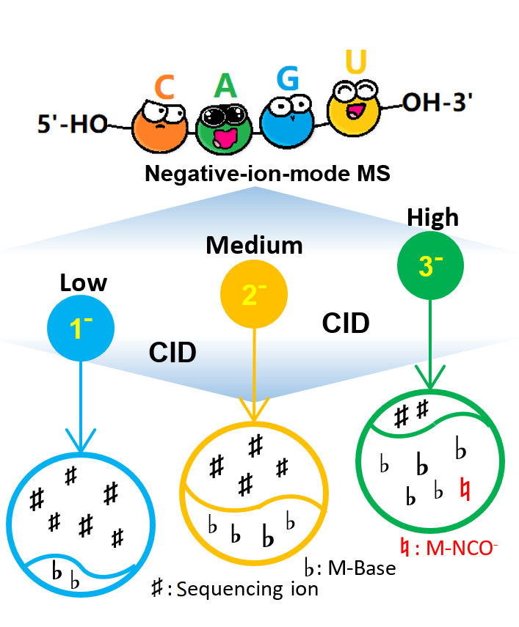
“Mass + Structure + Knowledge”： A Journey to In-depth Interpretation of
Tandem Mass Spectra Derived from RNA Oligonucleotides
“质量+结构+知识” : RNA寡聚核苷酸的
质谱深度解析路程
孙瑞祥
北京生命科学研究所
(NIBS)
CNCP-2023
2023/8/30 Wed., ICT, BJ
JASMS-2023-Aug.

Slide 2
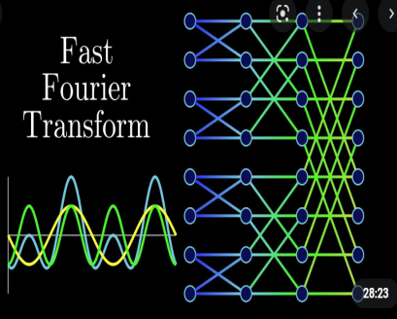
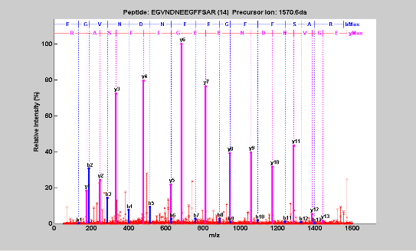
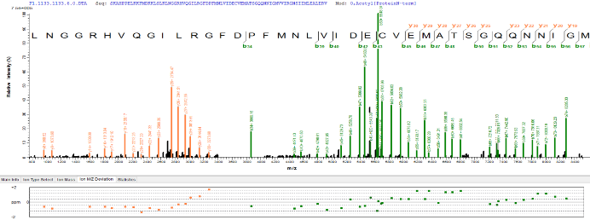

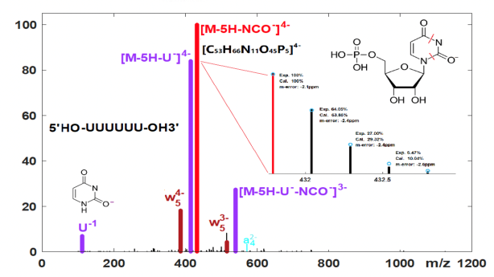
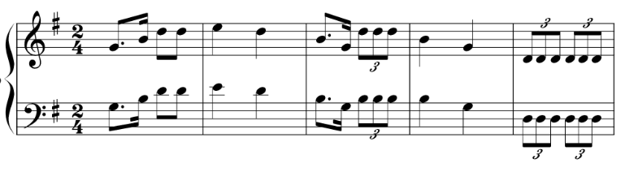
“最 靠 谱 的 人”（MS Super Fan)
1997-2000 PhD-FFT
2002-2013 Peptide (ETD,JPR2010)
2014-2018 Top Down (pTop1.0, AC2016; pTop2.0, 2022)
2020-2023 RNA Oligo (JASMS 2023/Aug.)
2021-2023 Staff
Notes:
2

Slide 3
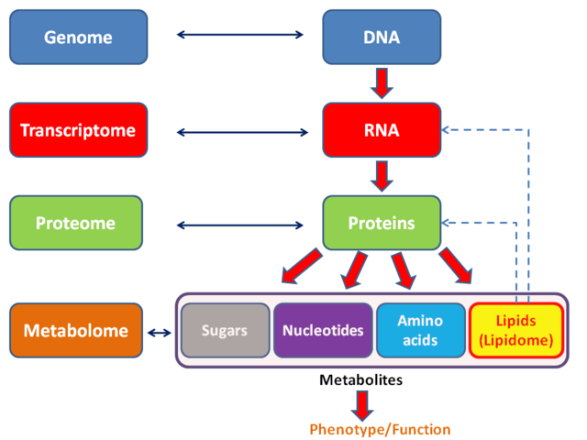
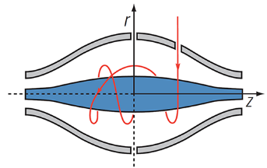
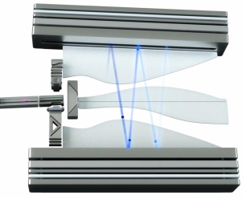
Mass Spectrometry for Biomolecular Structural Characterization
Mass Spectrometry
for –ome Analysis
Notes:
3

Slide 4
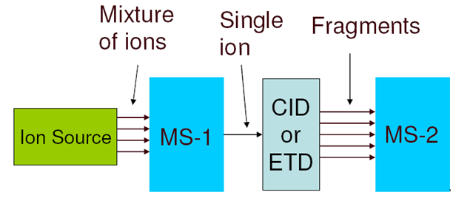
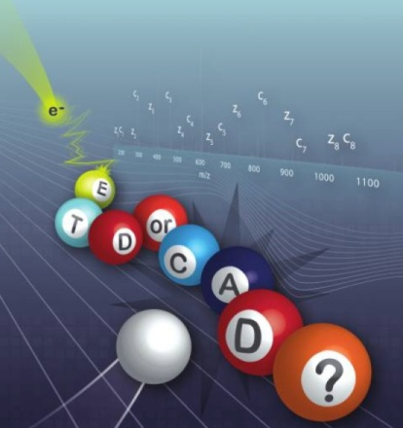
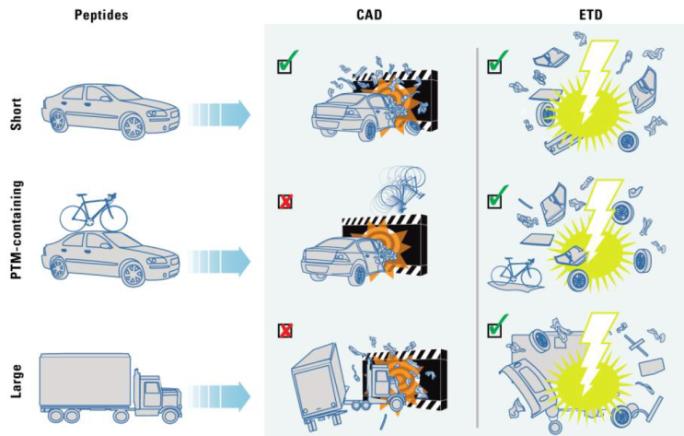
MS-1 > Fragmentation > MS-2
EThcD
UVPD
Notes:
4

Slide 5
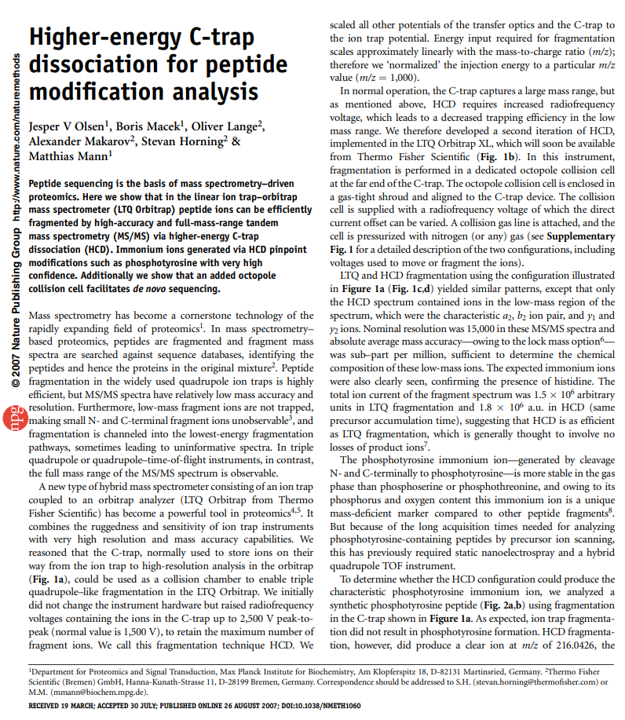
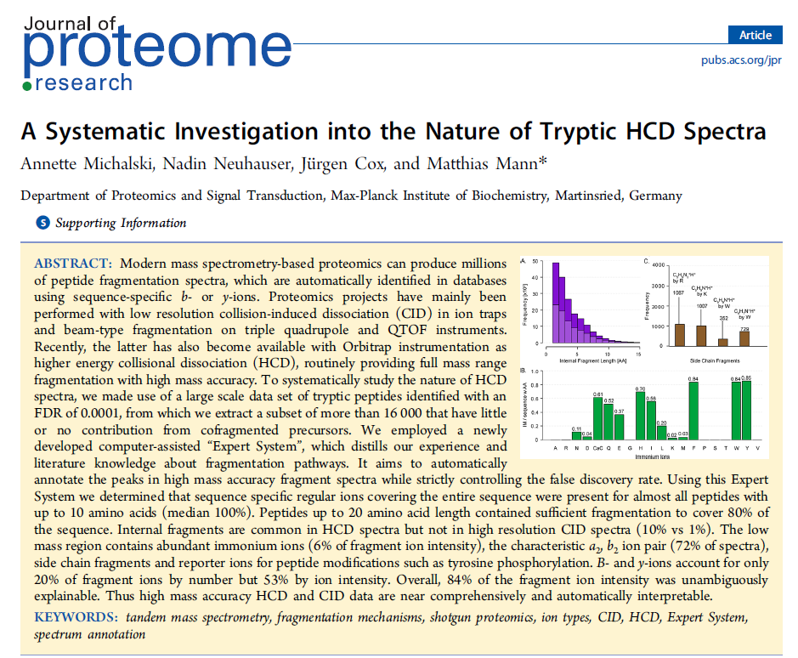
HCD: routinely employed in MS/MS analysis
2012
Nature Methods, 2007
Notes:
5

Slide 6
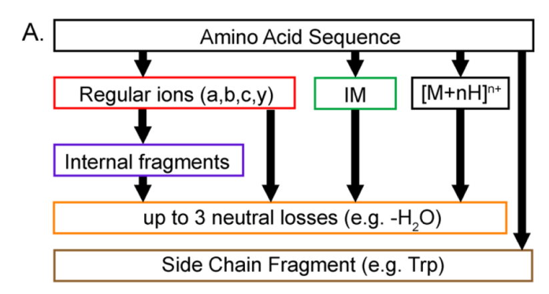
From a peptide sequence to its fragment ions
JPR, 2012
Notes:
6

Slide 7
‘UUUUUU’: CID (NCE=35%, m/z=353.83, z=5⁻ )
RA(%)
m/z
Notes:
7

Slide 8

‘UUUUUU’: An annotated CID (NCE=35%)
RA(%)
Notes:
8

Slide 9
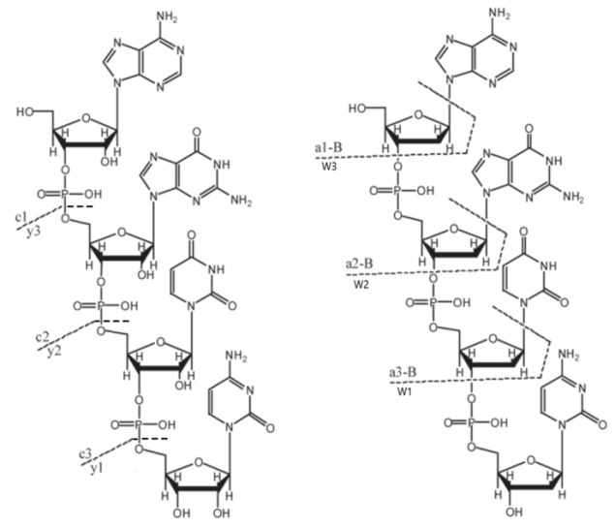
Challenges of MS analysis on RNA or DNA
1. ESI: MS negative-ion mode for nucleic acids
2. Multiply-charged and charge-state-dependent fragmentation
3. Adduct ions (Na, K, …)
4. LC and MS platform
5. Software tools
6. PTM localization
RNA
DNA
Notes:
9

Slide 10
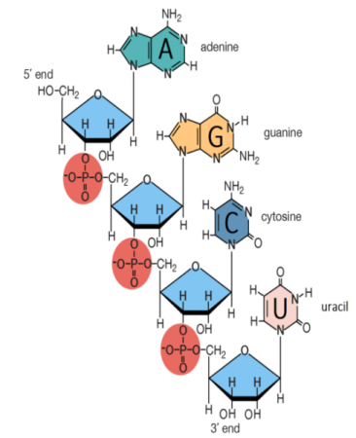
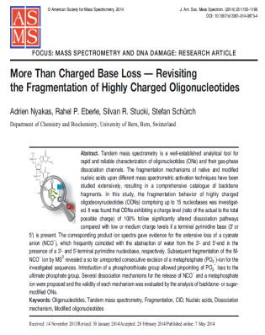

“Mass + Structure + Knowledge”: towards to
In-depth Interpretation of RNA Oligo’s MS/MS
Mass
Structure
Knowledge
Spectrum
Computing
Notes:
10

Slide 11
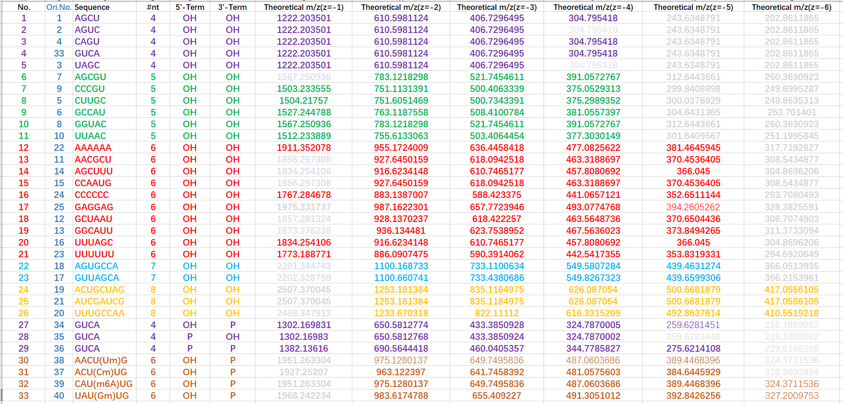
List of Our Synthesized RNA Oligos (nt=4~8)
Notes:
11

Slide 12
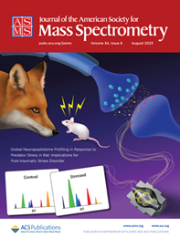
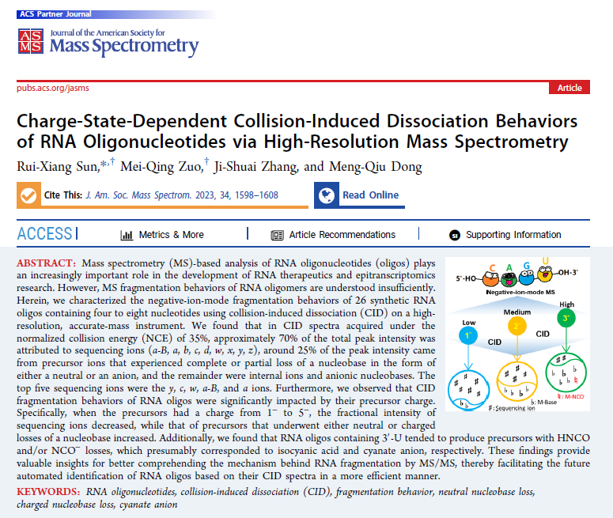
JASMS manuscript peer review (March, 2023)
“The scientific content is exciting and appears to be done in a, mostly, appropriate way. This endeavor also appears timely as many -omics efforts now stretch into DNA and RNA oligonucleotide characterization.”
“科学内容令人振奋，而且主要以适当的方式来呈现。这项努力显得也很及时，因为许多组学研究现在已拓展到了DNA 与 RNA 寡聚核苷酸表征领域。”
Notes:
12

Slide 13
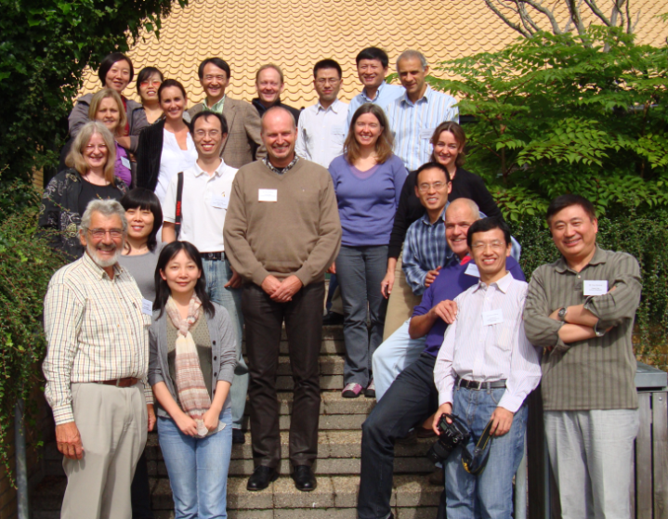
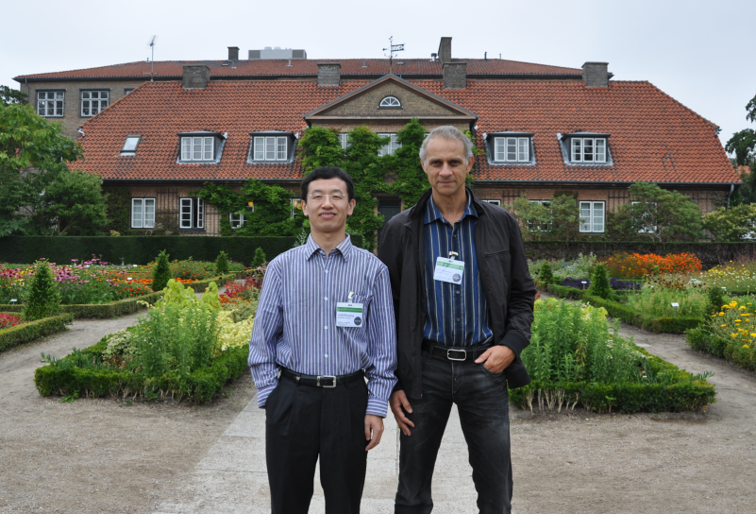
“一面之词，一生感动”的一个故事 (2011-2023)
Notes:
13

Slide 14
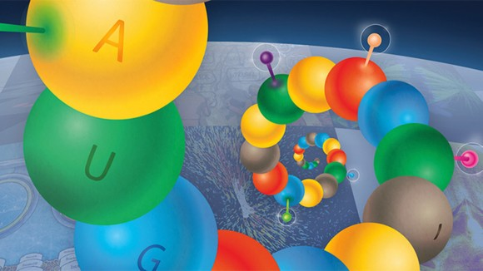
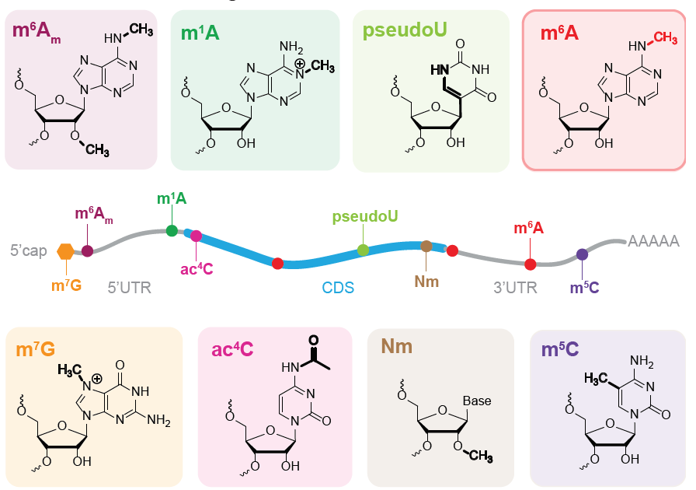
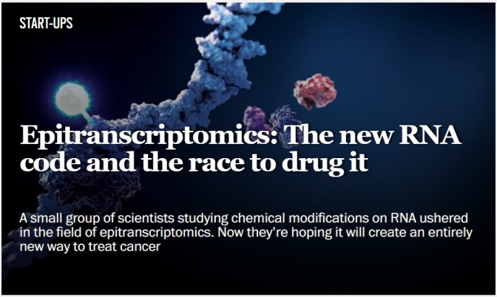
Epitranscriptome: Global Chemical Modifications on RNAs
Notes:
14

Slide 15
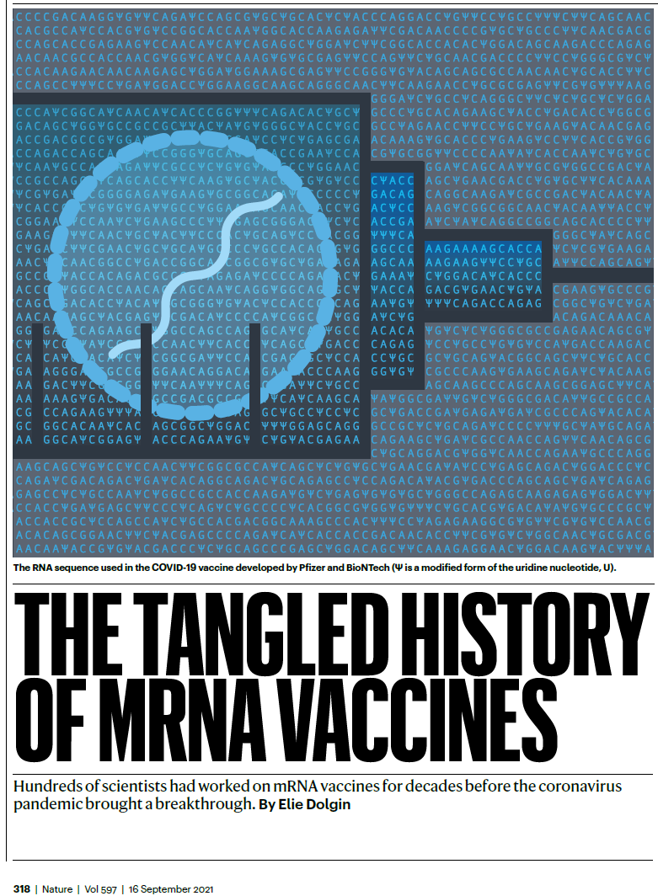
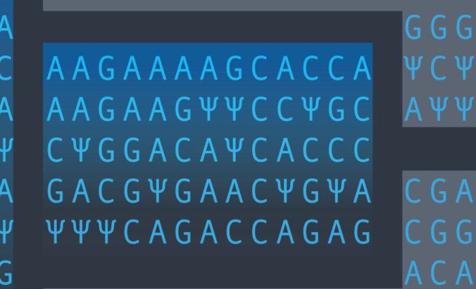
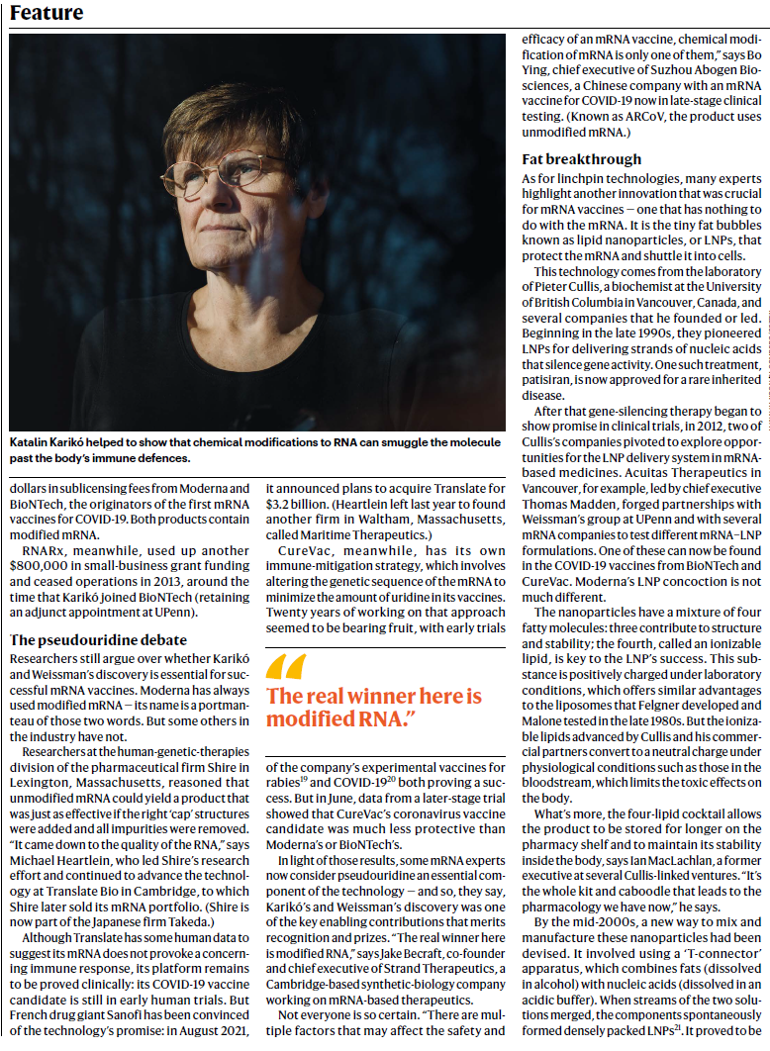
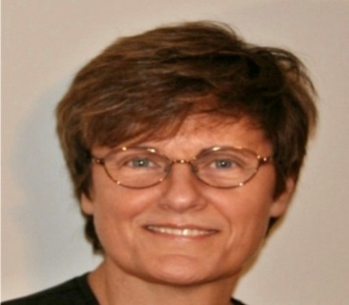
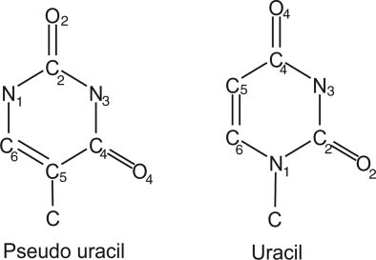
“The real winner here is modified RNA”-mRNA vaccines
Ψ
U
Notes:
15

Slide 16
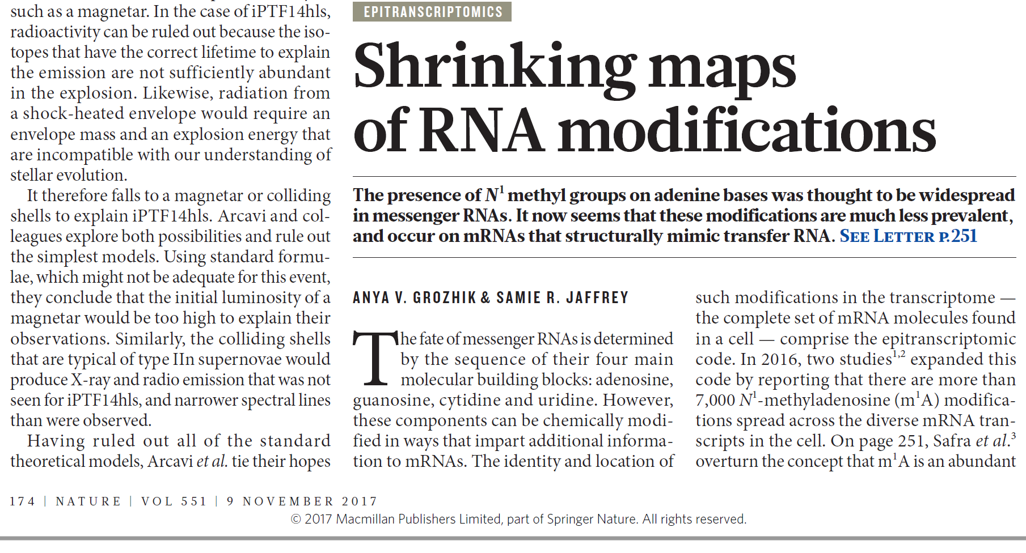
Reliability of RNA Modification Detections (m1A, 2017 Nature)
“The modifications were mapped from sequencing data but not biochemically validated. A recent study of the mammalian transcriptome mapped approximately 3,500 nucleotides that contain methyl groups on the ribose part of the molecules. However, subsequent reanalysis showed that the key sequence motifs discovered in this study matched those of ‘primer’ sequences used to generate complementary DNA, a common sequencing artefact.”
Notes:
16

Slide 17
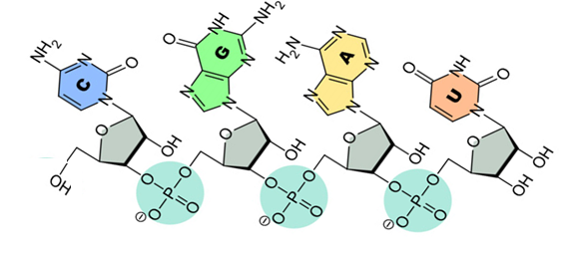
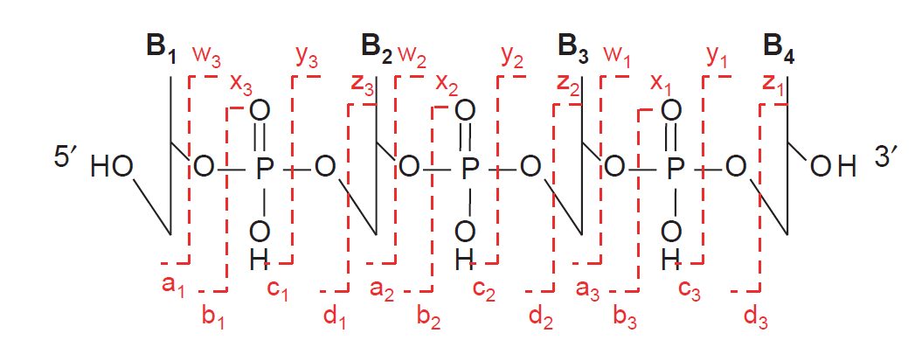
MS/MS fragmentation of RNA vs Peptide/Protein
5’-OH-CGAU-OH-3’
5’
3’
B: Base(C/U/A/G)
Peptide/Protein
Sugar
a/w: 3’ C-O b/x: 3’ P-O c/y: 5’ P-O d/z: 5’ C-O
a-B: a3-B/a3-B(G)
Notes:
17

Slide 18
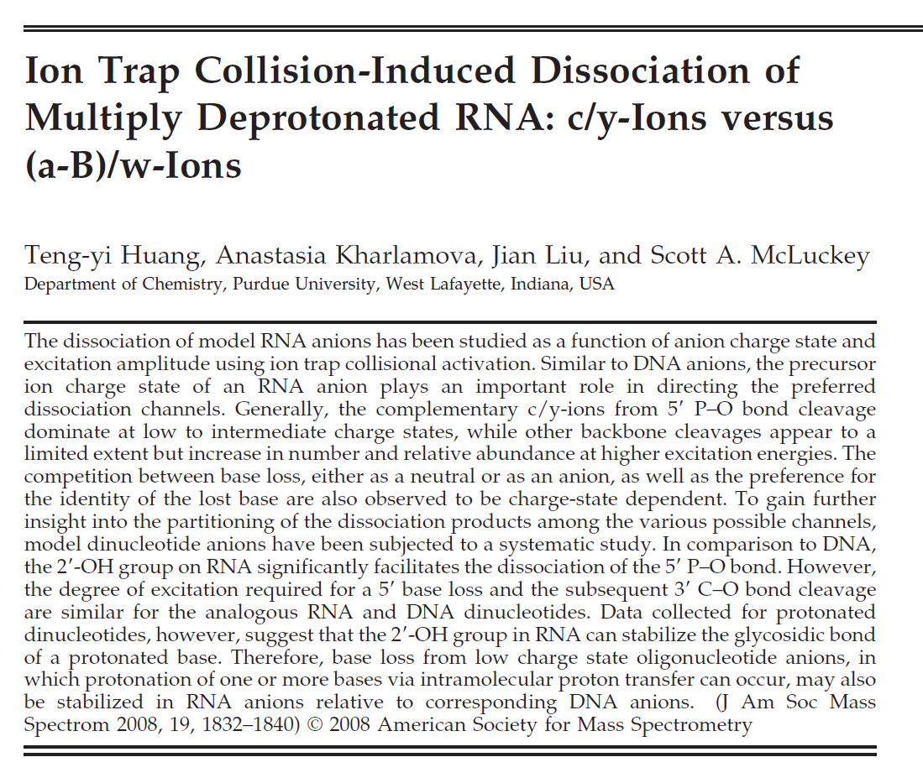

Available Knowledge on RNA vs DNA Fragmentation (JASMS-2008)
RNA
DNA
(J Am Soc Mass Spectrom 2008, 19, 1832–1840)
Notes:
18

Slide 19
Annotation and Visualization of RNA Oligo MS/MS
a3-B
a2-B
M-C
abcd/wxyz
Base-released/a-B
Internal ions/9 sub-types
za/ya.zb/yb/zc.xa/wa.xb.yc.zd/yd.wb/xc/wc.xd/wd
Released-Base/
Base-released
C-110/U-111/A-134/G-150/
W1-B(211)/C1-B(193)/
C1-B-H2O(175)
Precursor/
Base-lost Precursor
M/M-H2O
M-G/M-A/M-U/M-C
Notes:
19

Slide 20
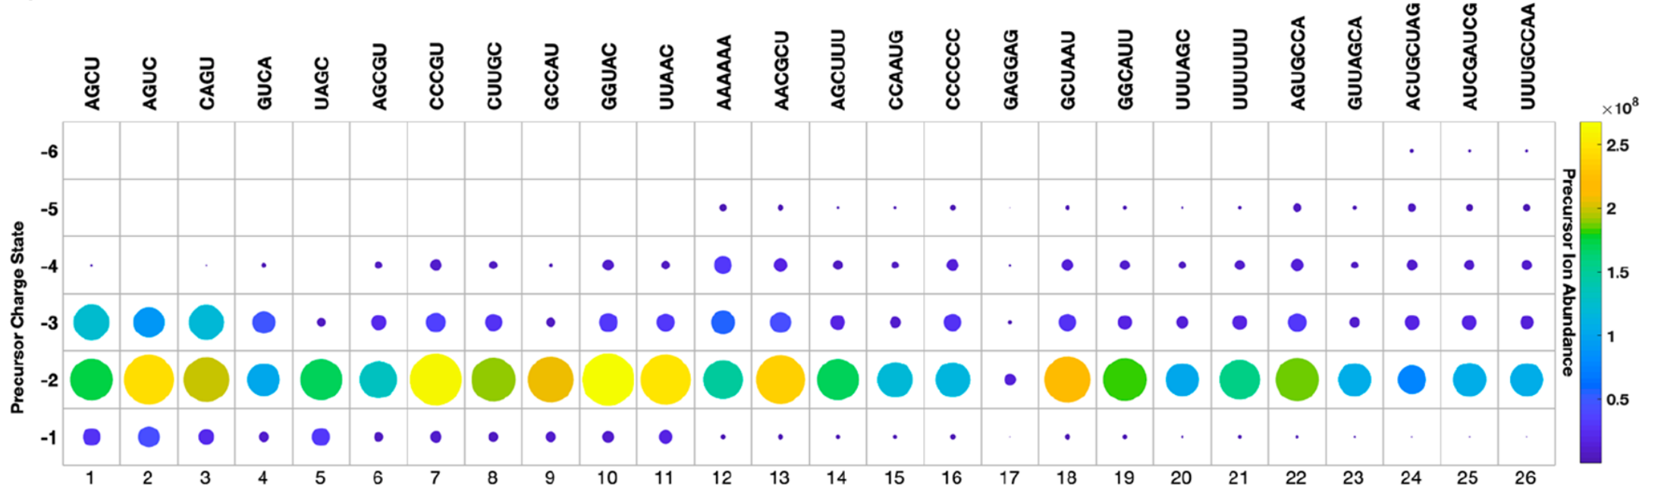
MS-1 Signal Intensity of Our Synthesized RNA Oligos
Notes:
20

Slide 21
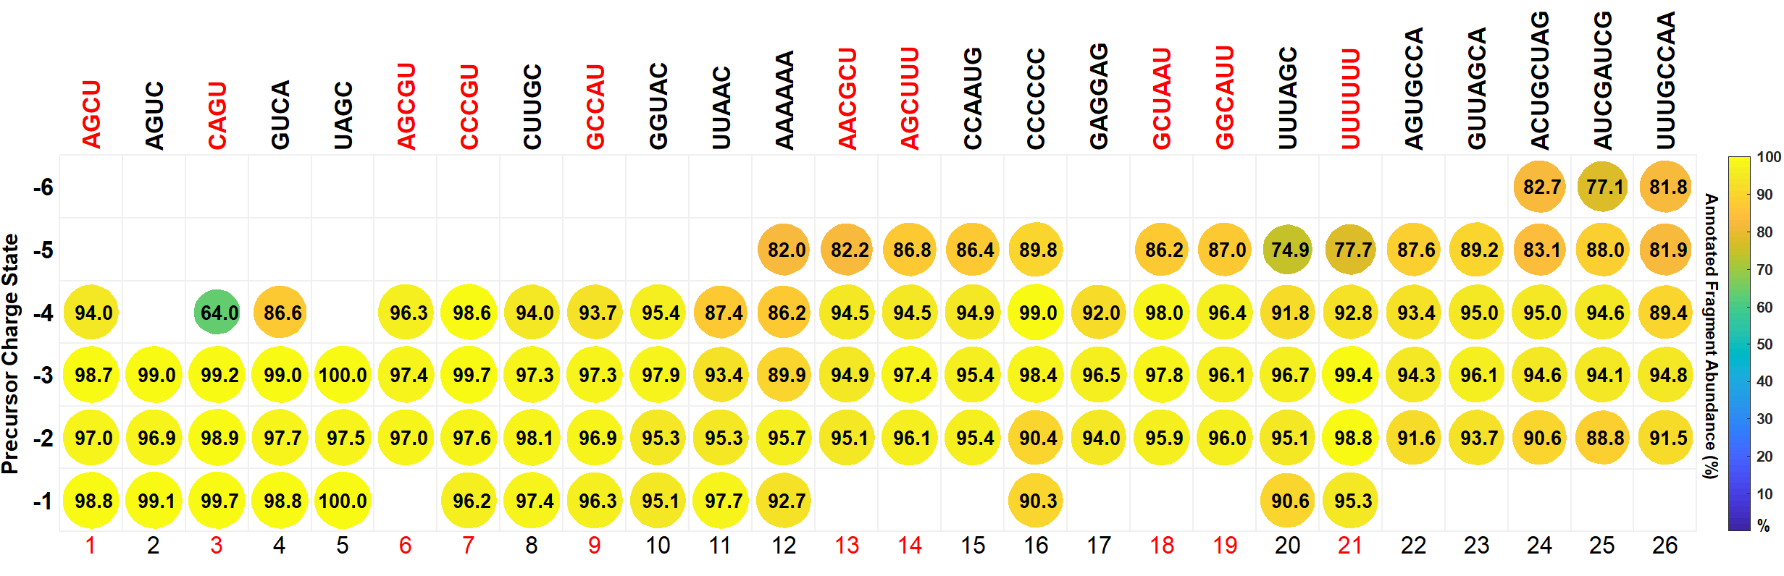
Annotated Fragment Abundance (%) for all 107 MS/MS CID Spectra
Notes:
21

Slide 22
CID-based Fragmentation Behaviors of RNA Oligomers
1. Main Factors that Affect RNA Fragmentation
(1) Normal collision energy
(2) Charge states (-1, -2, -3, -4, -5)
(3) Terminal groups: 5’ (OH/P), 3’ (OH/P)
(4) PTM (Methyl of 4 RNAs)
2. Fragment Ion Types of CID
(1) Sequencing ions (cy/wax/dbz)
(2) Nucleobase loss from precursors and fragments
(3) Internal ions (two cleavages)
(4) Released charged bases
3. Fragmentation Patterns (Sequence, Length)
(1) w ions from the cleavages of C (3’ side)
(2) M-HCNO/NCO⁻ (Ring-opened Uracil at 3’ terminus)
Notes:
22

Slide 23
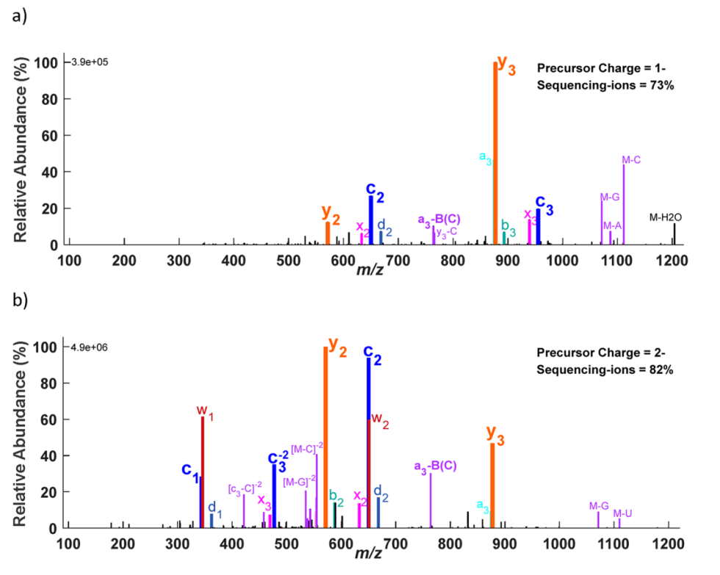
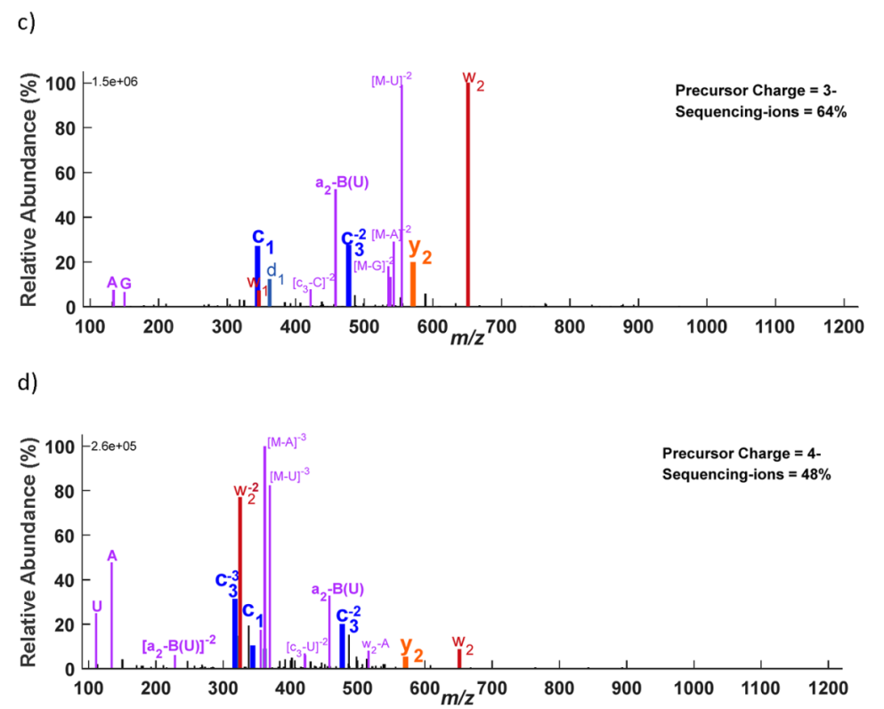
Effects of Precursor Charges on Fragmentation Patterns
z=1⁻
z=3⁻
z=2⁻
z=4⁻
5’-HO-GUCA-OH-3’
Notes:
23

Slide 24
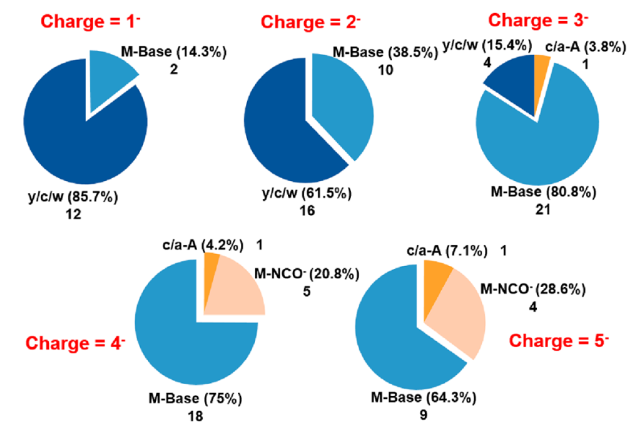
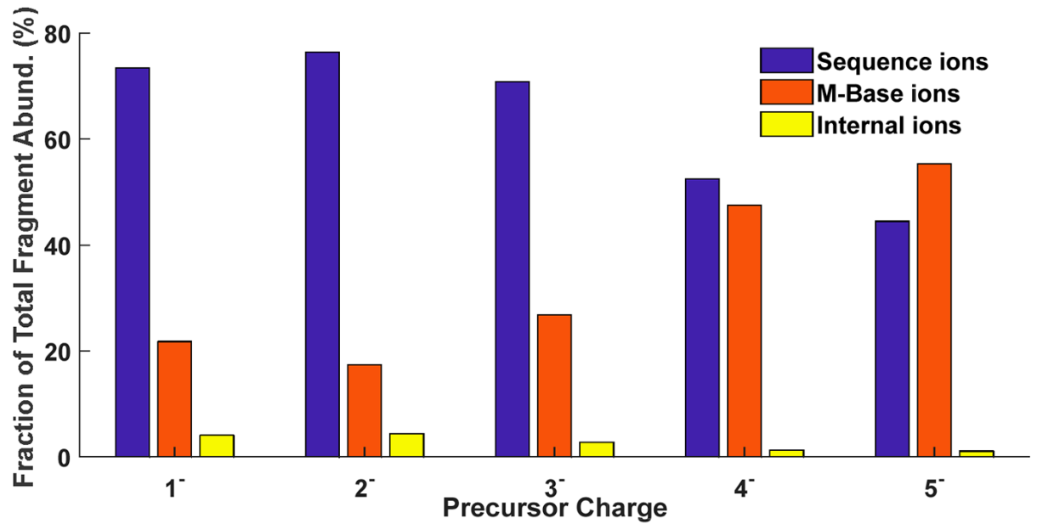
Percentage of Sequencing ions, M-Base and Internal Ions
104 Base Peaks
All Peaks
Notes:
24

Slide 25
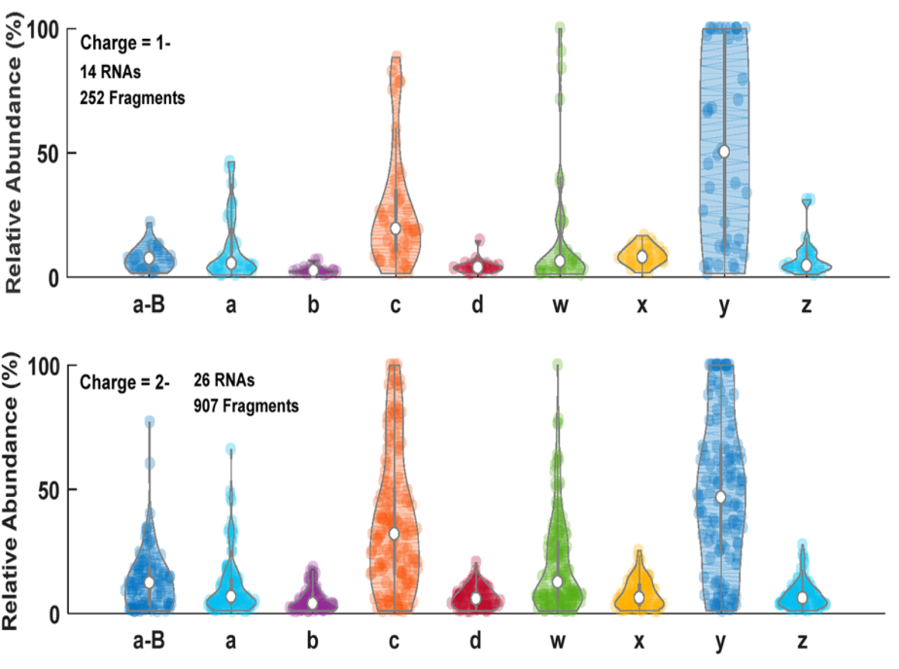
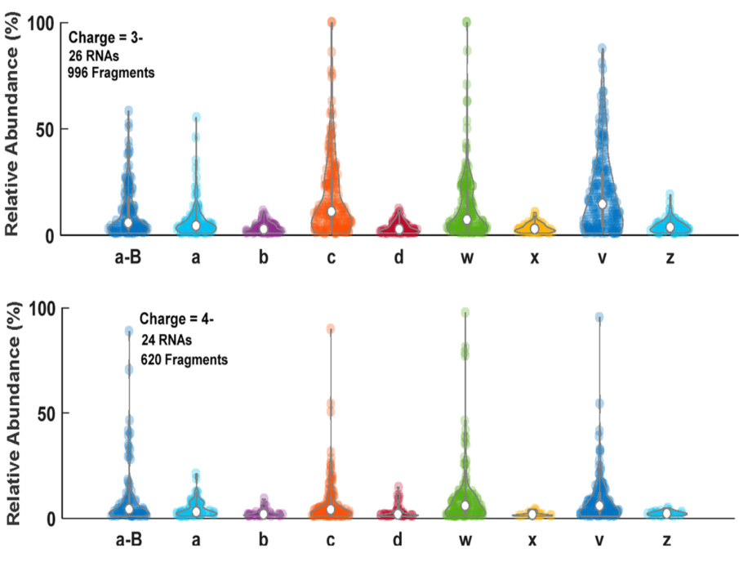
Distributions of Ion Intensities are Charge-dependent
z=1⁻
z=3⁻
z=2⁻
z=4⁻
Notes:
25

Slide 26
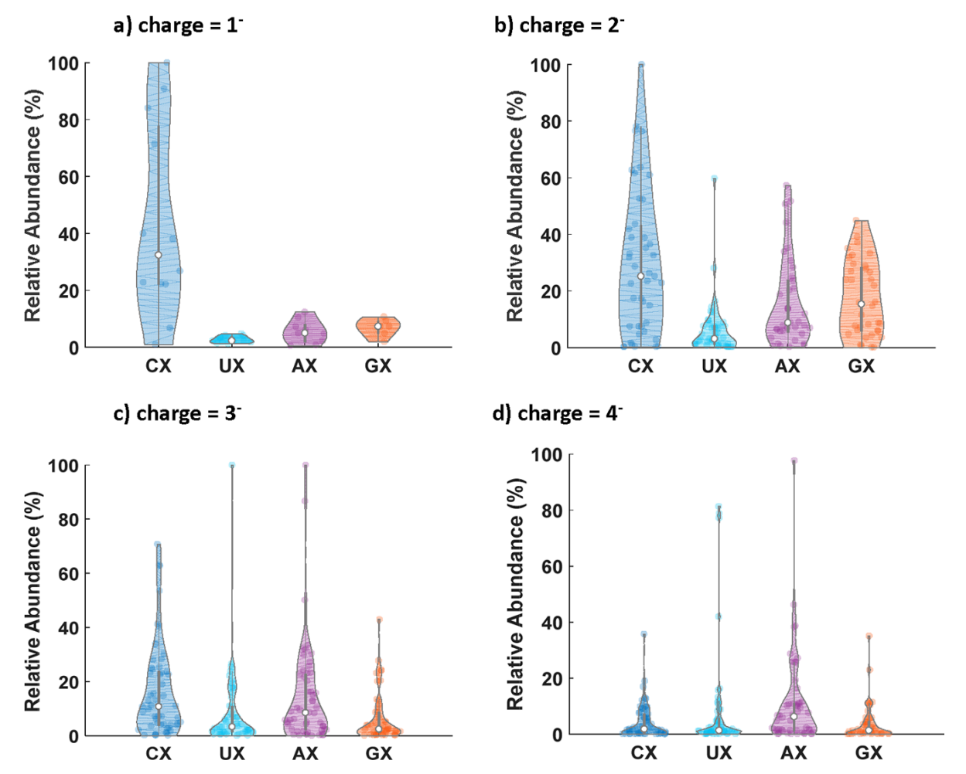
w ions are highly abundant when 5’ cleavage is Cytosine
Notes:
26

Slide 27
M-NCO⁻: Isotopic Evidence for Cyanate Anions
Notes:
27

Slide 28
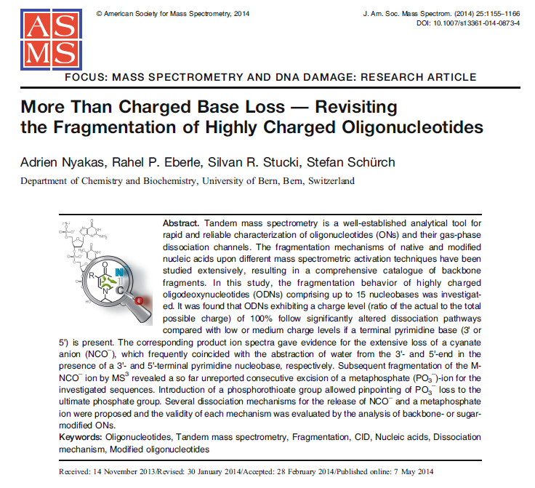
M-HNCO or M-NCO⁻? (isocyanic acid/cyanate anion)
Overlay of the experimental (top) and theoretical (bottom) isotopic distribution of a) [CCGGTT-NCO⁻-H₂O]⁴⁻ and b) [CCGGTT-NCO⁻]⁴⁻.
Notes:
28

Slide 29
Annotated Fragment Abundance (%) for all 107 MS/MS CID Spectra
Notes:
29

Slide 30
NCE=20
NCE=30
NCE=40
unpublished

Slide 31
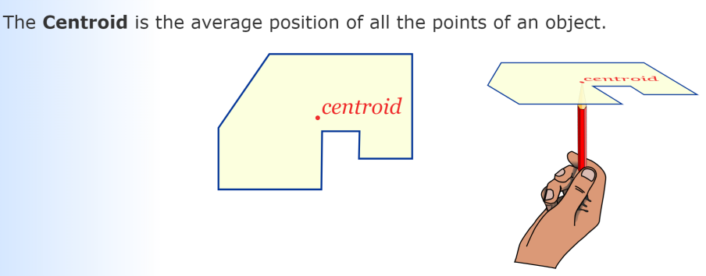
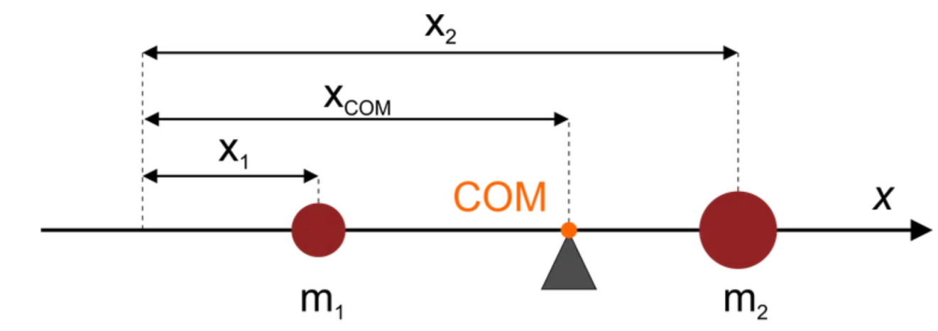
Center of Mass--Centroid (质心）
Notes:
31

Slide 32
Comparison of Normalized m/z Center between CID and HCD
CID
HCD
unpublished
Notes:
32

Slide 33
Sequence Coverage and Intensity Coverage for HCD
unpublished
Notes:
33

Slide 34
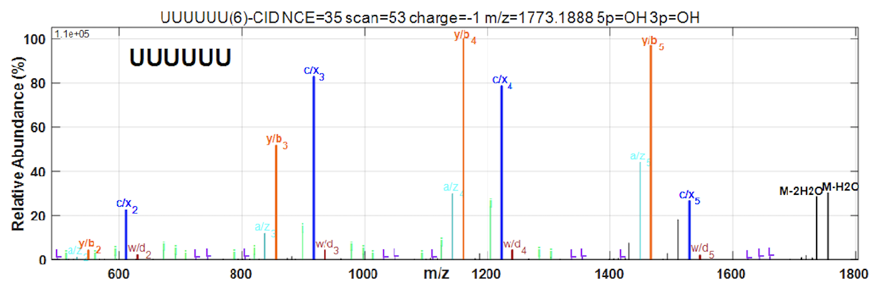
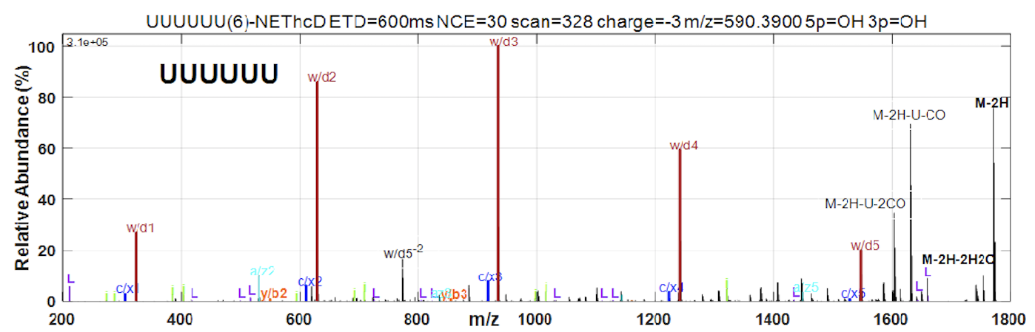
UUUUUU: CID (NCE=35%) and EThcD
unpublished
Notes:
34

Slide 35
Concluding Remarks
Fragmentation of RNA nucleotides is highly predictable and influenced significantly by the charge state of the precursor ions.
We achieved a such high-rate interpretation that close to all fragment ions can be annotated in the CID spectra acquired at the optimal normalized collisional energy of 35%, accounting for 95% of the total peak intensity.
For RNA oligos containing Uracil, especially a 3′-U, the nucleobases lost from precursors include additionally NCO⁻, which are presumably cyanate anion, when the precursors are highly charged in the negative ion mode.
Notes:
35

Slide 36
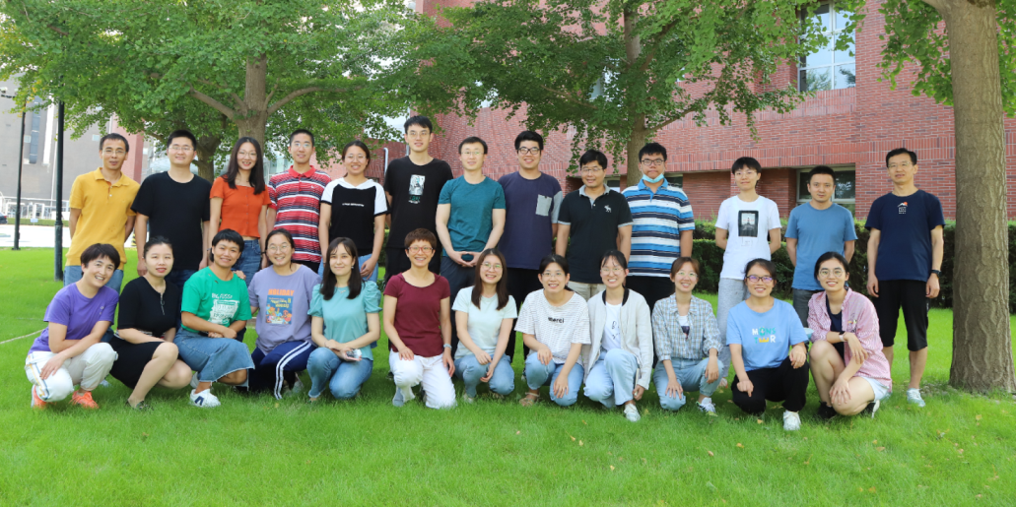

Acknowledgements
Dr. Meng-Qiu Dong (董梦秋)
Dr. Mei-Qing Zuo (左美晴)
Ji-Shuai Zhang (张继帅)
Ge Song (宋歌)
Notes:
36

