Slide 1


Mapping Conserved Metazoan Protein Complexes with Biochemical Fractionation and LC/MS/MS
Cuihong Wan
College of life sciences,
Central China Normal University
2016-08-10

Slide 2
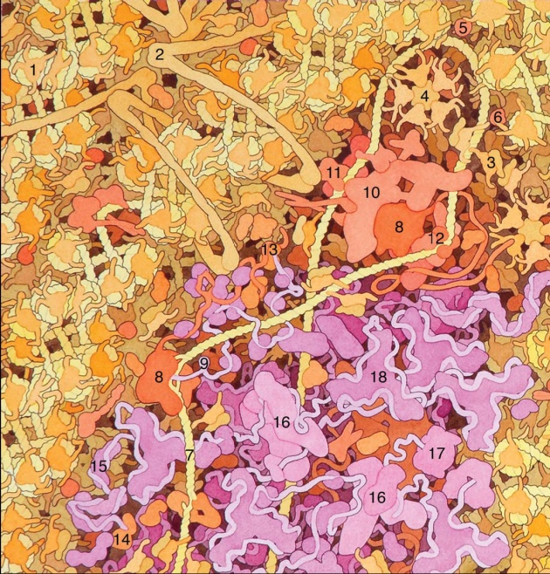
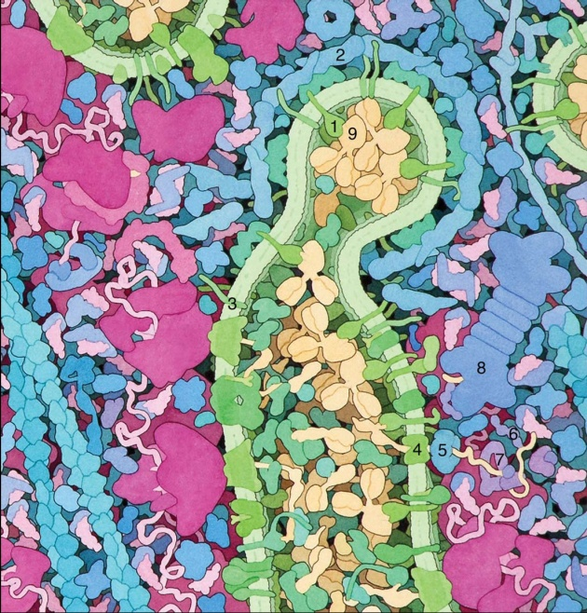
Miniseries Illustrating the Machinery of Life
Mechanistic understanding of biology via stable complexes
  Proteins mostly work via transient interactions and forming stable machines
  Most stable, widespread complexes are unknown
Functional characterization of genes
  co-memberships predict functions
  link genes to phenotypes/diseases, providing hypotheses for therapies

Slide 3
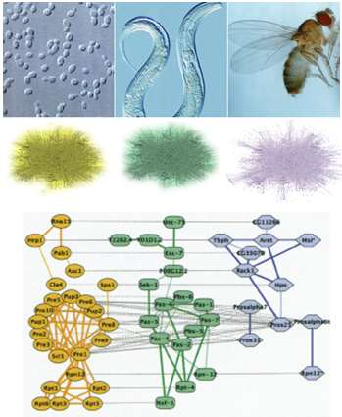
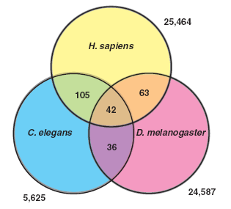
Sharan R et al., PNAS, 2005, 102(6):1974-1979
Gandhi TK et al., Nat Genet, 2006, 38(3):285-93

Slide 4
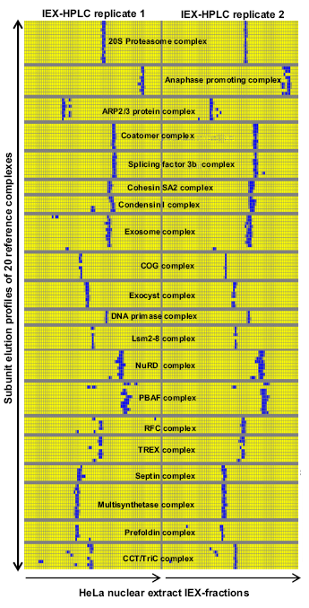
Protein-protein co-eluting fractionation
Larance M et al., Nat Rev Mol Cell Bio, 2015, 16:269-280
Havugimana P et al., Cell, 2012, 150:1068-1081

Slide 5
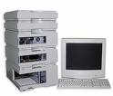
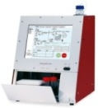
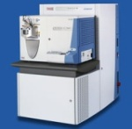



Pipeline of bio-fractionation and protein complexes identification
Biological sample
Protein mixture
IEX-HPLC fractionation
Protein precipitation and digestion
LC/MS/MS
Data acquire
Database search
Data analysis
Predict protein
complexes
Wan C et al., J Proteomics, 2013, 81:102-111

Slide 6
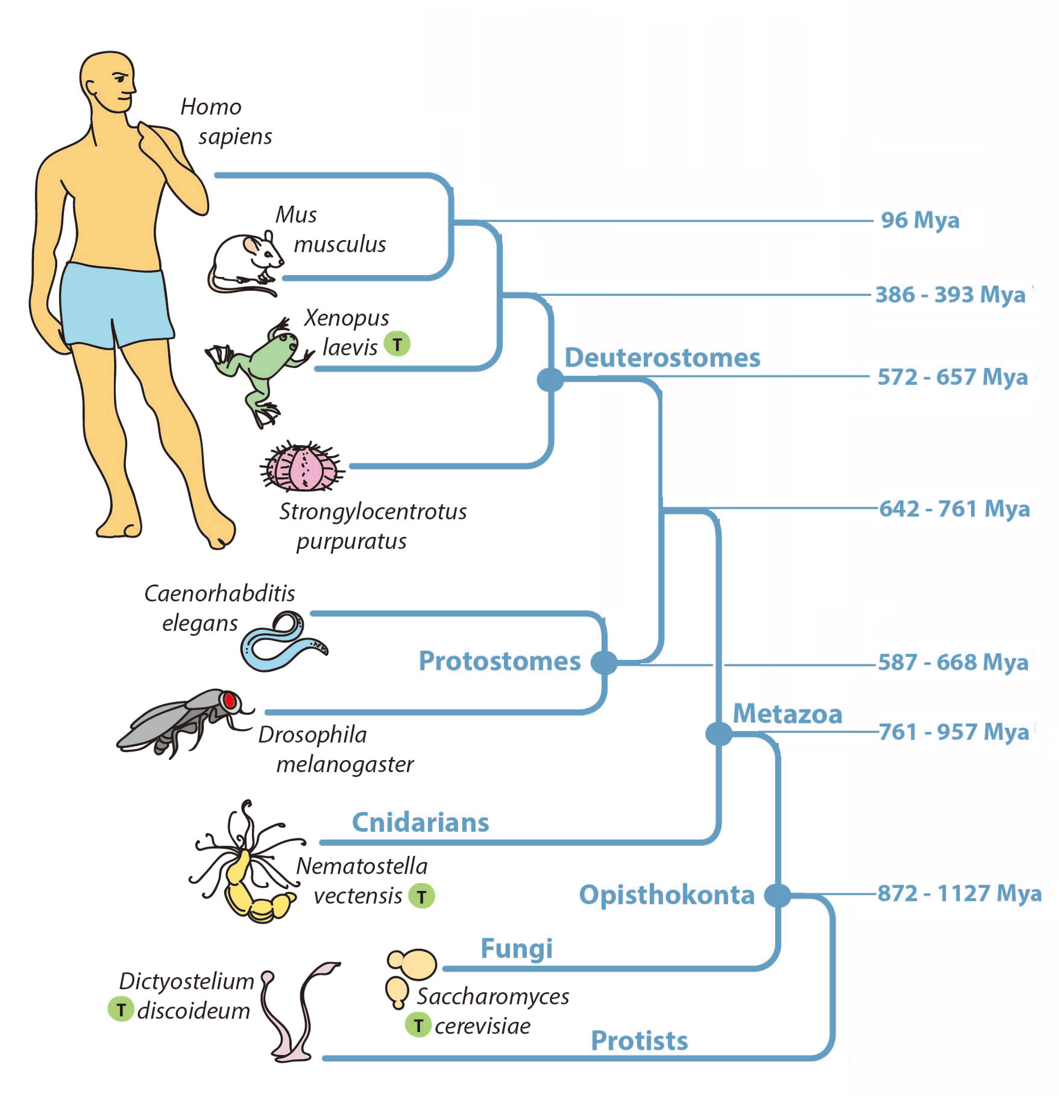
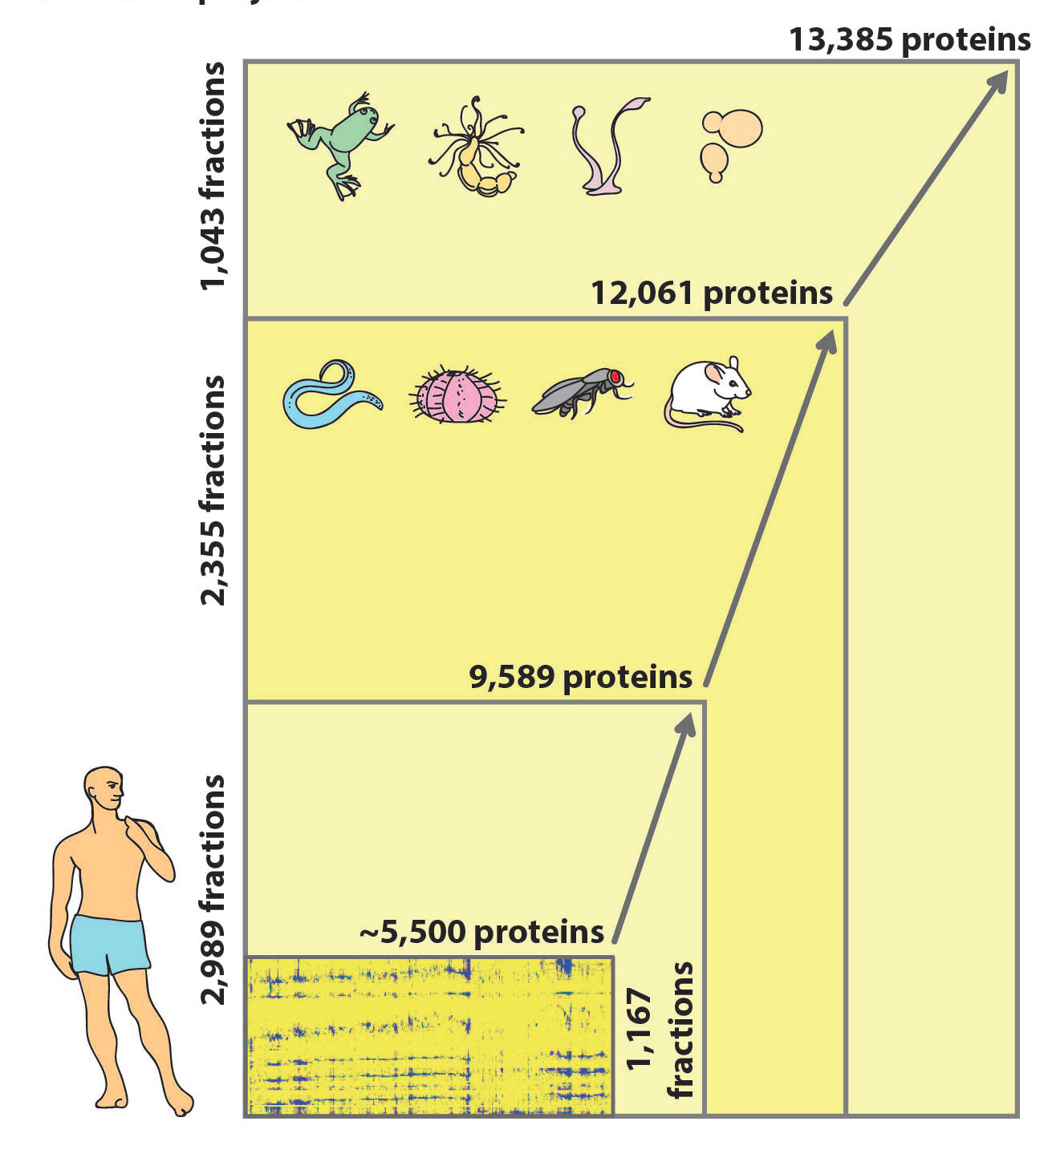
Species | Hs | Mm | Sp | Dm | Ce | Nv | Xl | Dd | Sc | TOTAL
Fractionations | 28 | 2 | 10 | 4 | 11 | 6 | 4 | 3 | 2 | 70
LC-MS/MS Experiments | 2989 | 228 | 868 | 435 | 824 | 515 | 90 | 330 | 240 | 6519
Wan C et al., Nature, 2015, 525:339-344

Slide 7
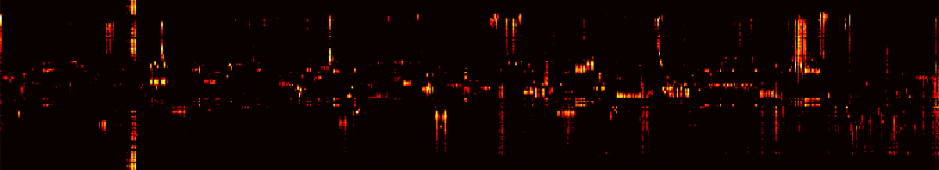

Turning fractionations into complexes
1) One separation
~120
fractions
...
59
60
61
62
63
64
Co-separation of the exocyst complex
exoc1
exoc2
exoc3
exoc4
exoc5
exoc6
exoc7
exoc8
Blake Borgeson
Notes:
Hurdle is false positives: since you’re searching the entire space of possible shared complex memberships, where true co-memberships are extremely sparse, high scorers are dominated by false positives. Must use external data to

Slide 8
Turning fractionations into complexes
1) One separation
~120
fractions
...
59
60
61
62
63
64
Co-separation of the exocyst complex
exoc1
exoc2
exoc3
exoc4
exoc5
exoc6
exoc7
exoc8
2) Pairwise protein correlations
high correlation
>> more likely in complex
Blake Borgeson
Notes:
Hurdle is false positives: since you’re searching the entire space of possible shared complex memberships, where true co-memberships are extremely sparse, high scorers are dominated by false positives. Must use external data to “Support Vector Machines”

Slide 9
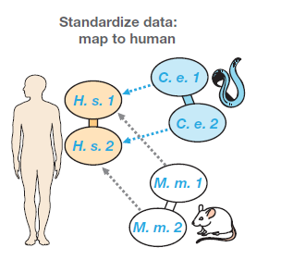

Slide 10


Turning fractionations into complexes
1) One separation
~120
fractions
...
59
60
61
62
63
64
Co-separation of the exocyst complex
exoc1
exoc2
exoc3
exoc4
exoc5
exoc6
exoc7
exoc8
2) Pairwise protein correlations
Machine learning
(SVM)
2b) External data
Co-expression, shared protein domains, much more (HumanNet)
Other AP-MS datasets (Guruharsha 2011, Malovannaya 2011)
high correlation
>> more likely in complex
associated previously
>> more likely in complex
Blake Borgeson
Notes:
Hurdle is false positives: since you’re searching the entire space of possible shared complex memberships, where true co-memberships are extremely sparse, high scorers are dominated by false positives. Must use external data to

Slide 11
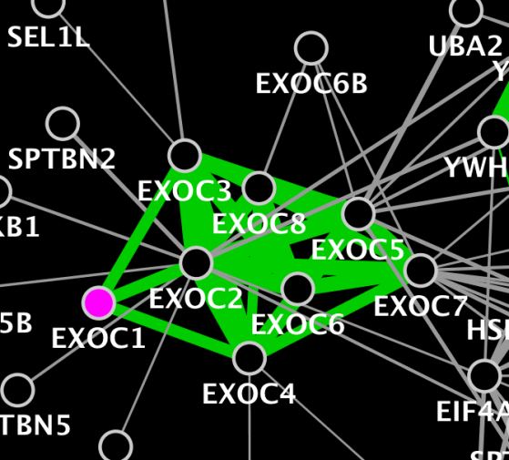
Turning fractionations into complexes
1) One separation
~120
fractions
...
59
60
61
62
63
64
Co-separation of the exocyst complex
exoc1
exoc2
exoc3
exoc4
exoc5
exoc6
exoc7
exoc8
3) Inferred interactions
2) Pairwise protein correlations
Machine learning
(SVM)
2b) External data
Co-expression, shared protein domains, much more (HumanNet)
Other AP-MS datasets (Guruharsha 2011, Malovannaya 2011)
high correlation
>> more likely in complex
associated previously
>> more likely in complex
Blake Borgeson
Notes:
Hurdle is false positives: since you’re searching the entire space of possible shared complex memberships, where true co-memberships are extremely sparse, high scorers are dominated by false positives. Must use external data to

Slide 12
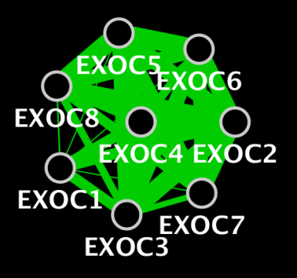
Turning fractionations into complexes
1) One separation
4) Predict complexes
~120
fractions
...
59
60
61
62
63
64
Co-separation of the exocyst complex
Cluster
exoc1
exoc2
exoc3
exoc4
exoc5
exoc6
exoc7
exoc8
3) Inferred interactions
2) Pairwise protein correlations
Machine learning
(SVM)
2b) External data
Co-expression, shared protein domains, much more (HumanNet)
Other AP-MS datasets (Guruharsha 2011, Malovannaya 2011)
high correlation
>> more likely in complex
associated previously
>> more likely in complex
Blake Borgeson
Notes:
Hurdle is false positives: since you’re searching the entire space of possible shared complex memberships, where true co-memberships are extremely sparse, high scorers are dominated by false positives. Must use external data to

Slide 13
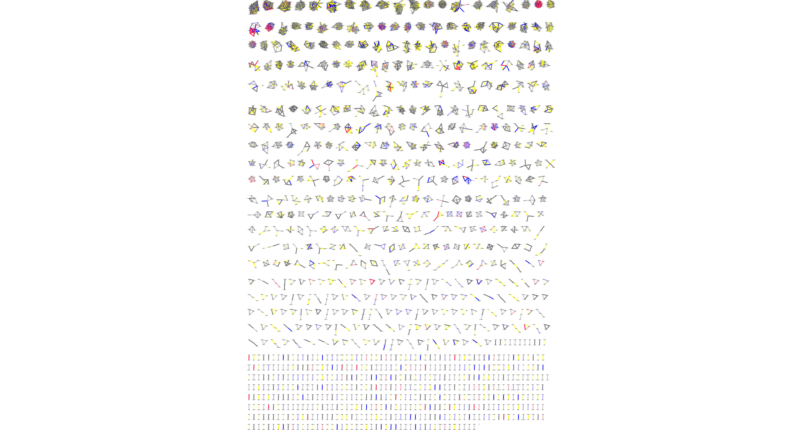
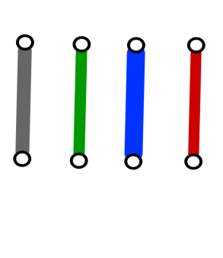
Conserved Metazoan protein complexes
All with experimental evidence
in at least 2 species:
981 complexes;
2153 unique proteins, 293 of them lack Gene Ontology functional annotations;
7,669 pairwise interactions, while 1,756 co-complex interactions are novel.
Protein number found in species
Hs | Mm | Sp | Dm | Ce
2153 | 2114 | 1811 | 1942 | 1796
all 5 animal species 686
4 animal species 1939
3 animal species 2295
2 animal species 2749

Slide 14
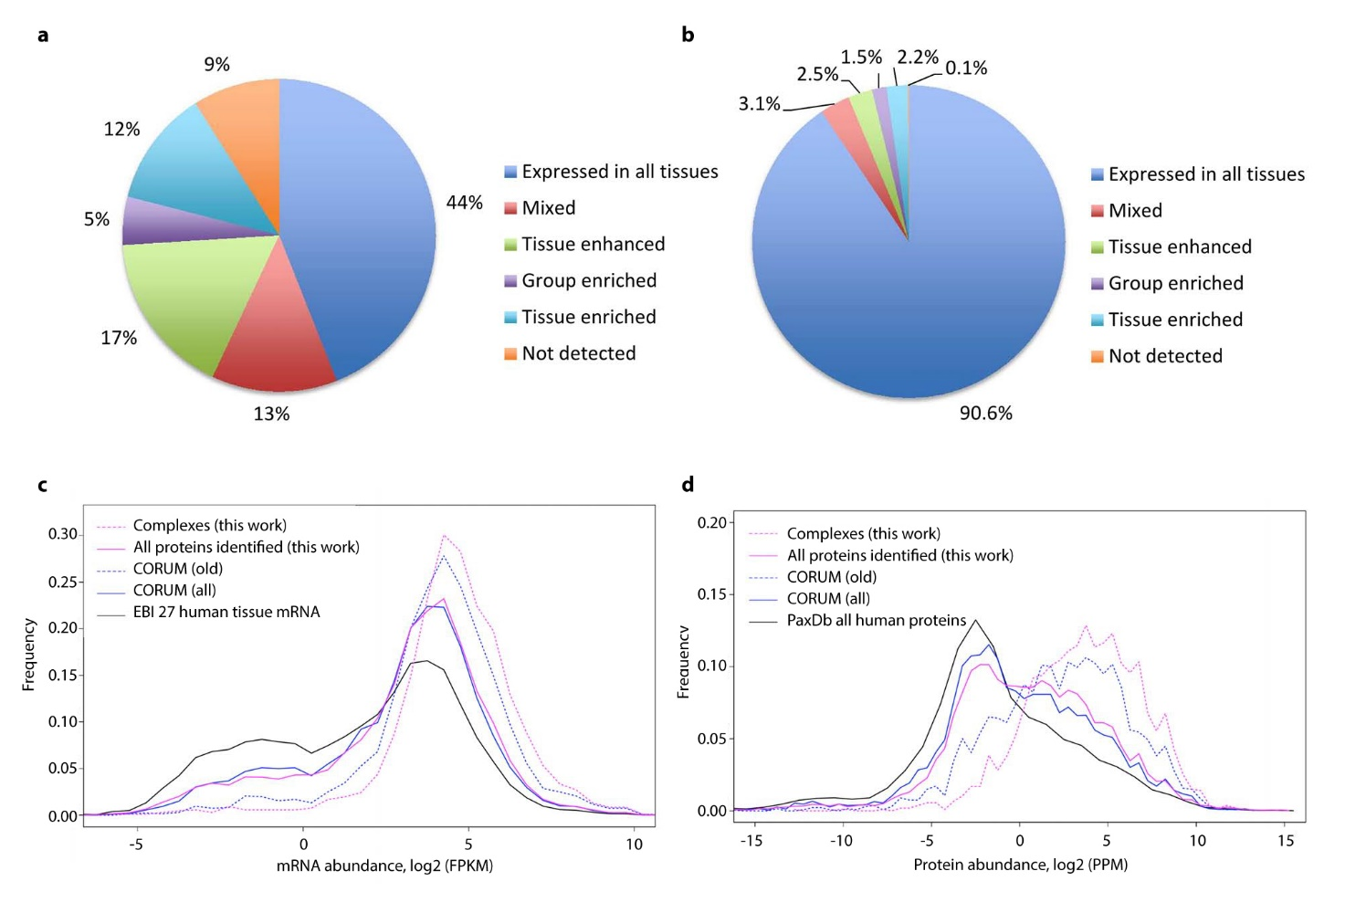
Abundance and expression trends for proteins in complexes
Uhlén M et al., Science, 2015, 347(6220):1260419
Wan C et al., Nature, 2015, 525:339-344

Slide 15
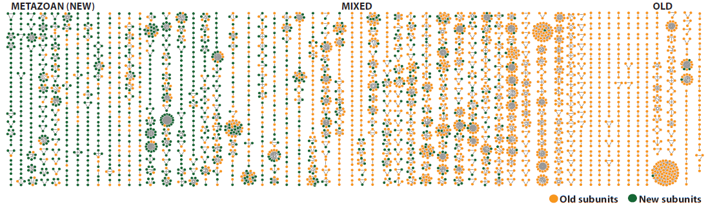
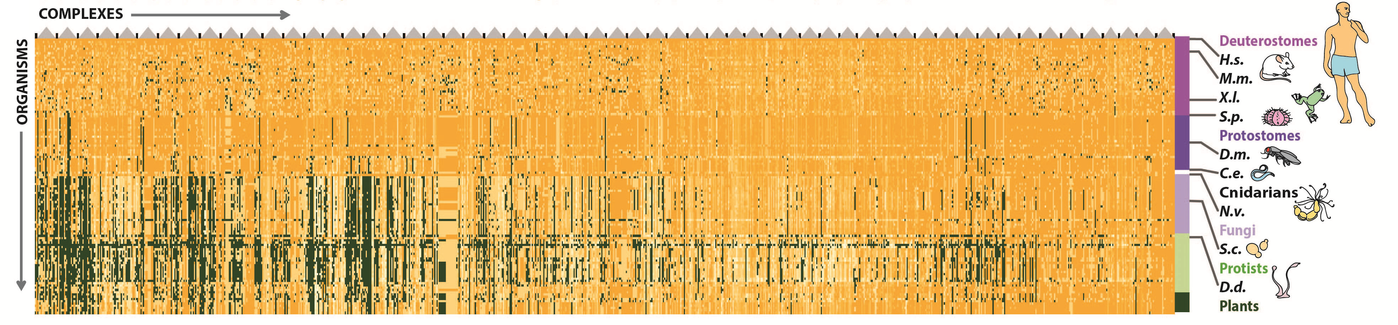
Complexes arranged according to average estimated component age

Slide 16
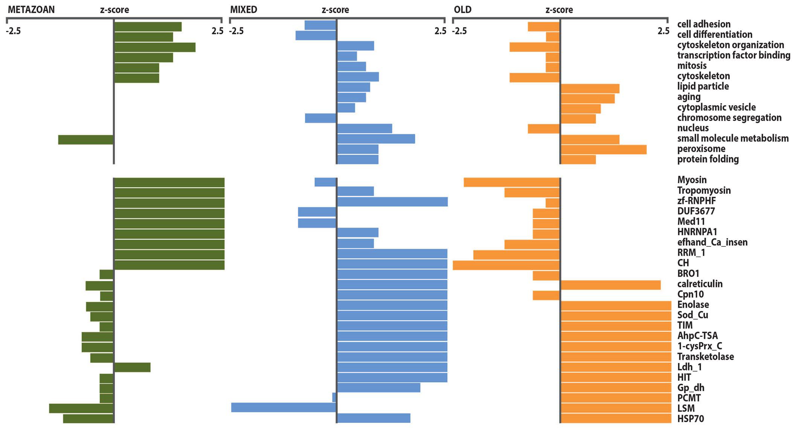
Functional annotations and protein domain enrichment of old, mixed and metazoan-specific protein complexes

Slide 17
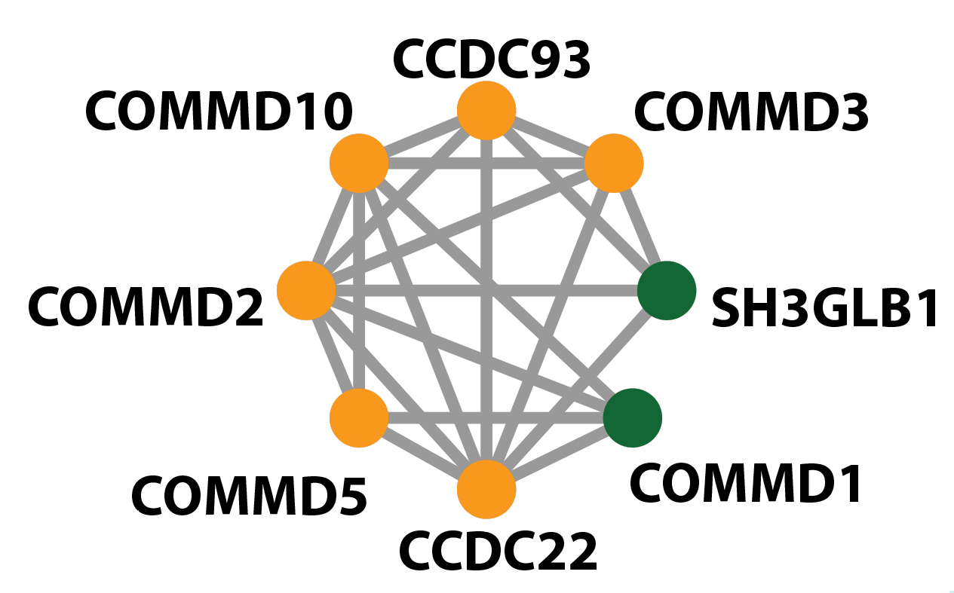
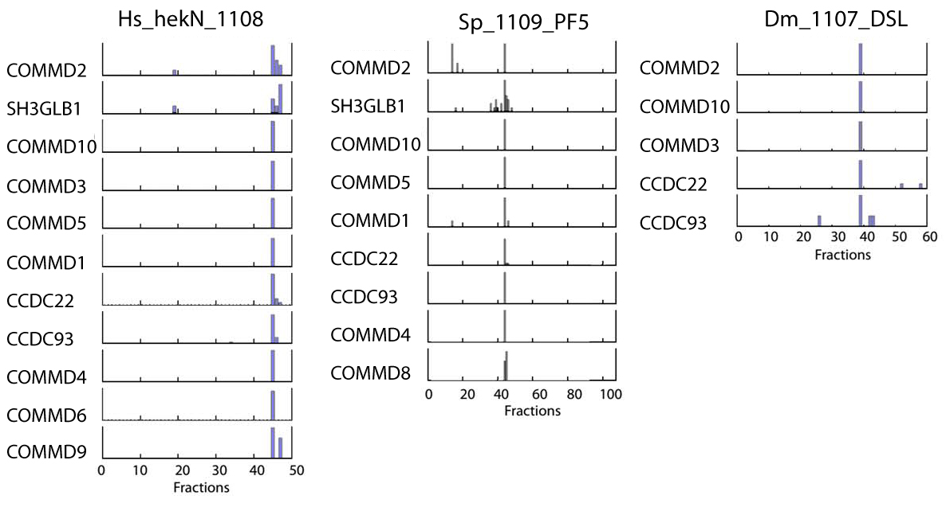
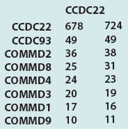
Disease associated protein complex —— Commder

Slide 18
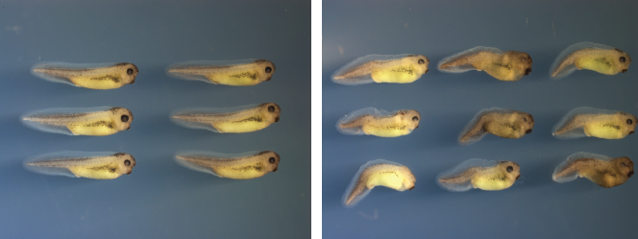
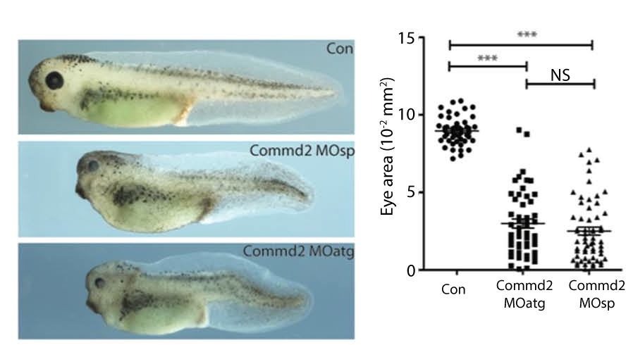
Properties of the Commander complex:
perturbs dorso-ventral axis formation and decreased eye size
Control
Commd2 splicing MO, stage 39

Slide 19
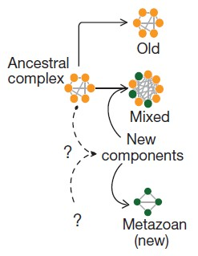
Summery and ongoing work
Presumed origins of metazoan (new), mixed and old complexes
Difference and Diversity
Projection of conserved co-complex interactions
across 122 eukaryotic species

Slide 20
Acknowledgements
Andrew Emili
University of Toronto
Sadhna Phanse
Olga Kagan
Julian Kwan
Oxana Pogoutse
Edward M. Marcotte
University of Texas at Austin
Blake Borgeson
Kevin Drew
Ophelia Papoulas
Daniel R. Boutz

