Slide 1
Trifunctional Cross-linker for Mapping Protein-Protein Interaction Networks and Comparing Protein Conformational States
Dan Tan
Laboratory of Dr. Meng-Qiu Dong
National Institute of Biological Sciences, Beijing

Slide 2
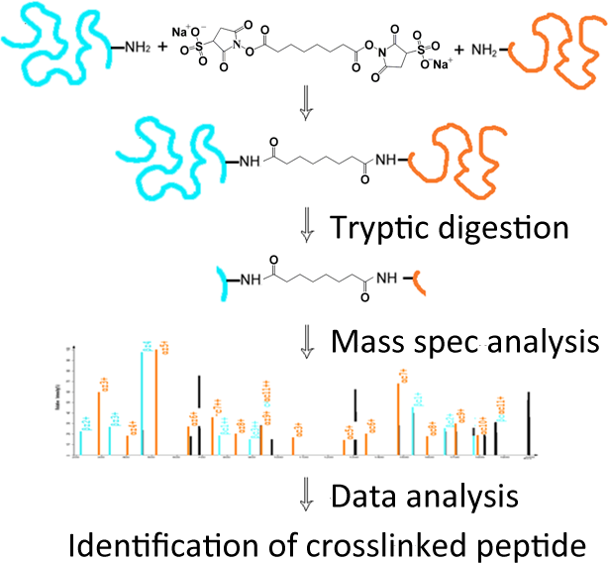
CXMS: Chemical Cross-linking of Proteins Coupled with Mass Spectrometry
Reactive
group
Spacer arm
Reactive
group
Enzymatic digestion
Mass spec analysis
Data analysis
Identification of cross-linked peptide

Slide 3
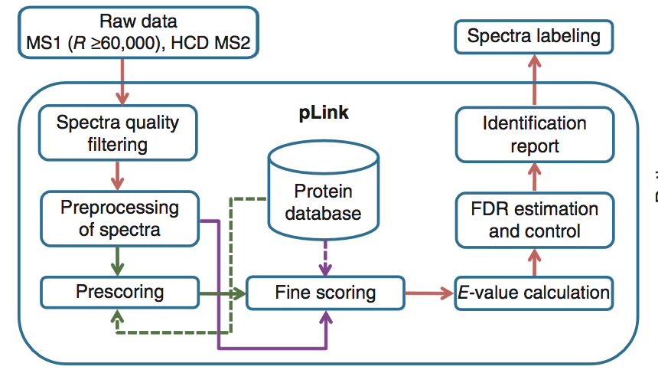
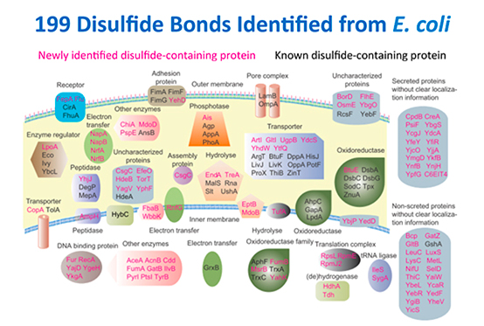
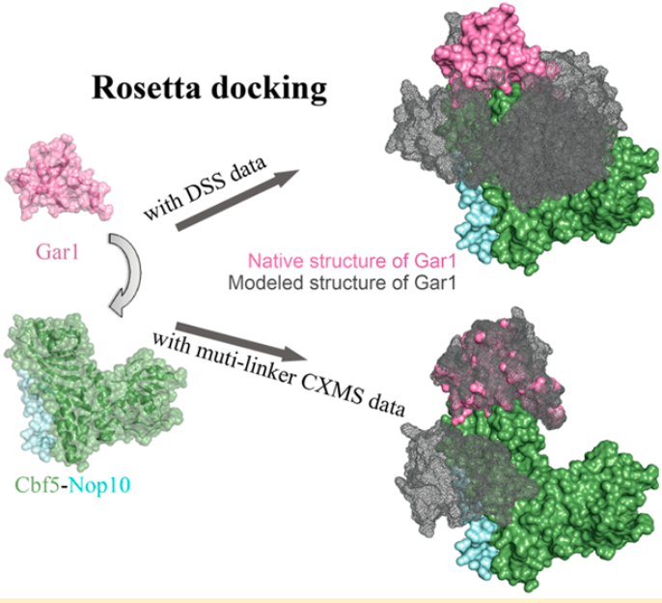
Cross-linking Studies in Dong Lab
Yang B†, Wu YJ†, Zhu M†, Fan SB† et al. Identification of cross-linked peptides from complex samples.
Nature Methods, 2012
(collaboration with the pFind group, ICT, CAS)
Lu S†, Fan SB†, Yang B† et al. Mapping native disulfide bonds at a proteome scale.
Nature Methods, 2015
(collaboration with the pFind group, ICT, CAS)
Ding YH et al. Increasing the depth of mass-spectrometry-based structural analysis of protein complexes through the use of multiple cross-Linkers. Anal Chem, 2016

Slide 4
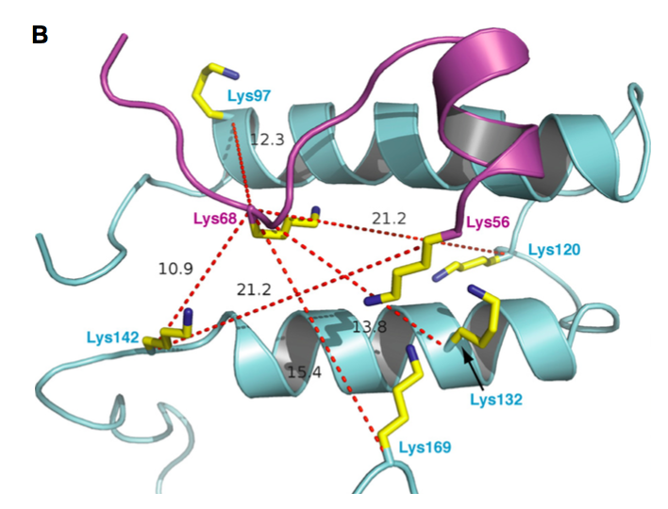
Advantages of CXMS
(1) Identify direct and detailed protein-protein interactions
(2) Provide distance restraints for structures of protein and protein complex
4E-BP1
identify direct binding proteins
map binding interfaces
Raptor
Coffman K et al., J Biol Chem, 2014

Slide 5
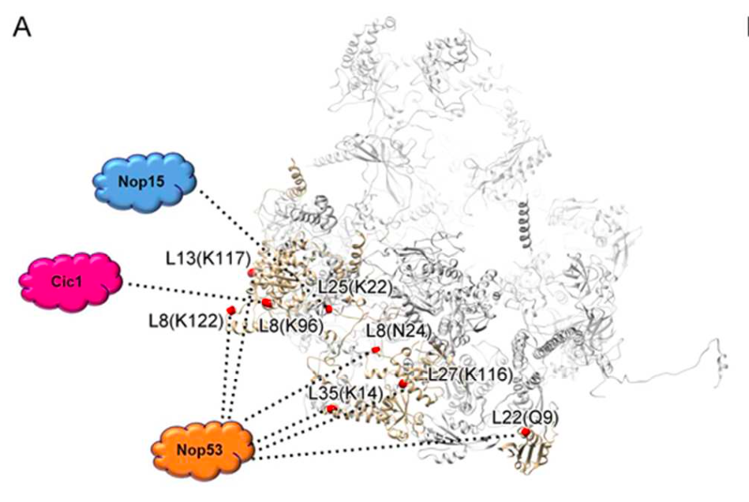
Advantages of CXMS
(1) Identify direct and detailed protein-protein interactions
(2) Provide distance restraints for structures of protein and protein complex
less limited by protein size, sample concentration and purity
capture dynamic conformations
short analysis time and high throughput
Wu S et al., Nature, 2016

Slide 6
Major Challenges
Cross-linked samples are extremely complex.
Normal sample
Regular
Cross-linked sample
Regular
Mono-linked
Loop-linked
Inter-linked

Slide 7
Major Challenges
low abundance of cross-linked peptides
regular peptides
cross-linked peptides

Slide 8
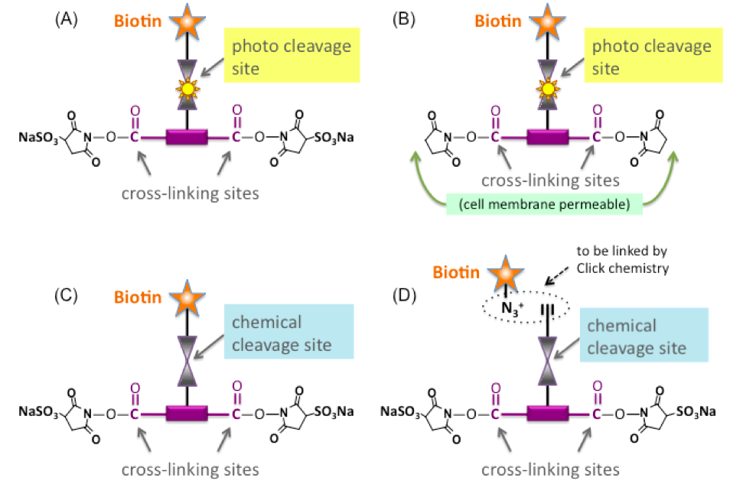
Solution: Lysine-targeted enrichable cross-linker (Leiker)
the best one
  collaboration with Dr. Xiaoguang Lei’s lab

Slide 9
Spacer arm: 9.3 Å
Cα - Cα distance restraint: 􏰂22 Å

Slide 10
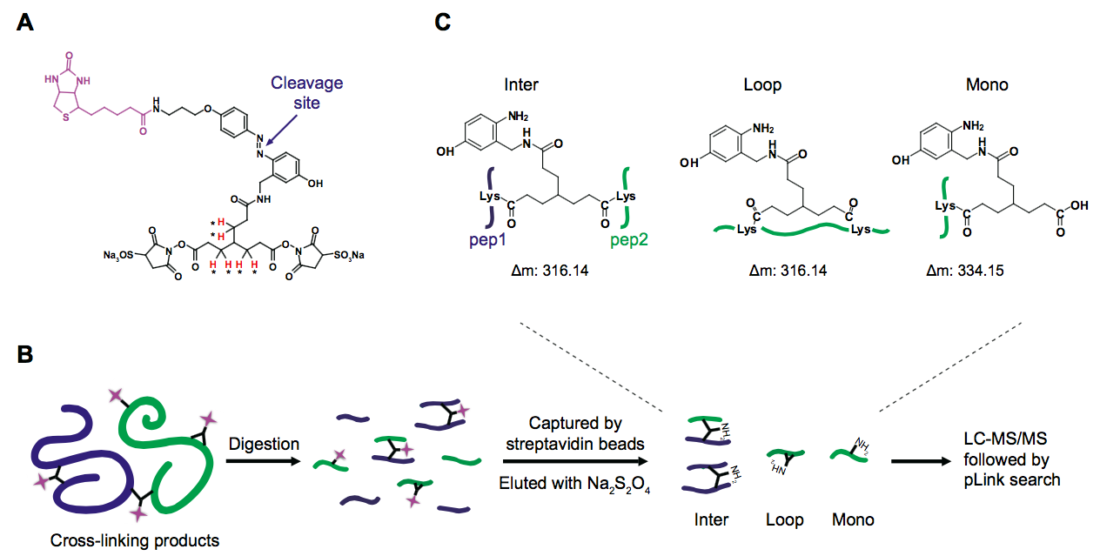
Enrichment Strategy

Slide 11
Evaluation of Leiker Using a Mixture of Ten Standard Proteins

Slide 12
Successful Enrichment
Cross-linked ten standard proteins diluted with E. coli lysates
Enrichment efficiency ≥ 97%
No. of peptides
Inter
Mono
Loop
Regular

Slide 13
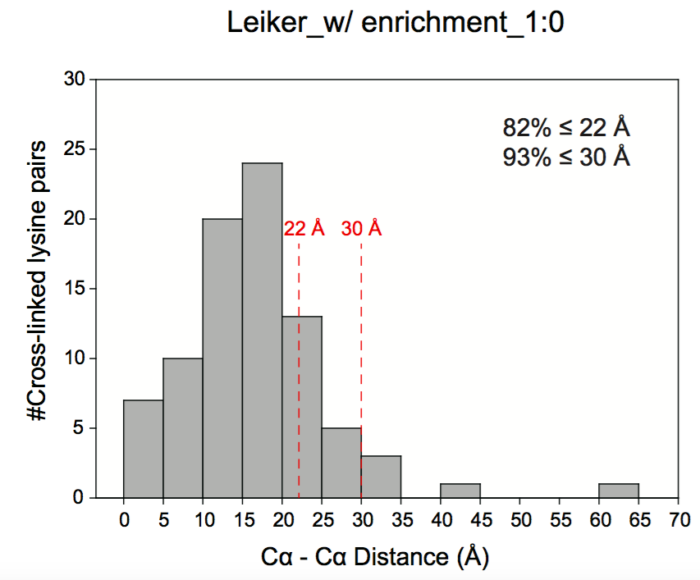
Leiker Generated Specific and Structurally Faithful Cross-links
 | BS³ | Leiker
total #spec | 999 | 4195
nonspecific* | 27 | 134
nonspecific% | 3% | 3%
specific% | 97% | 97%
*Cross-links between non-interacting proteins are considered to be nonspecific.
(FDR < 5%, E-value < 0.01)

Slide 14
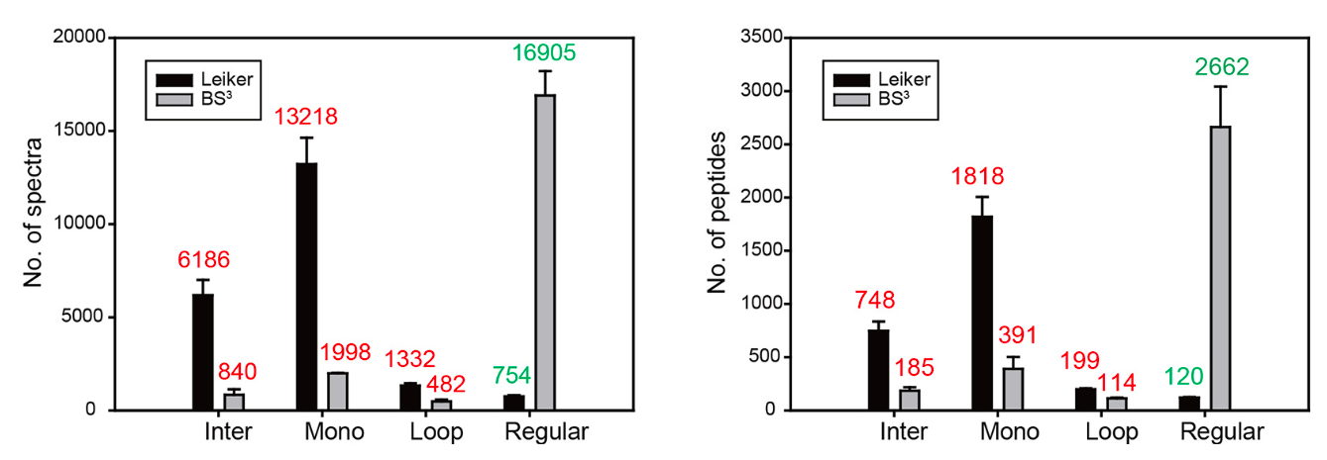
Leiker Yielded at Least a Fourfold Increase in the Number of Inter-links

Slide 15
Leiker-based CXMS Analysis of Ribosome Located Highly Dynamic Peripheral Ribosomal Proteins
Purified E. coli 70S ribosome: 54 ribosomal proteins, 2.5 MDa
A total of 222 inter-linked lysine pairs were identified with high confidence.
Top 10 ribosomal proteins with the most cross-links
 | Inter-Molecular | Intra- Molecular | Total
S1 | 19 | 7 | 26
L1 | 16 | 19 | 35
L7/12 | 16 | 12 | 28
L31 | 16 | 2 | 18
L9 | 12 | 12 | 24
L5 | 12 | 5 | 17
S3 | 8 | 12 | 20
S2 | 8 | 9 | 17
S21 | 7 | 2 | 9
L6 | 6 | 3 | 9
Lacking from the crystal structures!

Slide 16
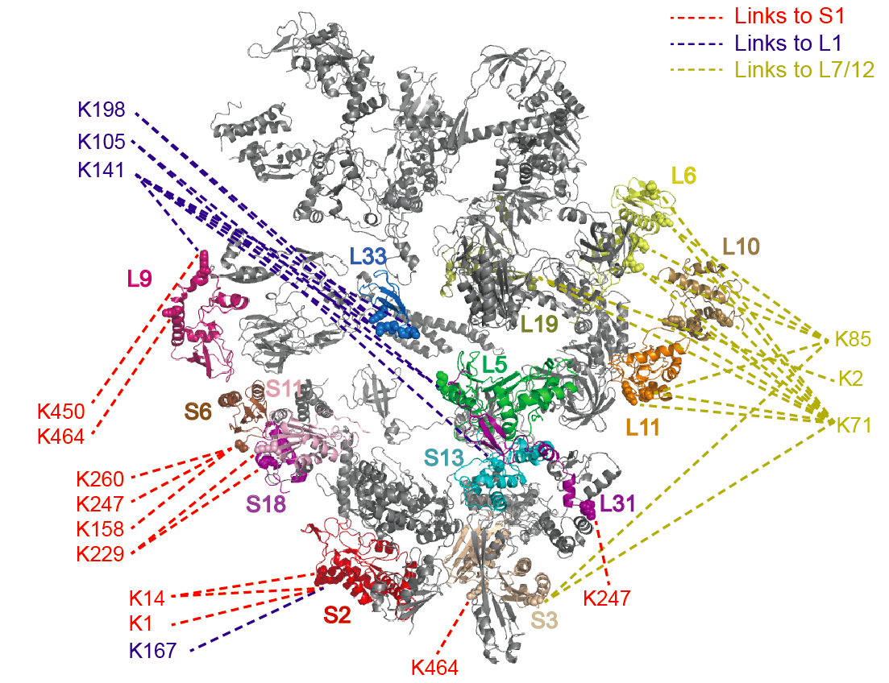
Leiker-based CXMS Analysis of Ribosome Located Highly Dynamic Peripheral Ribosomal Proteins
Purified E. coli 70S ribosome: 54 ribosomal proteins, 2.5 MDa
A total of 222 inter-linked lysine pairs were identified with high confidence.

Slide 17
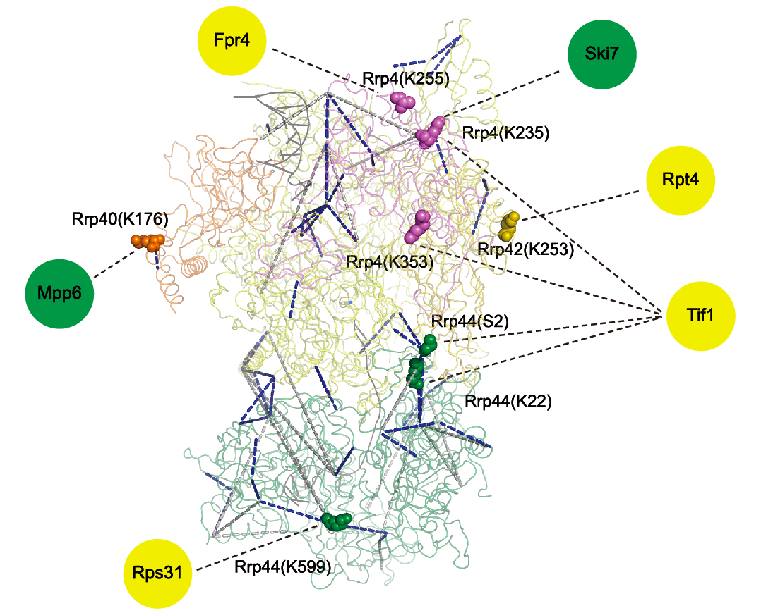
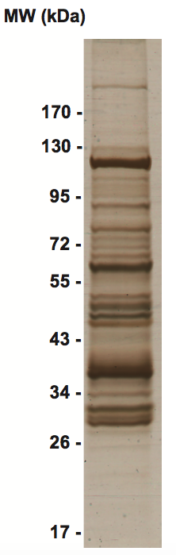
Leiker-based CXMS Analysis of Immunoprecipitated Exosome Revealed Direct Binding Proteins
The yeast core exosome complex:
  10 subunits, 350 kDa
A crude immunoprecipitate of a TAP-tagged exosome subunit Rrp46:
740 proteins identified at 0.1% FDR

Slide 18
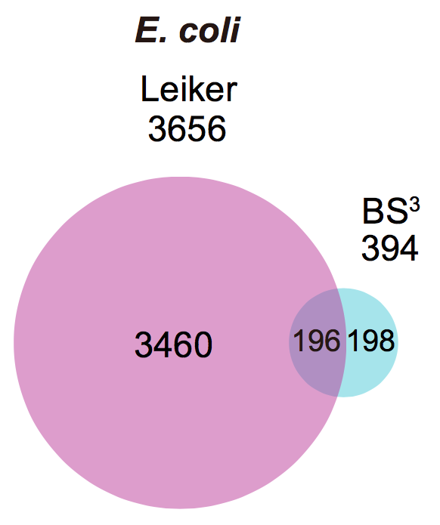
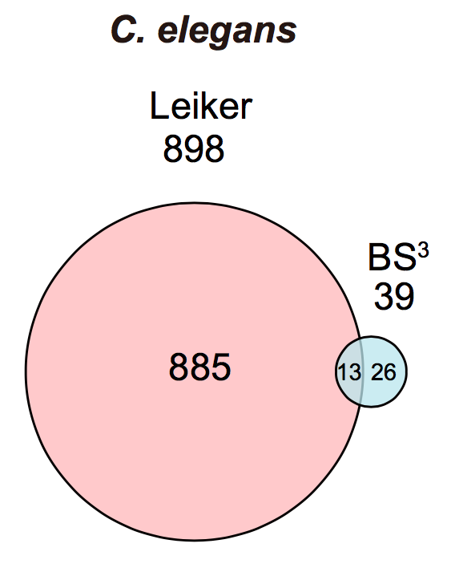
Leiker Significantly Improved the Breadth of Proteome-wide CXMS Analysis
E. coli whole-cell lysates C. elegans whole-cell lysates
(5% FDR, E-value < 0.01, spectral count 􏰃≥ 1)

Slide 19
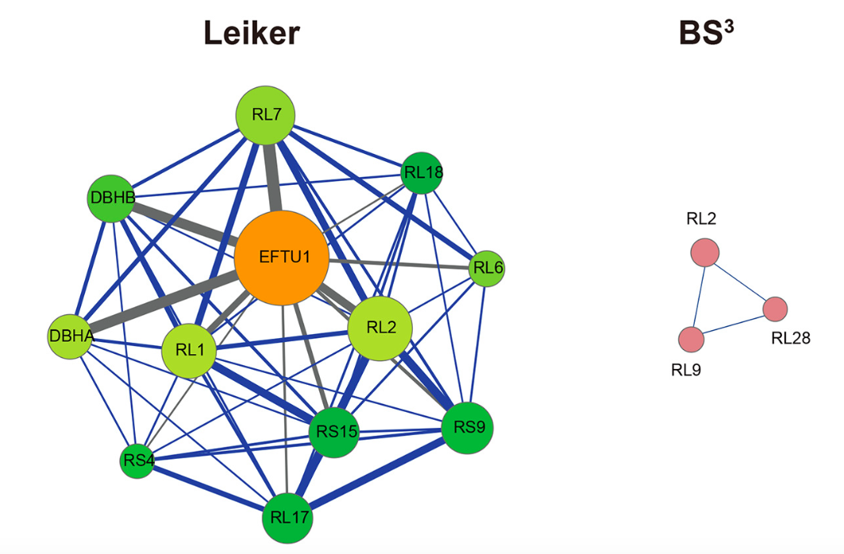
The Most Highly Connected Module in E. coli Protein-Protein Interaction Network

Slide 20
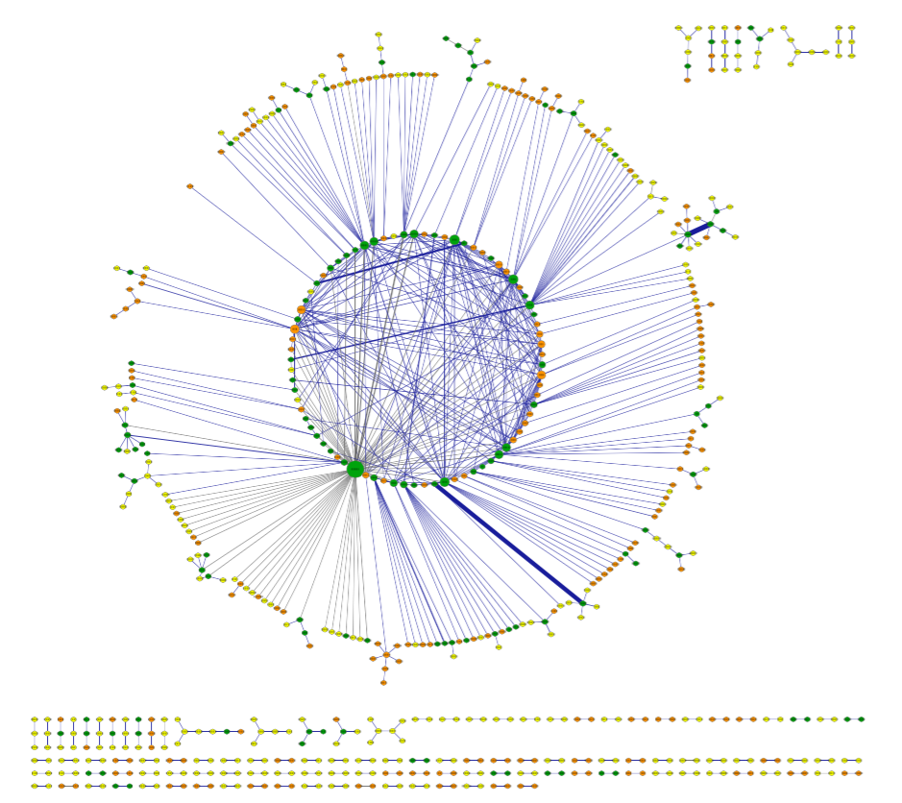
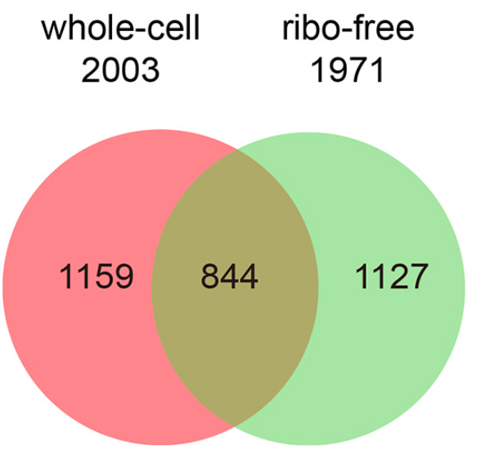
E. coli Protein-Protein Interactions Seen in the Leiker Data
(5% FDR, E-value < 0.01, spectral count ≥􏰃 3)
3130 non-redundant cross-linked lysine pairs
677 protein-protein interactions
Of 1691 Leiker-linked pairs that can be mapped to the PDB structures, 70% have Cα – Cα distance ≤ 􏰂22 Å.
whole-cell only
ribo-free only
both

Slide 21
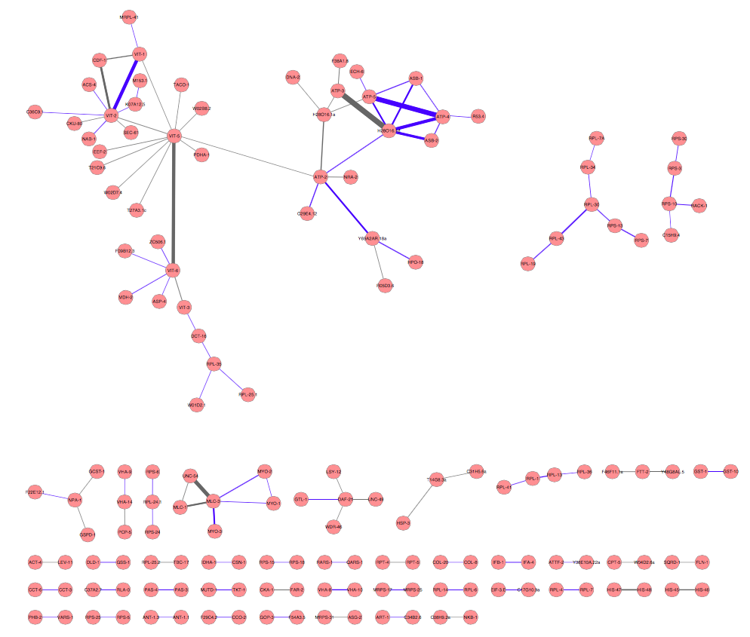
C. elegans Protein-Protein Interactions Translated from the Leiker Data
893 non-redundant cross-linked lysine pairs (5% FDR, E-value < 0.01, spectral count ≥􏰃 3)
434 were uniquely identified in an isolated mitochondrial fraction.
121 protein-protein interactions

Slide 22
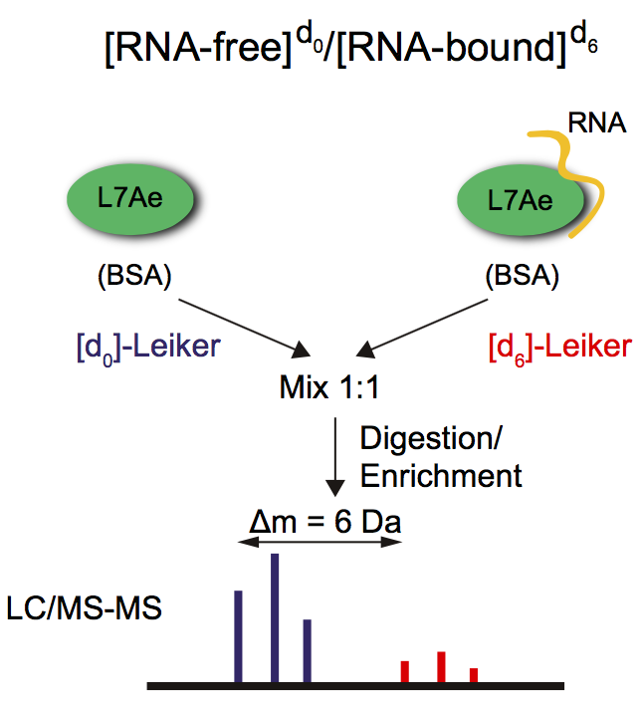
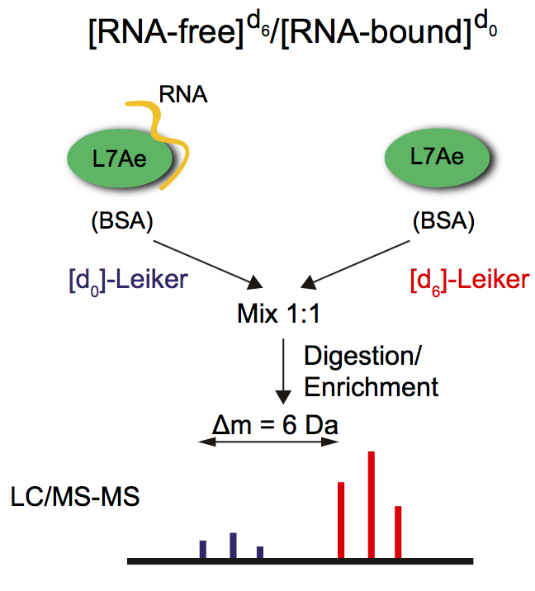
Leiker-based Quantitative CXMS
Forward
Reverse

Slide 23
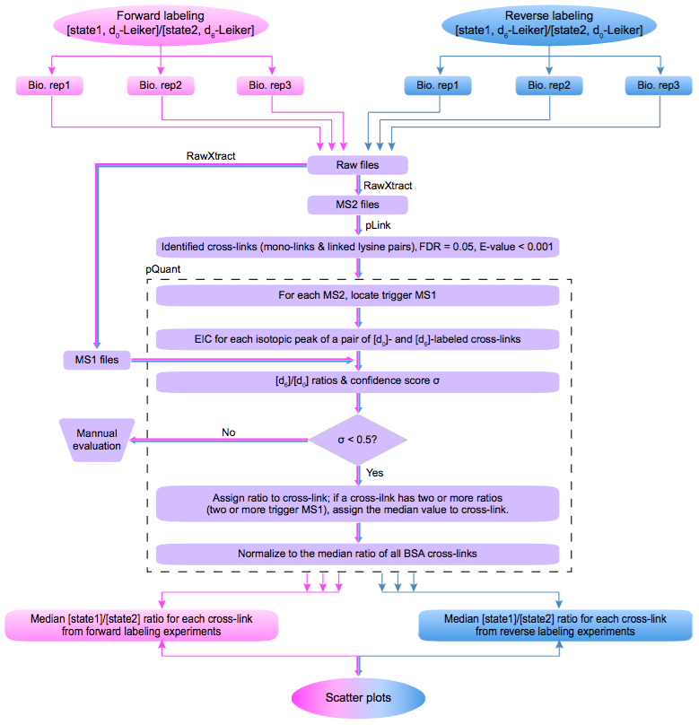
Automated Workflow for Leiker-based Quantitative CXMS
pQuant: Liu C et al., Anal Chem, 2014

Slide 24
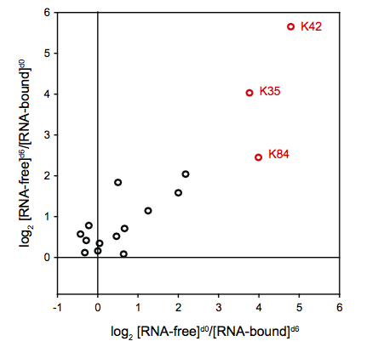
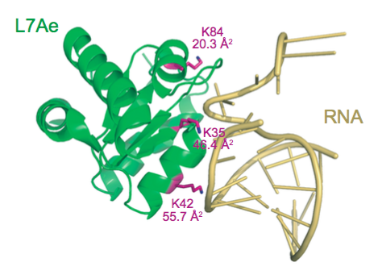
Leiker-based Quantitative CXMS Enabled Identification of the RNA-binding Sites of L7ae
Reverse
Forward

Slide 25
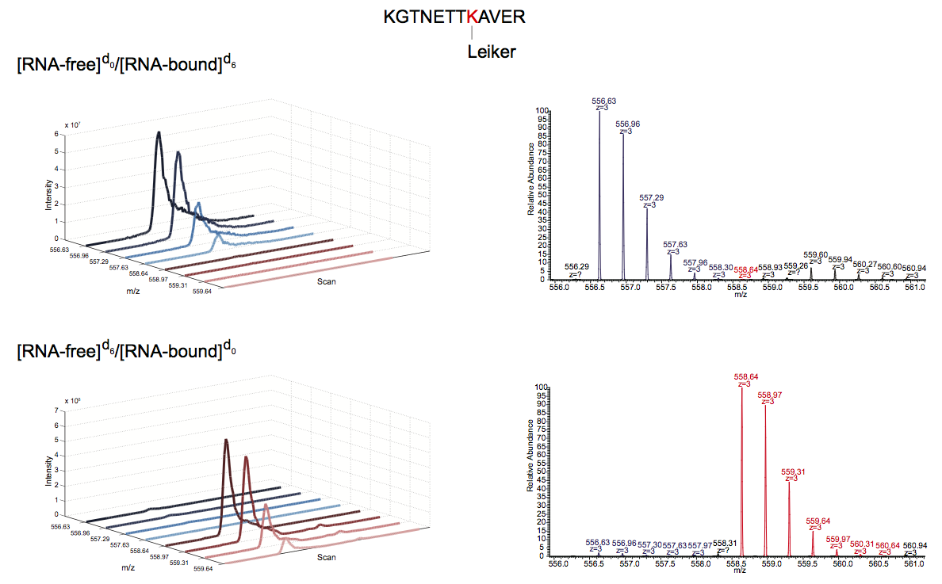
A Mono-link Peptide of L7ae(K42)
Forward labeling
Reverse labeling

Slide 26
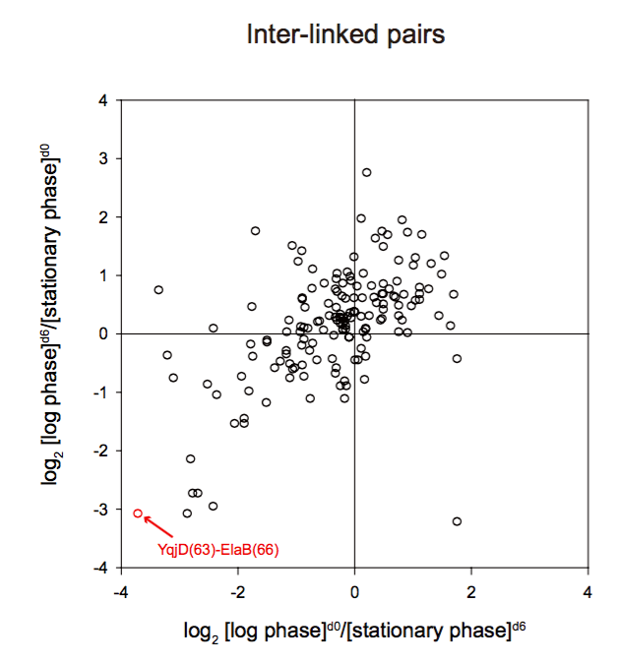
Quantitative CXMS Analysis of Log Phase vs. Stationary Phase E. coli Revealed a Ribosome-inactivating Protein Complex
n = 161
YqjD and ElaB, two paralogous proteins, are associated with the inner membrane of E. coli cells and both bind to stationary phase ribosomes.
YqjD binding to ribosomes inhibits translation.
(Yoshida H et. al, 2012)

Slide 27
Summary
Leiker significantly improves CXMS.
A record number of cross-linked peptides were identified from E. coli and C. elegans lysates, paving the road to direct, proteome-scale protein-protein interaction analysis by CXMS.
A Leiker-based quantitative CXMS workflow was established, which enables comparison of protein conformational states.

Slide 28
Acknowledgment
Dr. Meng-Qiu Dong, NIBS
Mei-Jun Zhang
Pan Zhang
Yue-He Ding
Li Tao
Bing Yang
Dr. Xiaoguang Lei, Peking Univ.
Qiang Li
Xiangke Li
Xiaohui Liu
Dr. Si-Min He, ICT
Chao Liu
Shengbo Fan
Hao Chi
Li Ji
Jiaming Meng
Yan-Jie Wu
Dr. Keqiong Ye, IBP
Shoucai Ma
Dr. Ning Gao ,Tsinghua Univ.
Chengying Ma
Boya Feng
Dr. Hong-Wei Wang, Tsinghua Univ.
Junjie Liu
Dr. Niu Huang, NIBS
Yao Wu
Dr. Li-Lin Du, NIBS
Xiaoman Liu
Dr. She Chen, NIBS

