Slide 1
Ultra-deep tyrosine phosphoproteomics enabled by a phosphotyrosine superbinder
Lei Li (李磊)
Medical School of Qingdao University
(青岛大学医学院)
2016 – 08 - 11

Slide 2
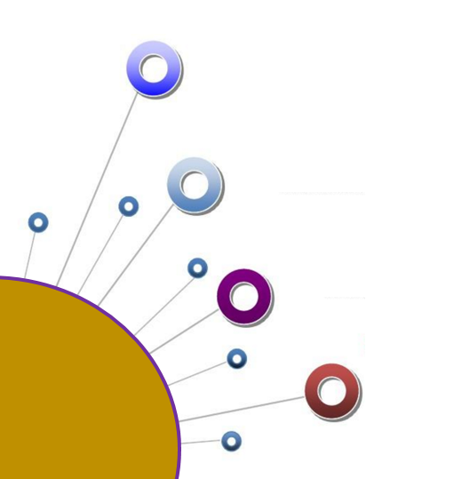
Content
Background
-Introduction of tyrosine phosphorylation signaling
-Enrichment of tyrosine phosphorylation using antibodies
Result
-Efficient pTyr peptide enrichment by an pTyr superbinder
-Tyr phosphoproteome determined by the superbinder
Conclusion
Acknowledgments

Slide 3
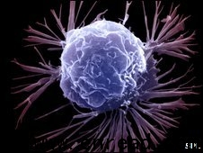
Background
Kinome
Illustrated reprinted courtesy of Cell Signaling Technology.

Slide 4
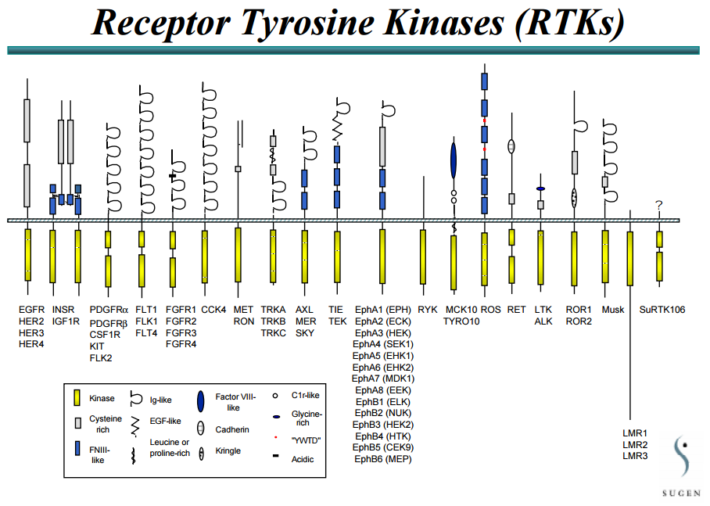
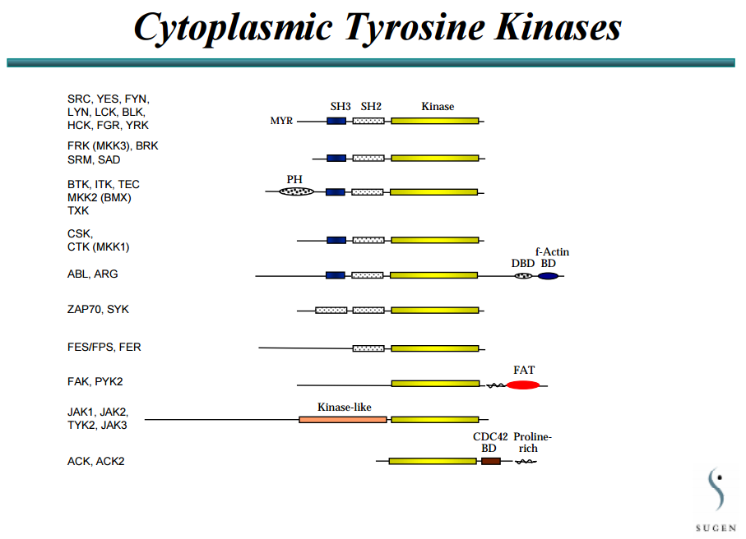
Background

Slide 5
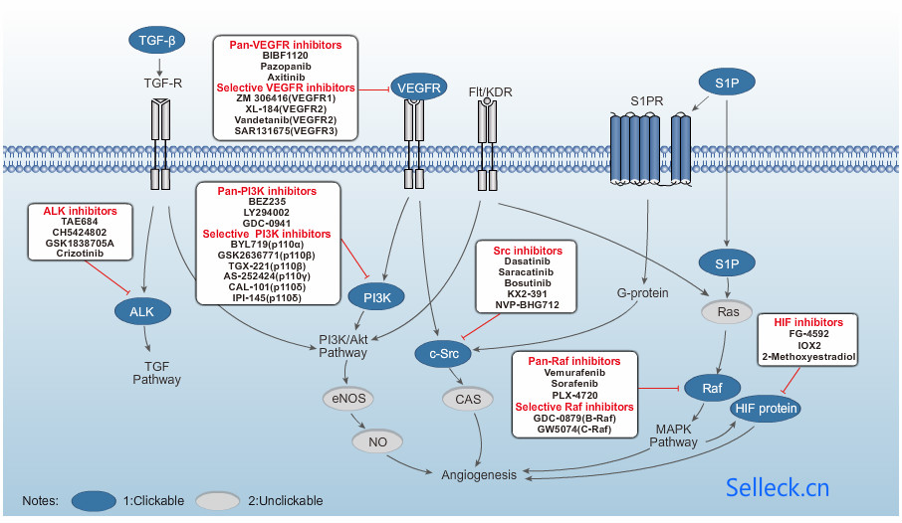
Background
Tyrosine kinases and their inhibitors

Slide 6
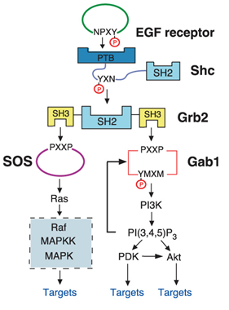
Background
Simplified EGFR signaling pathway
TK
Substrate
Substrate
P
SH2/PTB
PTP

Slide 7
Background
anti-pTyr antibody p-Tyr-100
anti-pTyr antibody 4G10
anti-pTyr antibody pY20
anti-pTyr antibody pY99
… …

Slide 8
Background
TK
Mutation
Substrate
Substrate
P
SH2/PTB
pTyr superbinder ?
PTP

Slide 9
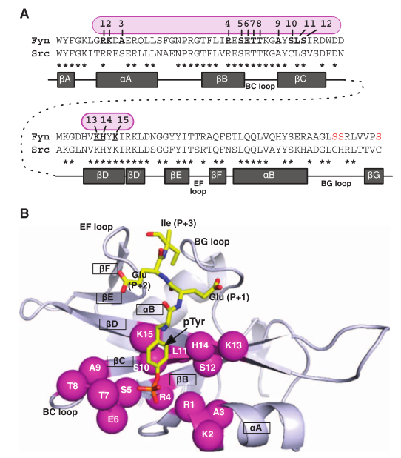
Background
Kaneko, T., et al. (2012). "Superbinder SH2 domains act as antagonists of cell signaling." Science signaling 5(243): ra68.

Slide 10
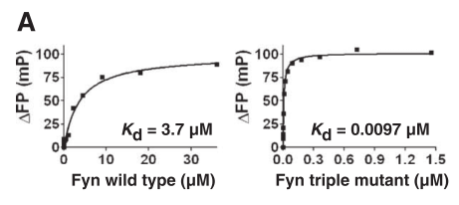
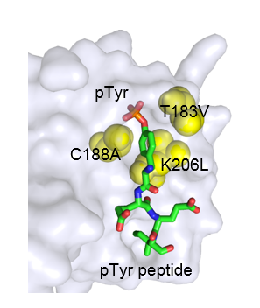
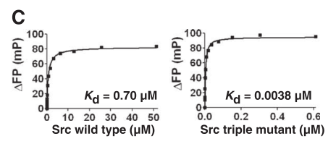
Background
PQRpYLVIQGD
SH2 superbinder
Kaneko, T., et al. (2012). "Superbinder SH2 domains act as antagonists of cell signaling." Science signaling 5(243): ra68.

Slide 11
Background
Q1: How is the performance of an SH2 superbinder on the enrichment of tyrosine phosphoproteome?
Q2: What is the difference between an SH2 superbinder and an antibody of pTyr enrichment?

Slide 12
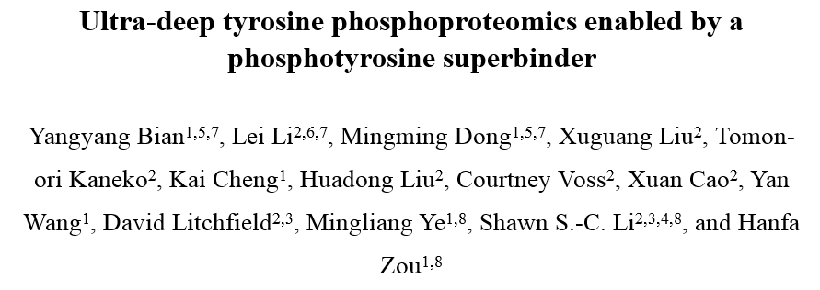
Background
Accepted by Nature Chemical Biology

Slide 13
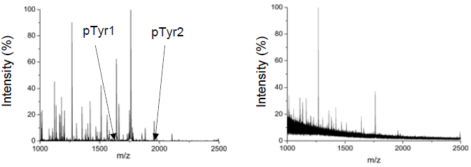
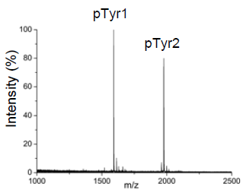
Result
Efficient pTyr peptide enrichment by an SH2 superbinder
Peptides digested from BSA and α-casein, synthetic pTyr1 and pTyr2
Mixture wt Src SH2 domain Ti⁴⁺-IMAC SH2 superbinder
SH2 superbinder
& Ti⁴⁺-IMAC
SH2 superbinder is capable of extracting the two pTyr peptides from the peptide mixture
The specificity for pTyr peptide enrichment was further improved when the Ti4+-IMAC was used subsequently to the superbinder
Bian, et al. "Ultra-deep tyrosine phosphoproteomics enabled by a phosphotyrosine superbinder” Nature Chemical Biology. Accepted.

Slide 14
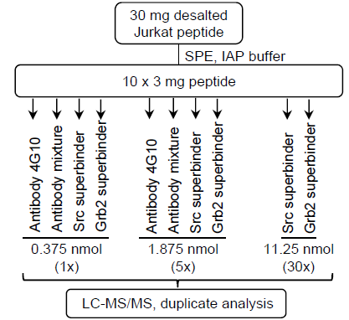
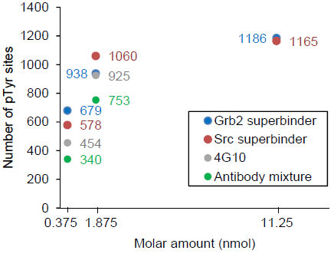
Result
Comparison with pTyr antibodies
➔ Both the Src and Grb2 SH2 superbinders identified more pTyr sites than either 4G10 or the antibody mixture

Slide 15
Result
Comparison with pTyr antibodies
Distance in pTyr peptide-selectivity

Slide 16
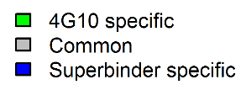
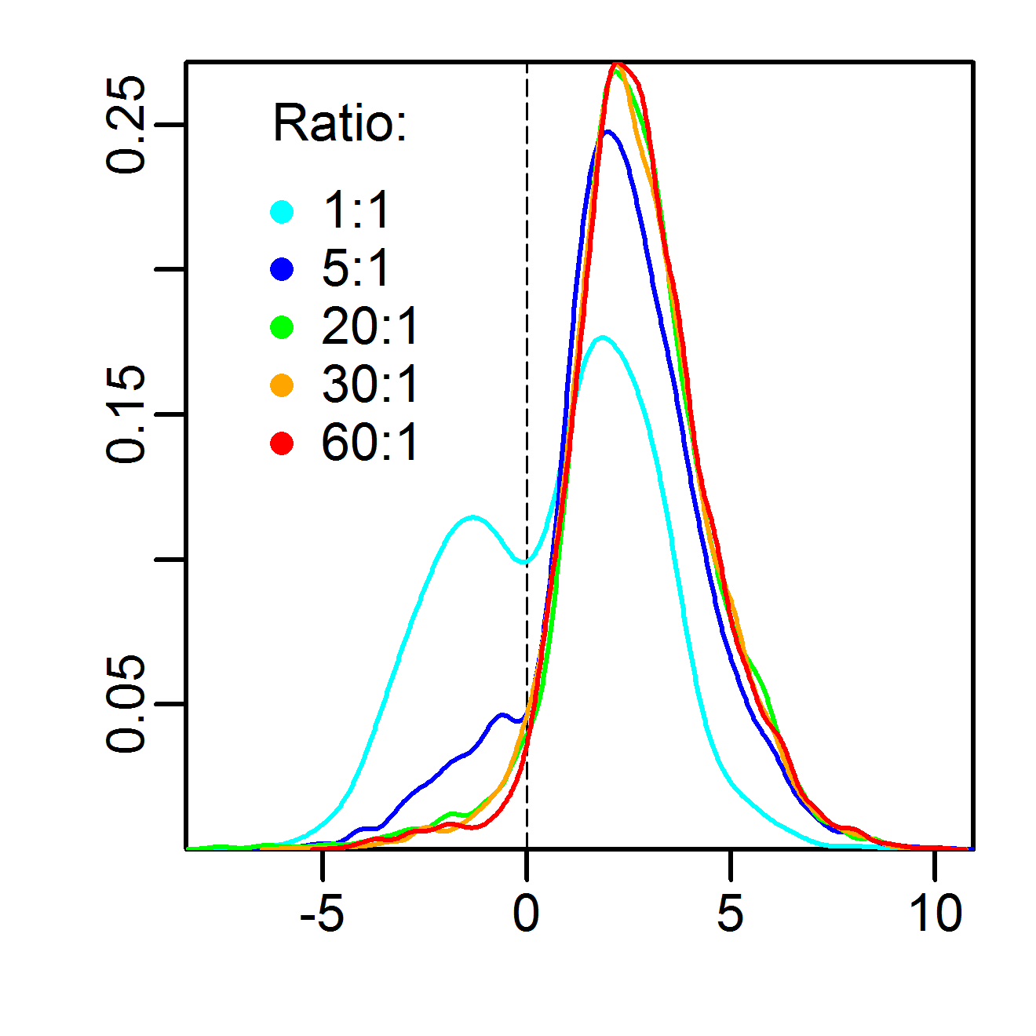
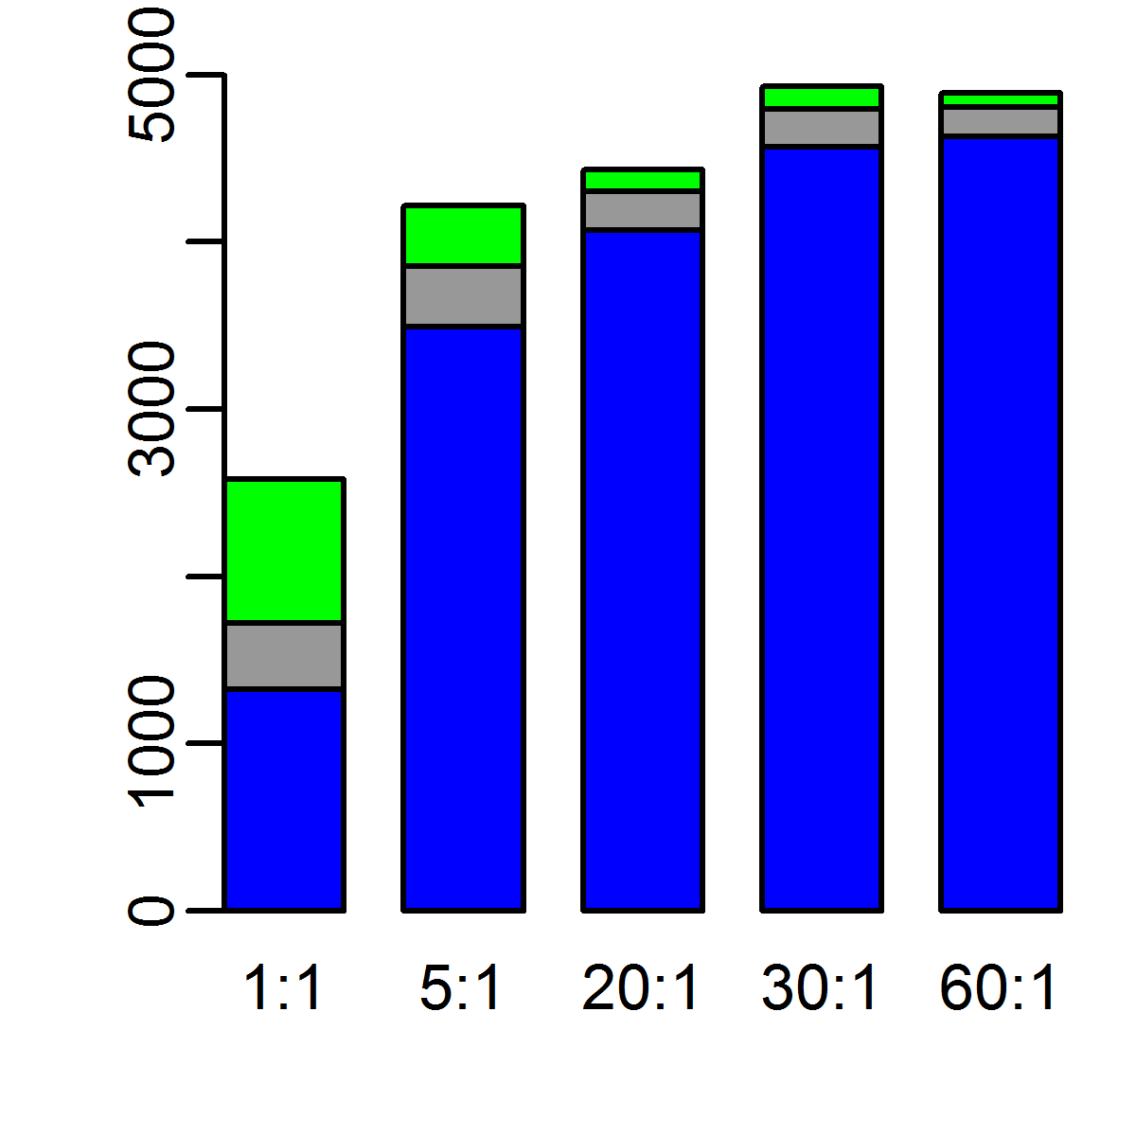
Result
Comparison with pTyr antibodies
Comparison between the Src superbinder (S) or 4G10 (A) (dimethyl labeling)
Density
Number of pTyr peptides
Log2 intensity ratio (S/A)
Ratio (S:A)
Number of pTyr peptides
Log2 intensity ratio for pTyr peptides

Slide 17
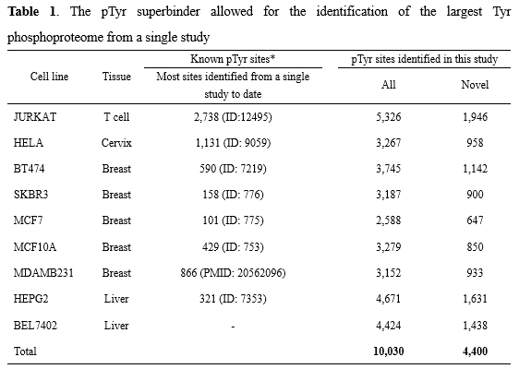
Result
Ultra-deep Tyr phosphoproteomics by superbinder AP-MS/MS
Nine human cell lines

Slide 18
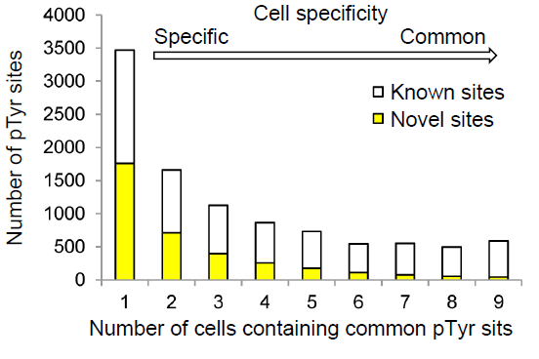
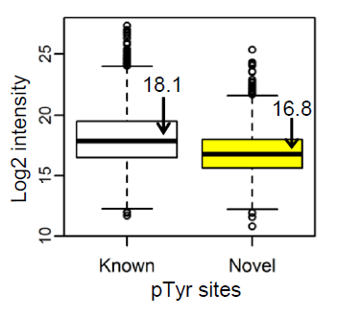
Result
Ultra-deep Tyr phosphoproteomics by superbinder AP-MS/MS
Comparison of known and novel pTyr sites

Slide 19
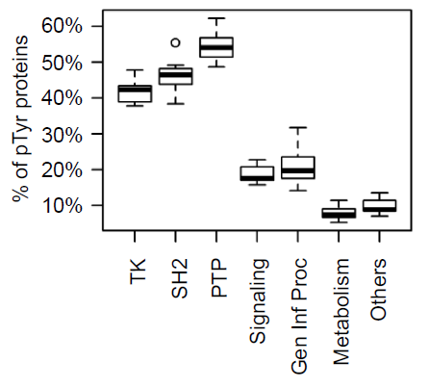
Result
Functional features of the Tyr phosphoproteome
pTyr toolkit
proportion of Tyr phosphorylation in the human cell lines in the different functional categories of proteins

Slide 20
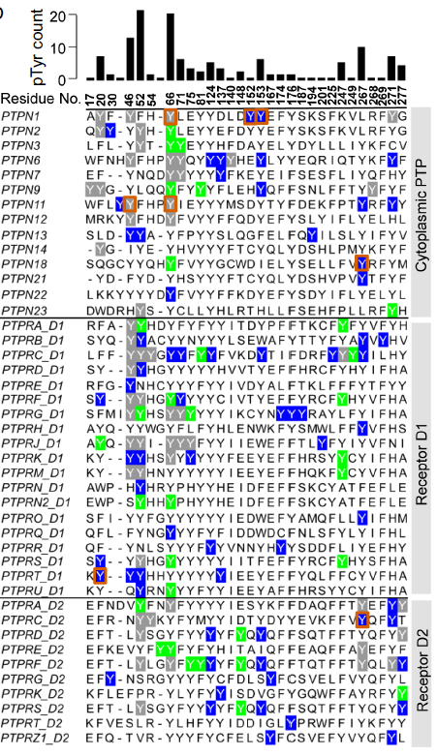
Result
Functional features of the Tyr phosphoproteome

Slide 21
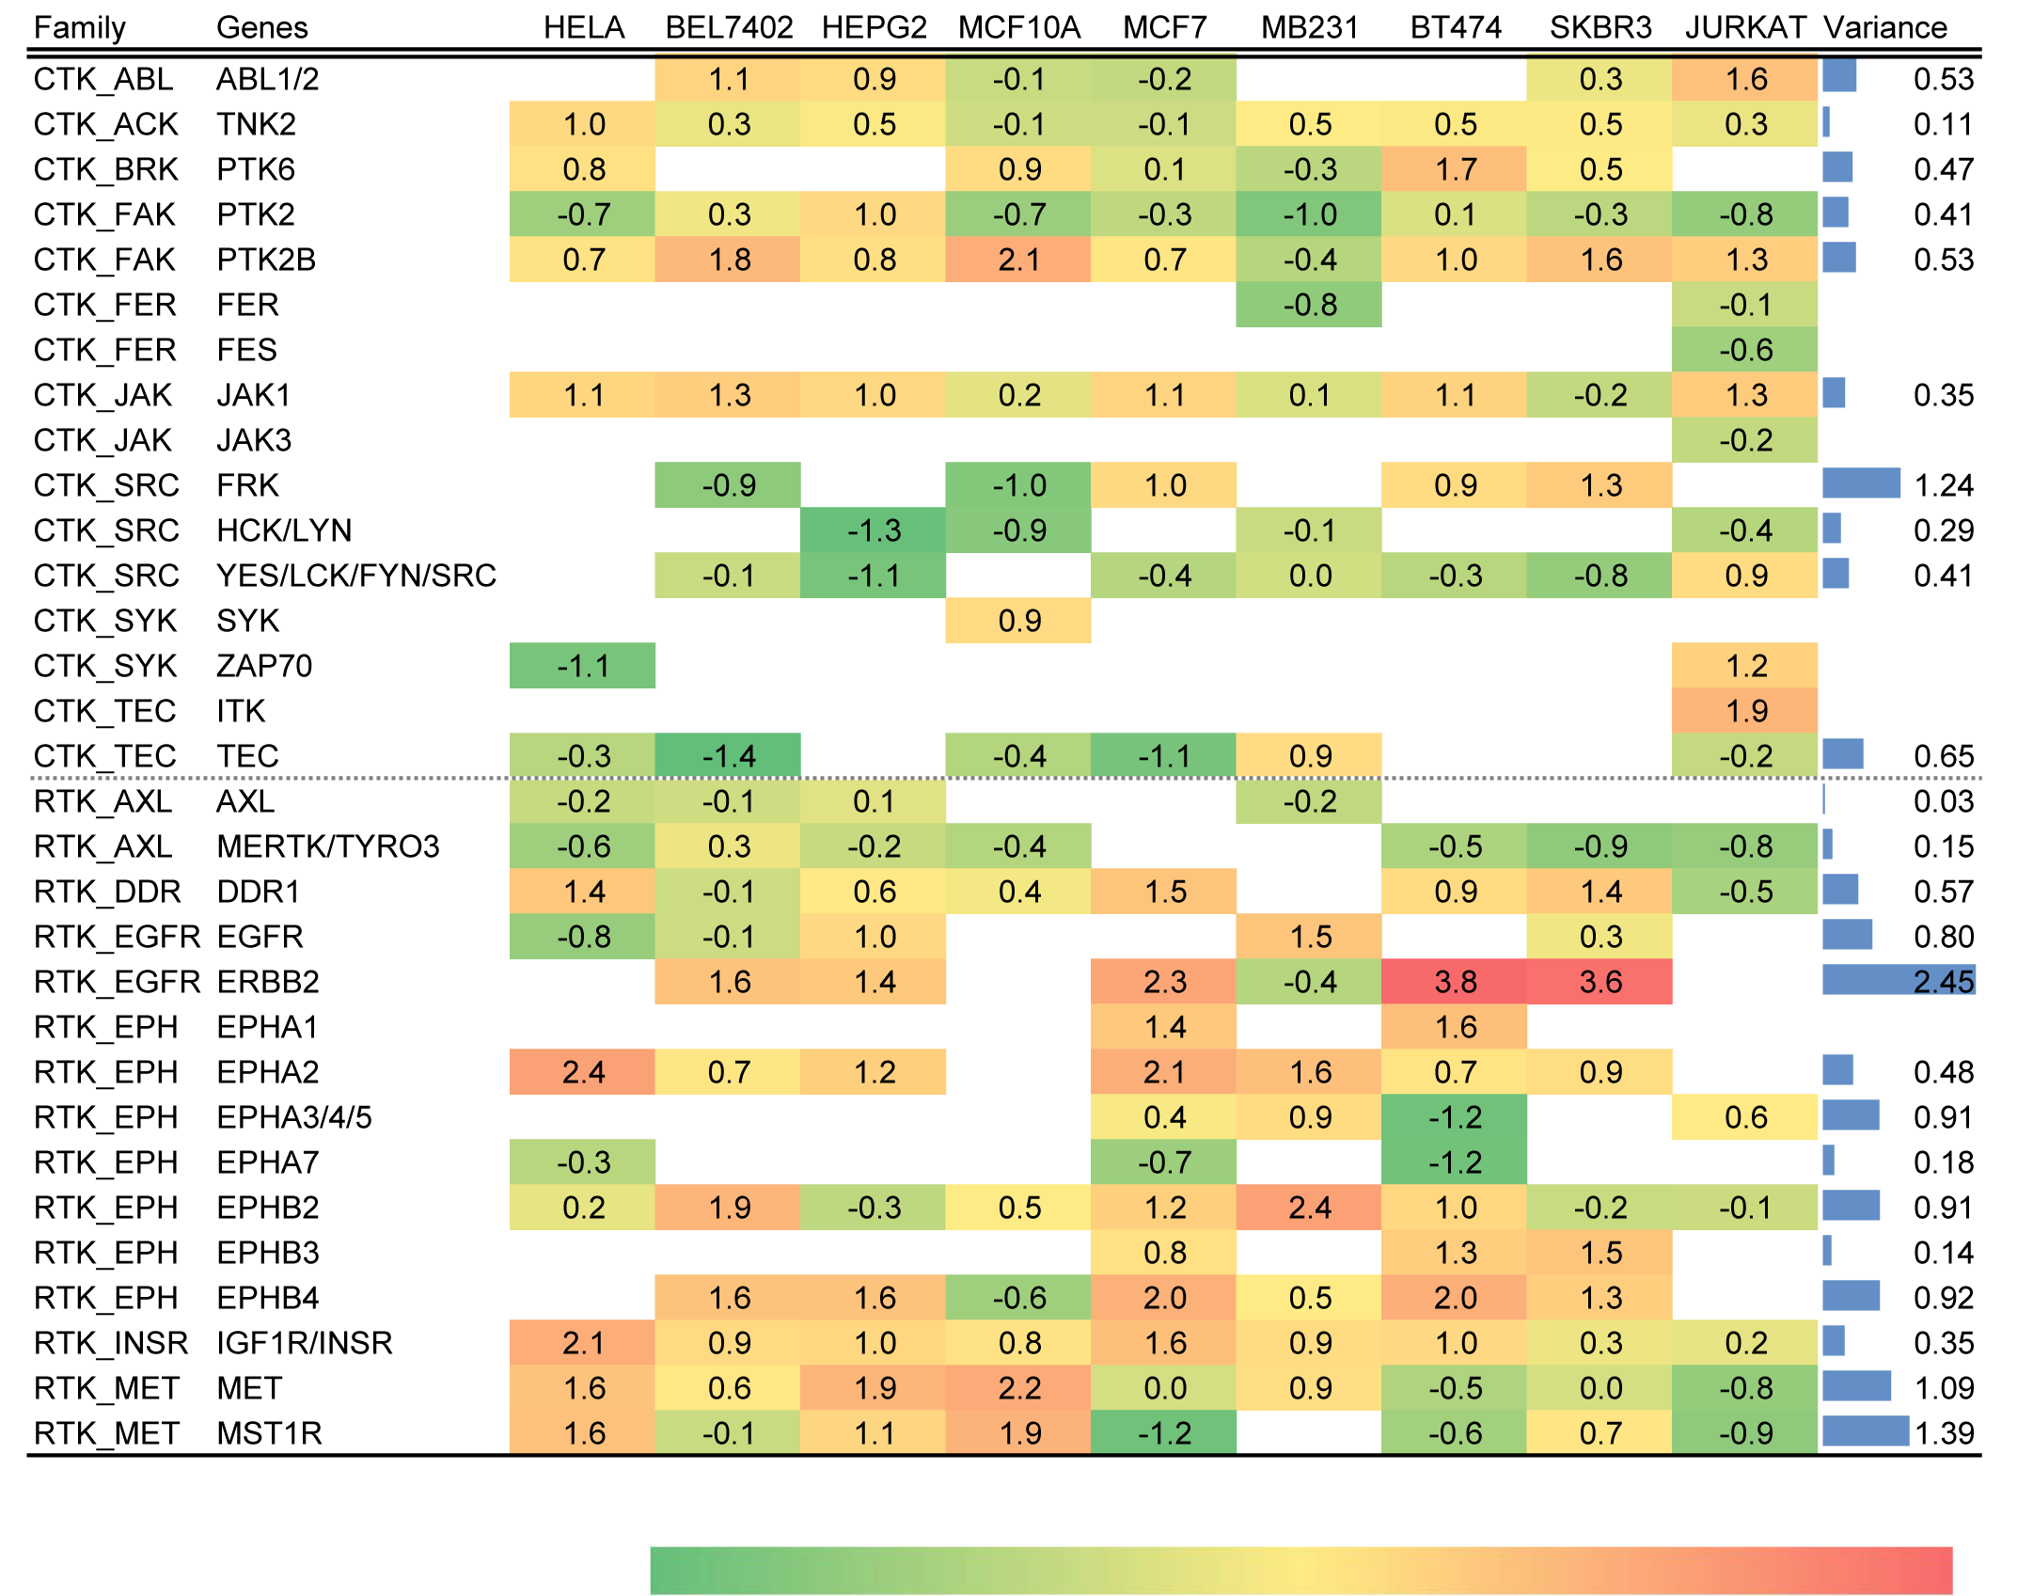
Result
Profiling tyrosine kinase activity by the superbinder
Distinct kinase activation loop phosphorylation profiles associated with different cell lines
Breast cell lines

Slide 22
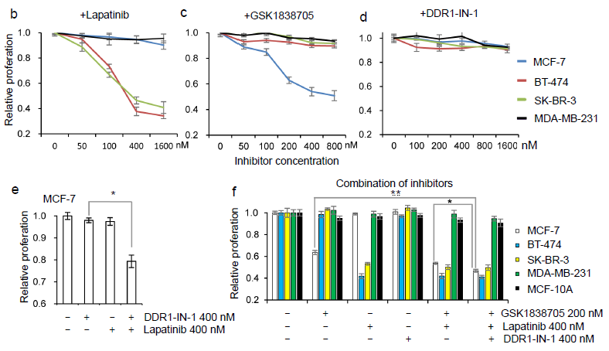
Result
Cell growth inhibited by TK Inhibitors
(ERBB2)
(IGF1R)
(DDR1)
(IGF1R inhibitor)
(ERBB2 inhibitor)
(DDR1 inhibitor)
➔ Quantitative kinase activity profiling enabled by the superbinder-based phosphoproteomics may be used to inform cancer treatment by specifically targeting the activated kinases

Slide 23
Conclusions
Development of a novel strategy for pTyr enrichment;
Cell type-specific global kinase activation patterns guide the design of experiments to inhibit cancer cell proliferation by blocking the highly activated tyrosine kinases;
Superbinder is a highly efficient and cost-effective alternative to conventional pTyr antibodies.

Slide 24
Acknowledgements
Zou lab
Dr. Mingliang Ye
Dr. Yangyang Bian
Dr. Mingming Dong
Shawn Li lab
Dr. Tomonori Kaneko
Dr. Huadong Liu
Dr. Xuguang Liu

Slide 25
Thanks for your attention!

