Slide 1

Discovery and Characterization of Short-Chain Lysine Acylations with Mass Spectrometry and Quantitative Proteomics
Yue Chen, Ph.D.
Assistant Professor
CNCP2016, Dalian, China
Department of Biochemistry, Molecular Biology and Biophysics

Slide 2
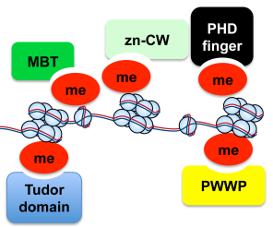
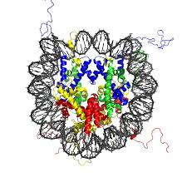
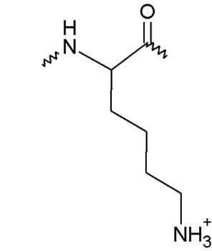
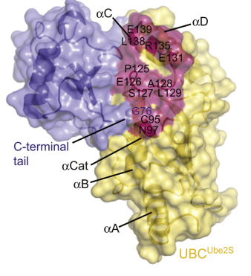
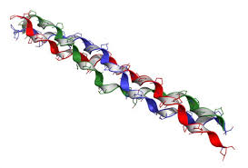
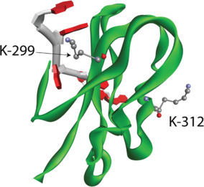
Lysine – An Abundant and Versatile Amino Acid in Protein Structure and Function
Posttranslational Modifications
Protein – Protein Interactions
Ac
Palmitoylation
Ub
SUMO
Lysine
Me
Protein Structural Stability

Slide 3
Lysine Acetylation
1963 – Lysine acetylation
1984 – O-GlcNAc Modification
1932 – Serine Phosphorylation
1978 – Farnesylation
1996 – SUMOylation
1920
1930
1940
1950
1960
1970
1980
1990
2000
2010
1982 – Myristoylation
1938 – Glycosylation
1977 – Ubiquitination
1959 – Lysine methylation

Slide 4
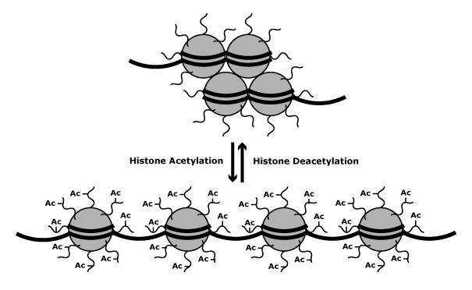
Lysine Acetylation in Epigenetic Regulation
Condensed chromatin
Transcription silencing
Relaxed chromatin
Transcription activation

Slide 5
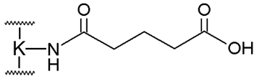
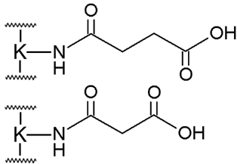

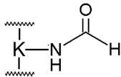
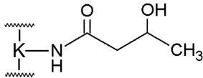
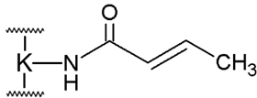
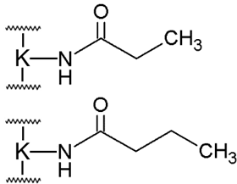
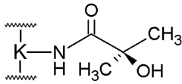
Lysine Short-Chain Acylations
Lysine acetylation (Kac)
Kglu
Ksucc and Kmal
Kfo
K3ohBu
Lys acetylation proteomics analysis
2006
2007
2008
2009
2010
2011
2012
2013
2014
2015
2016
Kcr
K2ohiBu
Kprop and Kbuty

Slide 6
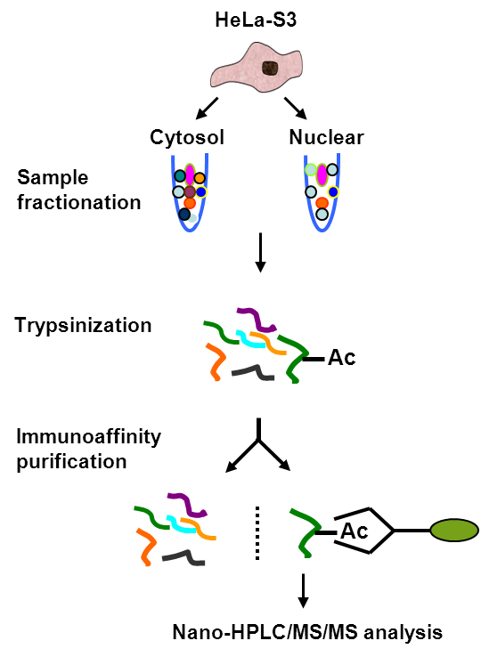
The First Systematic Profiling of Lysine Acetylation Proteome
Reduce sample complexity
Reduce complexity and avoid loss of peptides
Increase sensitivity and reliability
Mol Cell (2006) 23, 607-618

Slide 7
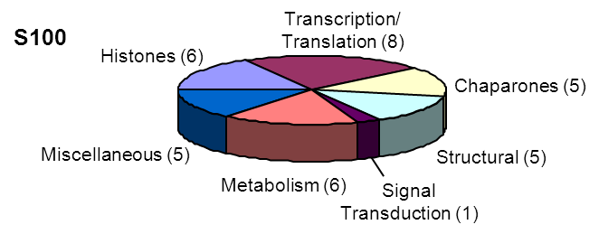
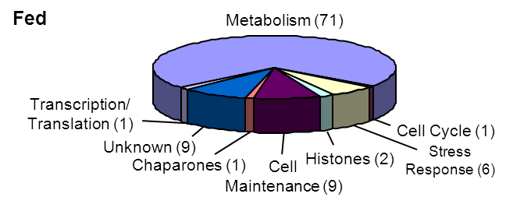
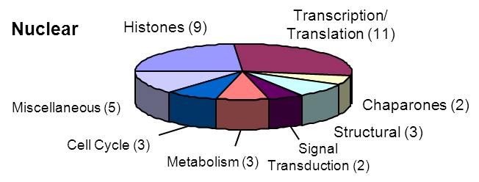
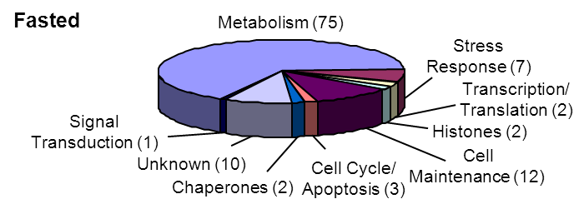
The First Systematic Profiling of Lysine Acetylation Proteome
Hela cells
Mouse liver
The first demonstration of Lys acetylation on metabolic enzymes.
More than 20% mitochondria proteins were Lys acetylated.

Slide 8
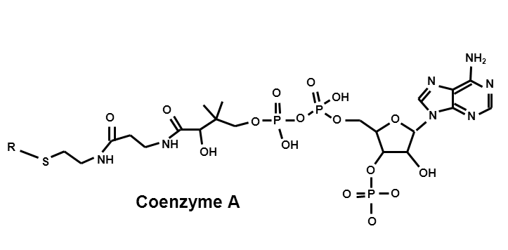
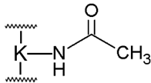
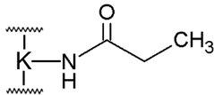
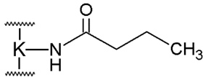
Lysine Propionylation and Lysine Butyrylation – Discovery
Deacetylase
Acetyltransferase
+ Acetyl - CoA
CoA
Acetyl - CoA
Acetylation
CoA
Propionyl - CoA
Propionylation
CoA
Butyryl - CoA
Butyrylation

Slide 9

Lysine Propionylation and Lysine Butyrylation – Discovery
A: GGK^{Prop}GLGK^{Ac}GGAK^{Ac}R
y₅^{A}
100
Relative Intensity
b₆^{A}
y₇^{A}
b₅^{A}
[y₁₀^{A}]²⁺
y₄^{A}
b₇^{A}
y₆^{A}
b₁₀^{A}
50
y₂^{A}
b₃^{A}
y₈^{A}
y₉^{A}
y₃^{A}
b₄^{A}
b₉^{A}
b₁₁^{A}
y₁^{A,B}
0
200
400
600
800
1000
1200
m/z

Slide 10
Lysine Propionylation and Lysine Butyrylation – Discovery
A: GGK^{Prop}GLGK^{Ac}GGAK^{Ac}R
B: GGK^{Ac}GLGK^{Prop}GGAK^{Ac}R
y₅^{A,B}
100
Relative Intensity
b₆^{A}
b₆^{B}
y₇^{A}
b₅^{A}
[y₁₀^{A,B}]²⁺
y₄^{A,B}
b₇^{A,B}
b₅^{B}
y₆^{A}
b₁₀^{A,B}
50
y₂^{A,B}
y₇^{B}
b₃^{A}
y₆^{B}
y₈^{A}
y₉^{A}
b₃^{B}
y₃^{A,B}
b₄^{B}
b₉^{A,B}
y₈^{B}
y₉^{B}
b₄^{A}
b₁₁^{A,B}
y₁^{A,B}
0
200
400
600
800
1000
1200
m/z

Slide 11
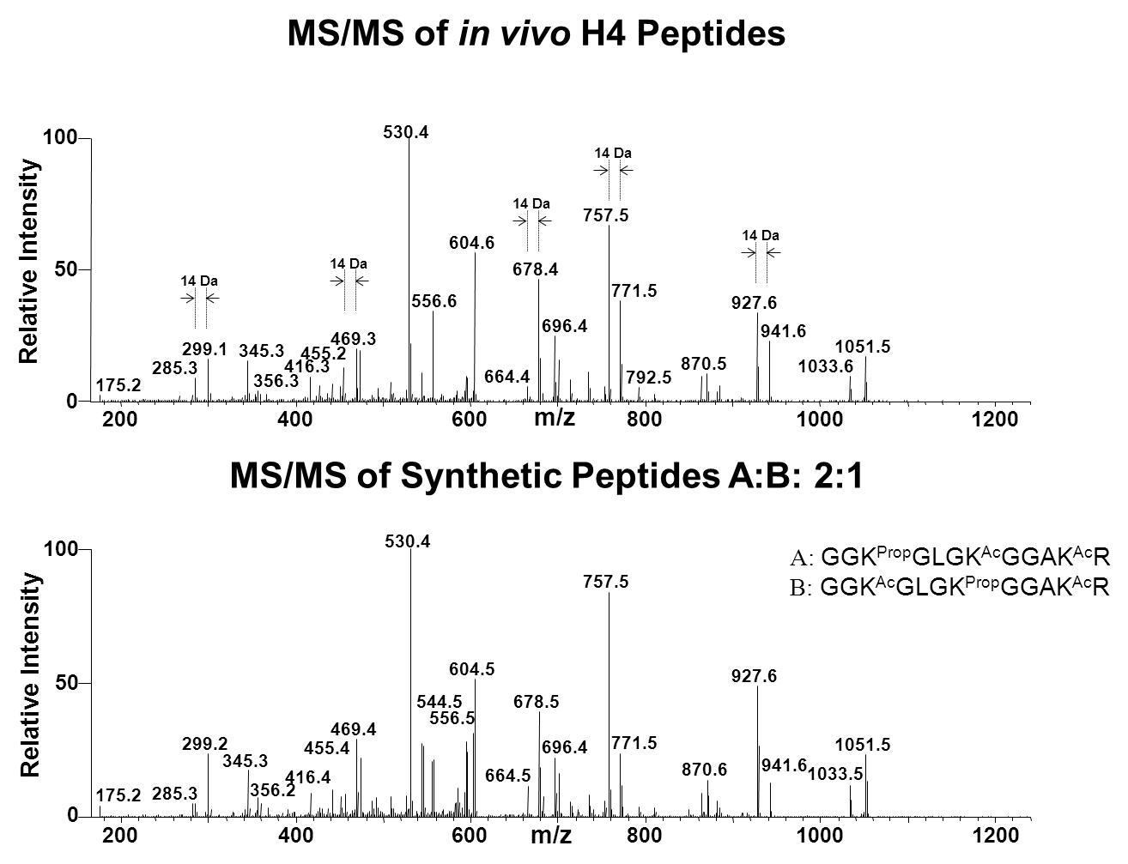
Lysine Propionylation and Lysine Butyrylation – Validation
Mol Cell Proteomics (6), 812-819 (2007)

Slide 12
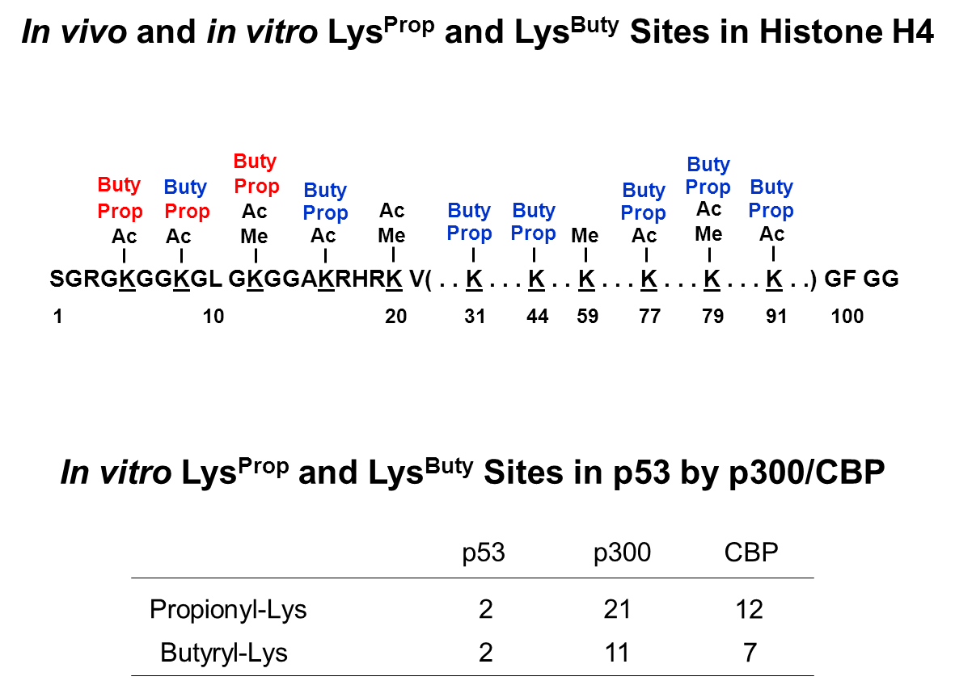
Lysine Propionylation and Lysine Butyrylation – Enzymatic Regulation
Mol Cell Proteomics (6), 812-819 (2007)

Slide 13
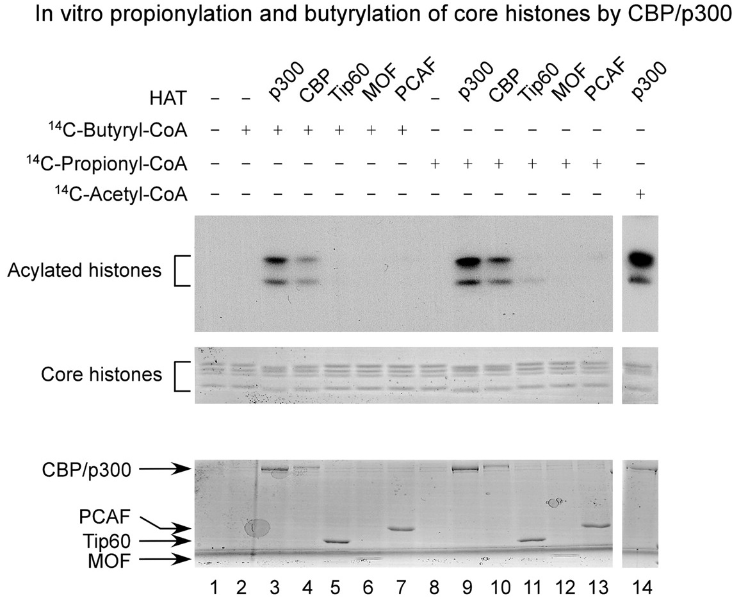
Lysine Propionylation and Lysine Butyrylation – Enzymatic Regulation
Mol Cell Proteomics (6), 812-819 (2007)

Slide 14
Lysine Propionylation and Lysine Butyrylation
Why Did We Miss the Identification of Lys Propionylation?
Can We Identify Novel Modification?

Slide 15
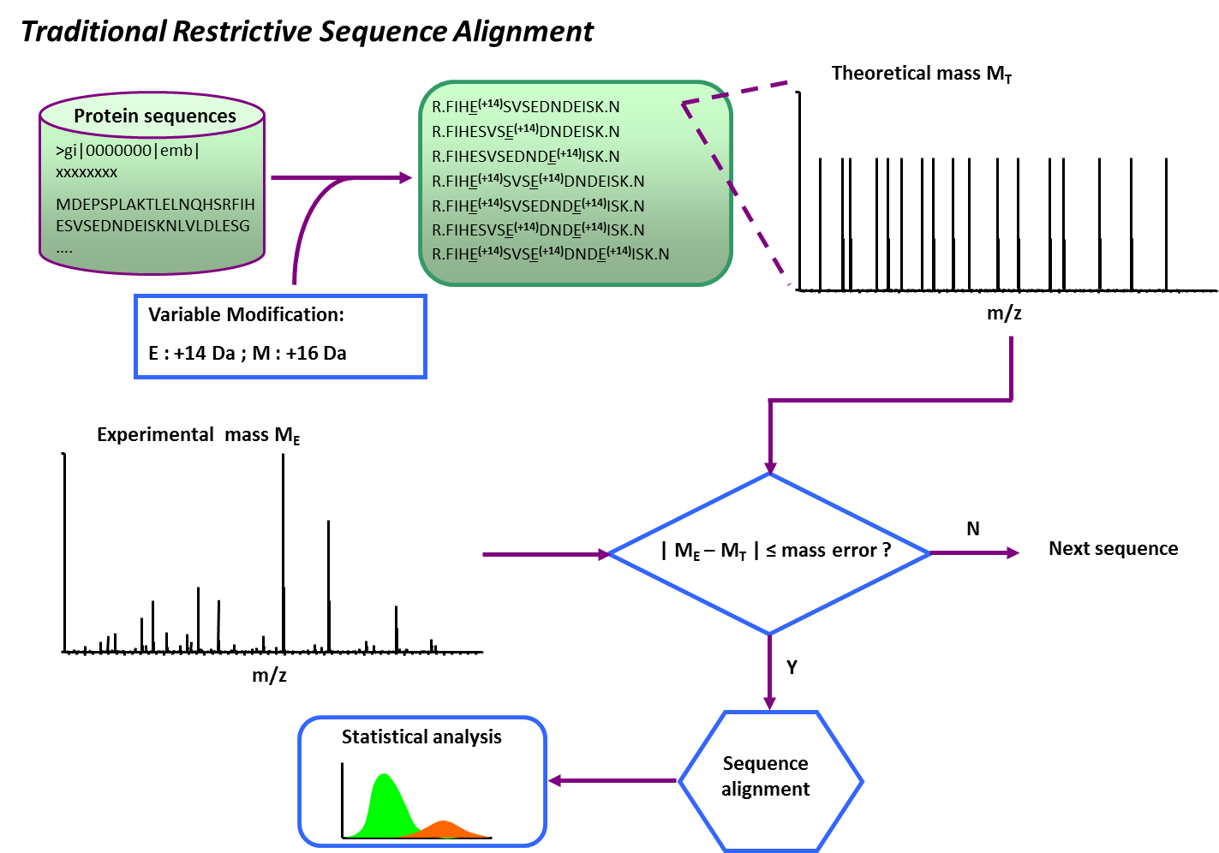
Systematic PTM Discovery from MS/MS Data

Slide 16
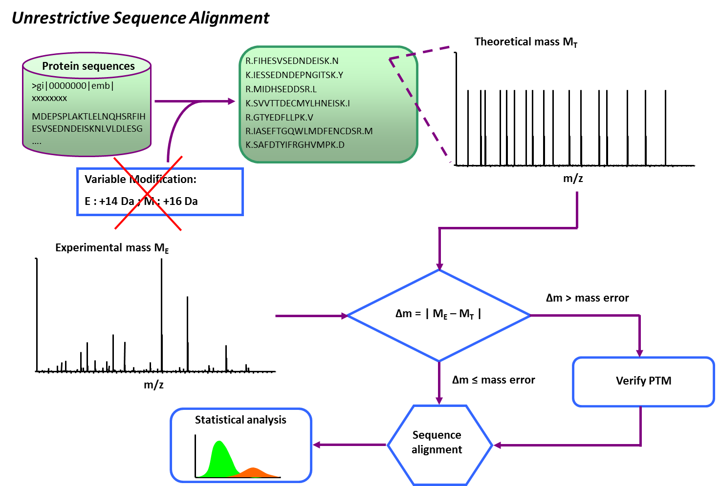
Systematic PTM Discovery from MS/MS Data
Significantly Increased Search Space and False Positive Rate

Slide 17
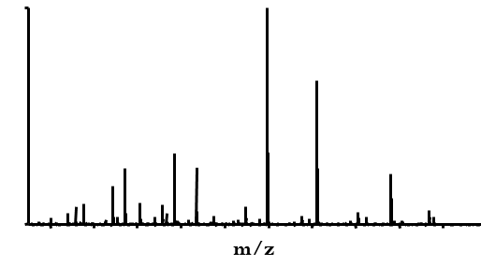

Systematic PTM Discovery from MS/MS Data
Identification
R.F L N V E T S L k I P H K.T
Verification
Principle:
Correct peptide identification should adequately explain major fragments in the tandem mass spectrum.
PTMap – Emphasizing unmatched peaks to remove low confident identifications
Base peak selection and noise removal
Automatic mass shift adjustment
Exclusive modification site localization

Slide 18
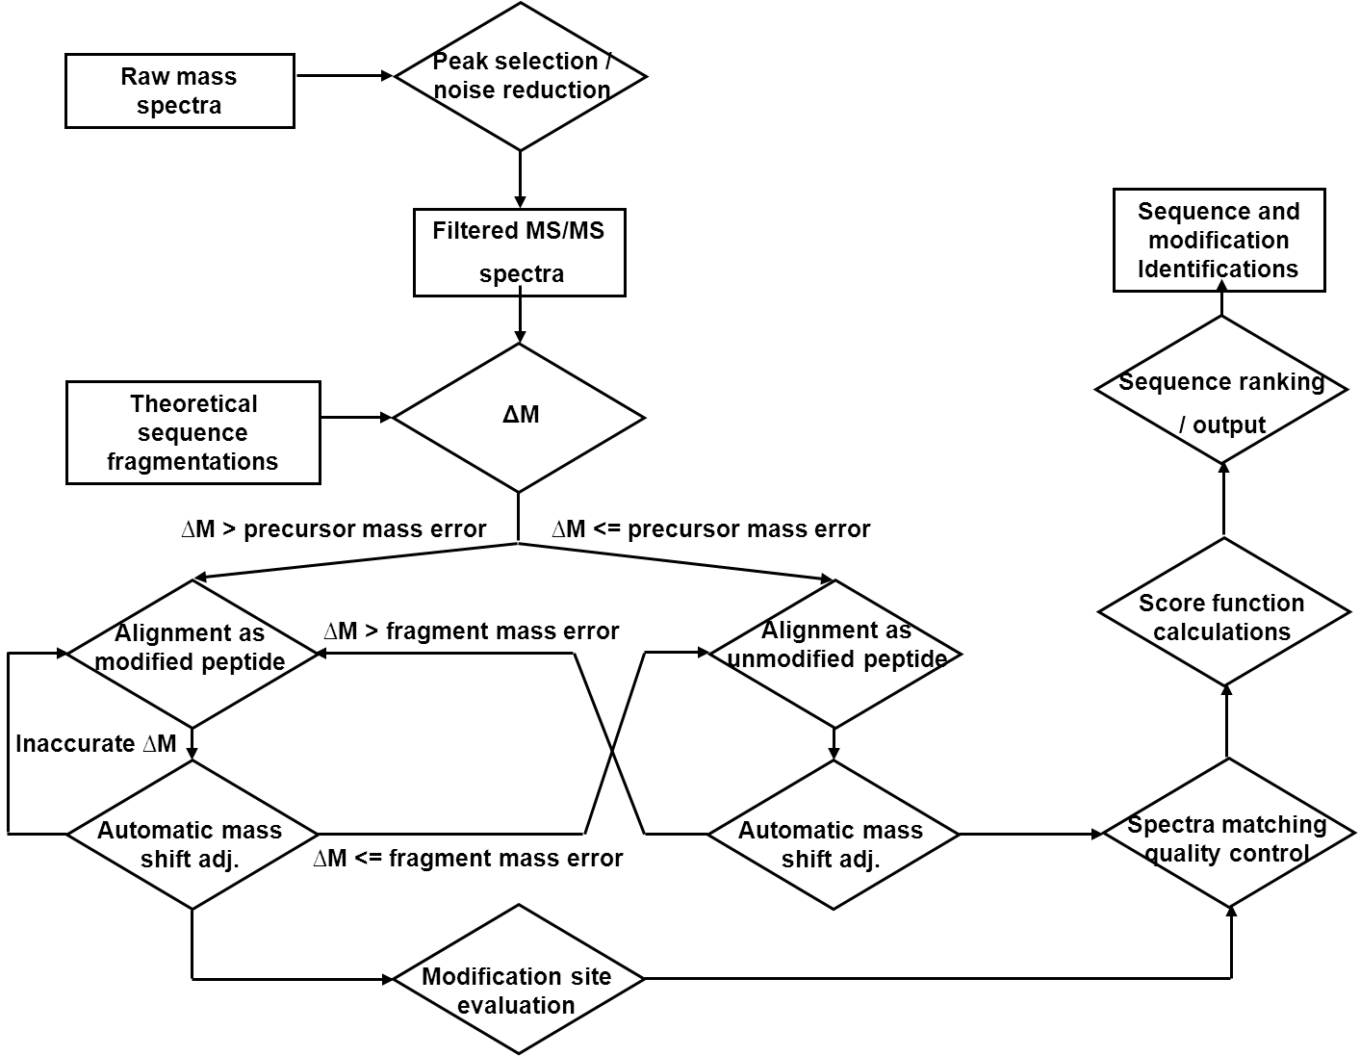
Systematic PTM Discovery from MS/MS Data
PNAS (2009) 106, 761-766

Slide 19
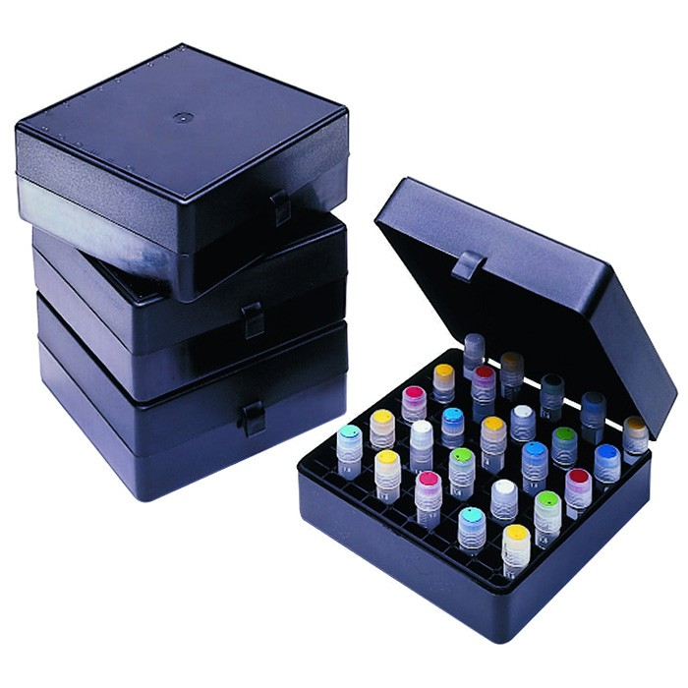
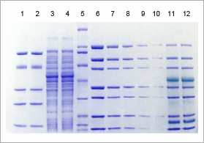
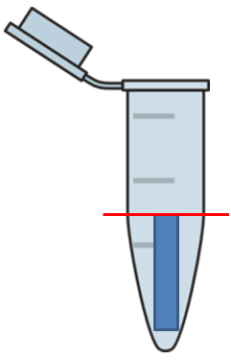
Systematic PTM Discovery from MS/MS Data
Biological Sample Preparation
Glycerol Adducts
Sample storage
+74 Da Glu and Asp
Acrylamide, β-ME Adducts
+108 Da Cys
+76 Da
+71 Da
SDS-PAGE
Ethanol Adducts
+28 Da Glu
In-gel digestion
PTMap
Analysis
HPLC-MS/MS Analysis

Slide 20
Systematic PTM Discovery from MS/MS Data
X
: Known sites
X
: Novel sites
Novel PTM Sites
Type | Sites
Kcr | 28
Kbu | 9
Kpr | 5
Yoh | 6
Ksucc | 14
Kmal | 1
Kfo | 4
Kme | 18
Kme2 | 1
Rme | 8
Kac | 2
Total | 121
Cell (2011) 146, 1016-1028

Slide 21
Systematic PTM Discovery from MS/MS Data
PTMap Analysis
+100.0186 Da
+ 86.0368 Da
+ 68.0230 Da
+ 86.0368 Da
Zhang, Z. et al Nat Chem Biol. 2011 Jan;7(1):58-63
Xie, Z. et al Mol Cell. 2016 Apr 21;62(2):194-206
Tan, M. et al Cell. 2011 Sep 16;146(6):1016-28
Dai, L. et al Nat Chem Biol. 2014 May;10(5):365-70

Slide 22
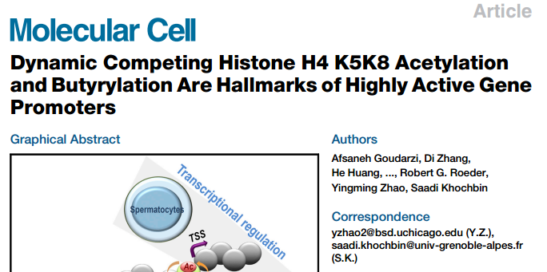
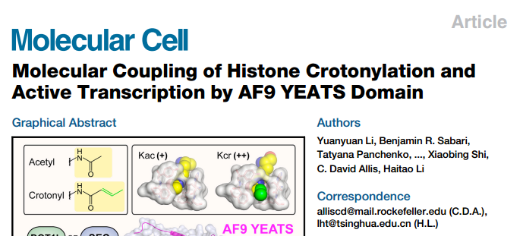
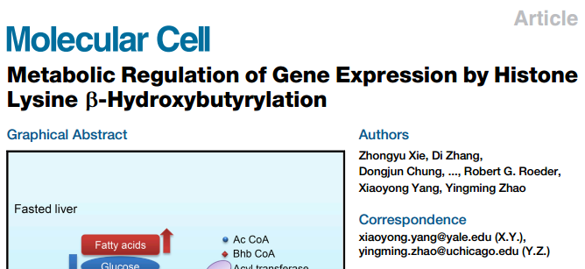
Lysine Butyrylation
Lysine Crotonylation
Lysine 3-Hydroxybutyrylation

Slide 23
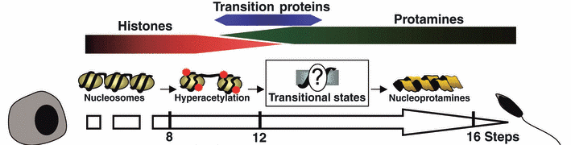

Lysine Butyrylation – Function
Brdt
Ac
Ac
Histone replacement and sperm maturation
+Ac-CoA
Brdt
Acetyltransferase (HAT)
Ac
Bu
Delayed histone replacement and altered chromatin in mature sperm
+Bu-CoA

Slide 24
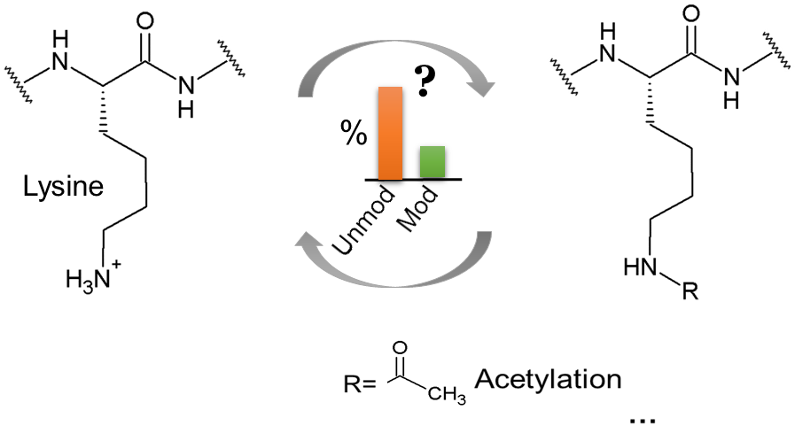
The Prevalence of Lysine Acylations

Slide 25
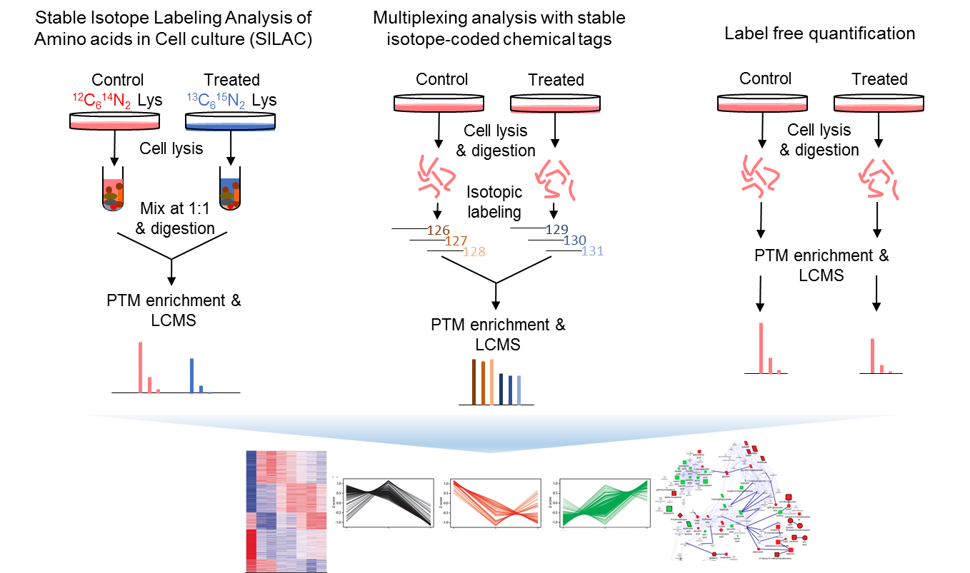
Current Quantitative Proteomics Reveal Dynamically Regulated PTMs

Slide 26
Stoichiometry vs Relative Quantification
SILAC Ratio H/L = 10
Stoichiometry from 0.1% to 1%
∆ = 0.9%
Stoichiometry from 10% to 20%
Or
Stoichiometry from 50% to 100%
∆ = 10%
SILAC Ratio H/L = 2

Slide 27
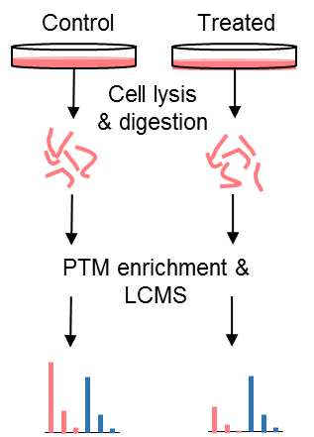
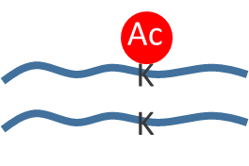
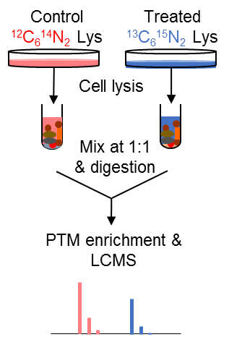
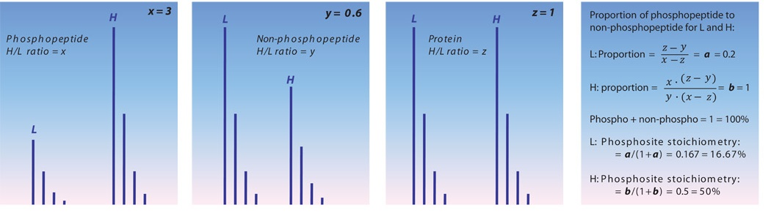
Strategies for PTM Stoichiometry Analysis
Key challenge for MS-based stoichiometry analysis – unequal ionization efficiency between modified and unmodified peptides.
A
Absolute quantification
Synthetic heavy modified peptide
Spike-in
Synthetic heavy unmodified peptide
B
Sci. Signal. 2010;3:ra3

Slide 28
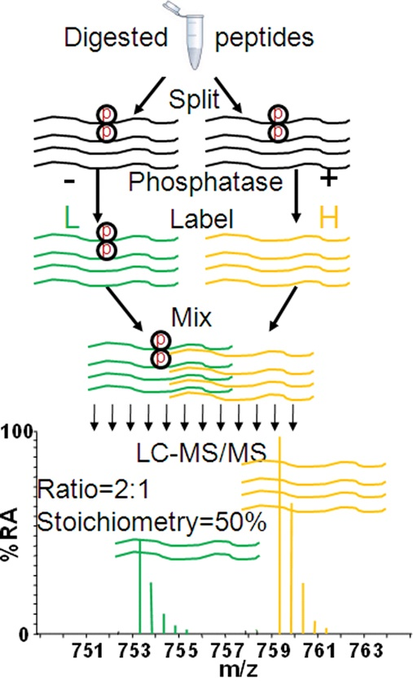
Strategies for PTM Stoichiometry Analysis
C
Identification of Lys acetylation stoichiometries remain challenging.
Trypsin cleaves at K, which creates unequal length of modified and unmodified peptides;
Lysine acetylation often forms clusters, such as histones, p53;
No uniform method to efficiently deacetylate all acetylation sites.
Nature Methods (2011) 8, 677–683

Slide 29
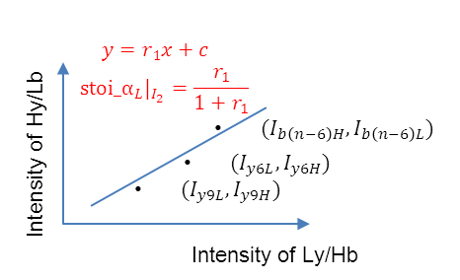
An Isotope-Balanced Analysis of Acetylation Stoichiometries
Tryptic digestion
DDA LC-MS/MS
Natural acetylation
Isotope-encoded chemical acetylation
J Proteome Res 15, 1103-1113. (2016)

Slide 30
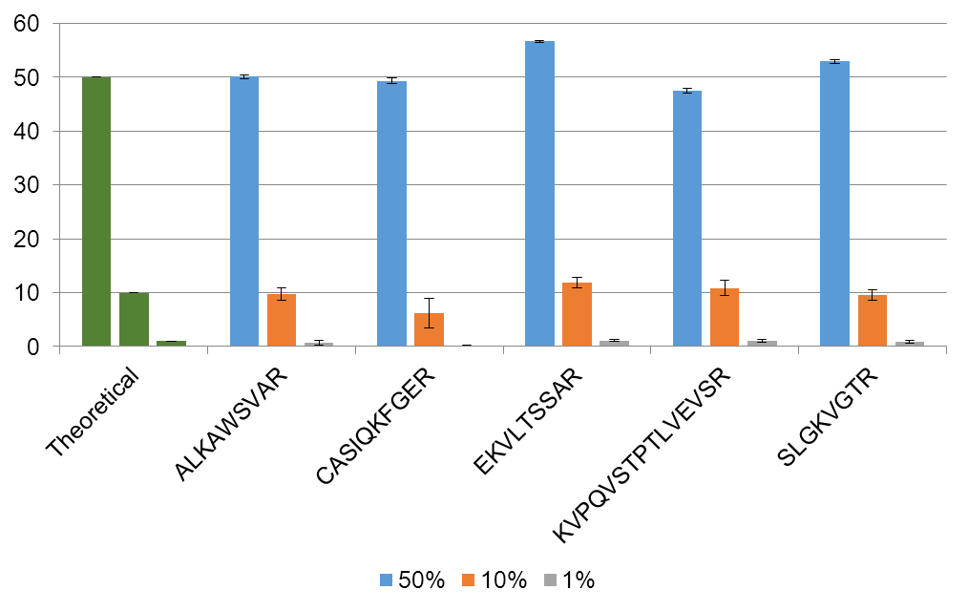
Strategies for PTM Stoichiometry Analysis
BSA stock solution
Digestion and mix at different ratios
LCMS analysis

Slide 31
Strategies for PTM Stoichiometry Analysis
Synthetic peptides
Histone H4 N-terminal acetylation cluster
GK*GGK*GLGK*GGAK*R
GK*GGK*GLGK#GGAK*R
GK*GGK*GLGK*GGAK#R
GK#GGK*GLGK#GGAK*R
GK#GGK#GLGK*GGAK*R
GK*GGK#GLGK#GGAK#R
GK#GGK*GLGK#GGAK#R
“#” =Ac, “*” = Ah
Mix at specific ratios
Chemical labeling
LCMS analysis
Stoichiometry (%)

Slide 32
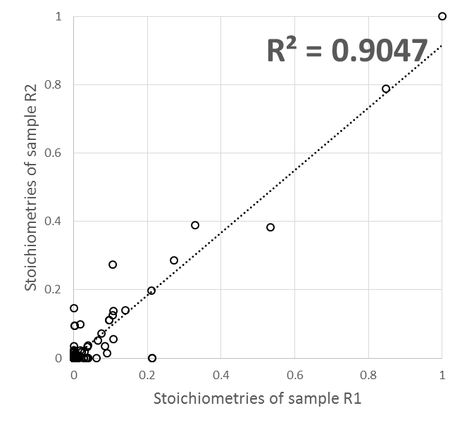

Strategies for PTM Stoichiometry Analysis
>95% labeling efficiency for more than 95% of the sites
HeLa cells
Cell lysis
Chemical labeling
StoichAnalyzer quantification
Tryptic digestion
LCMS analysis
Fractionation

Slide 33
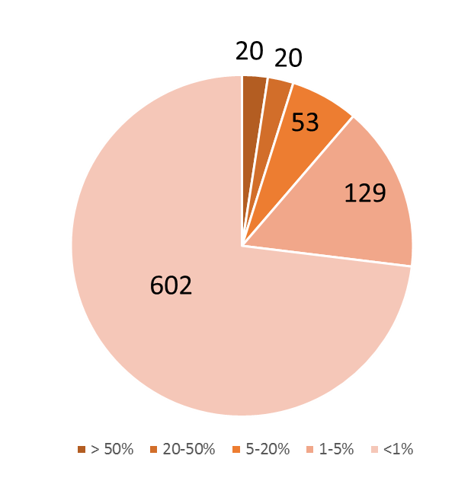
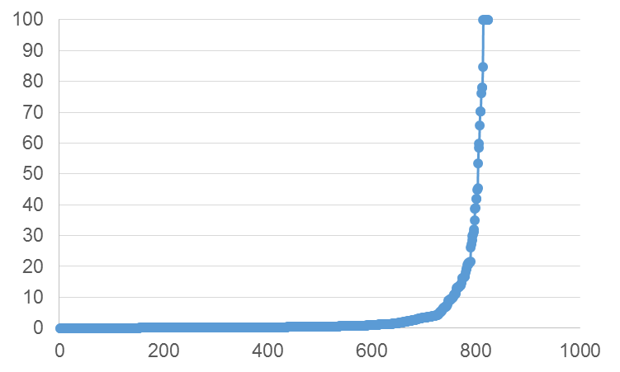
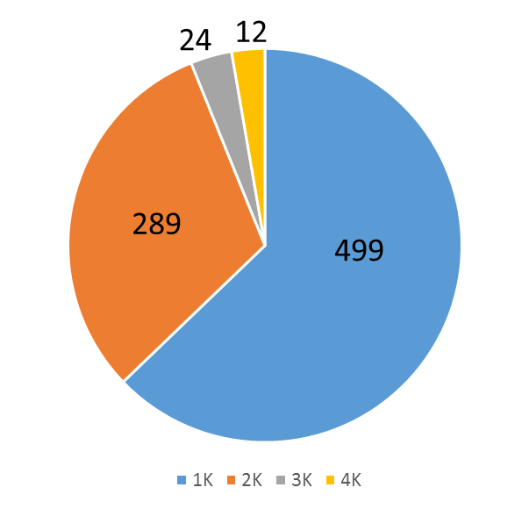

Strategies for PTM Stoichiometry Analysis
A
B
Stoichiometry (%)
Average acetylation stoichiometry in Hela cells – 4.1%
Average mitochondria acetylation stoichiometry – 2.4%
C
Stoichiometry
Sequence | Site | Protein name | Stoichiometry
EIFNFVLKAIR | K254 | DNA-dependent protein kinase | 100%*
ESKVPADLLKR | K3877,K3884 | DNA-dependent protein kinase | 70.34%
LGFITNNSSKTR | K72 | Phosphoglycolate phosphatase | 84.76%
KADLVNR | K374 | Programmed cell death 6-interacting protein | 65.74%
IGGKGTAR | K1061 | Transcription factor BTF3 | 58.61%
NIGGQIQEKVR | K142 | Protein unc-45 homolog A | 76.26%
DKIIVNDR | K285 | tRNA-splicing ligase RtcB homolog | 45.43%
* Note: Heavy labeled peptide was not detected
Regulation of gene expression
DNA damage and repair
Macromolecule metabolic process
Z score

Slide 34




Strategies for PTM Stoichiometry Analysis
HeLa cells
Control
Butyrate treated
Cell lysis
Chemical labeling
Tryptic digestion
LC-MS/MS and Stoichiometry quantification
Control
Butyrate treated

Slide 35
Conclusions
Unrestrictive sequence alignment and stringent validation enables the discovery of novel short-chain lysine acylations.
Lysine acylation serves as an emerging mechanism and metabolic sensors that profoundly affect cellular response to metabolic perturbations.
Stoichiometry analysis of PTMs provides unique information on the PTM abundance and allow comparative analysis PTM abundance between different sites and different modifications.
We have developed an improved method for global lysine acetylation stoichiometry analysis using stable isotope chemical labeling and quantitative data analysis.
Our data showed lysine acetylation stoichiometry in mammalian cells is generally pretty low comparing to phosphorylation stoichiometry, with proteins involved in gene expression and chromatin activities having higher acetylation stoichiometry.
The strategy has been applied to study the site-specific change of stoichiometry upon HDAC inhibitor treatment and allowed us to identify novel dynamic changes of site-specific stoichiometry of histone acetylation clusters.

Slide 36




Acknowledgement
Chen lab
University of Minnesota
Tong Zhou
Ying-Hua Chung
Luke Erber
Jianji Chen
Yingming Zhao
University of Chicago
Minjia Tan
Lunzhi Dai
Chao Peng
Zhike Lu
Zhongyu Xie
Zhongyi Cheng
Center for Mass spectrometry and Proteomics
Tim Griffin
Pratik Jagtap
Biochemistry, Molecular Biology and Biophysics
David Bernlohr
Do-Hyung Kim
Funding:
Biochemistry, Molecular Biology & Biophysics

