Slide 1
Redox Proteomics of Oxidative Stress-Induced Cell Death
Haiteng Deng

Slide 2
Effects of Oxidative Stress on Carcinogenesis and Cancer Treatment
Carcinogenesis
Chronic Oxidative Stress
Genetic instability
New phenotypes
Tumor
Formation
Apoptosis
Growth
Etc.
inflammation
genetic disorder
environment
Anti-Cancer Agents
Cancer Treatment
Tumor
Regression
Doxorubicin
Daunorubicin
Mitomycin C
Etoposide
Cisplatin
Arsenic trioxide
Ionizing radiation
ROS-based
Therapy
NO
Induced apoptosis
or Necrosis
YES
Oxidative
resistant cells

Slide 3
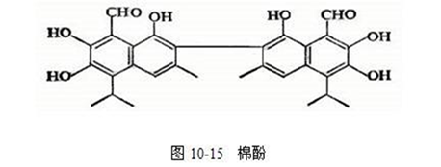
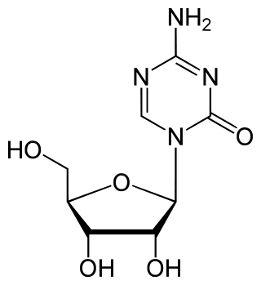
Action Mechansims of Two Drugs
Azacitidine

Slide 4
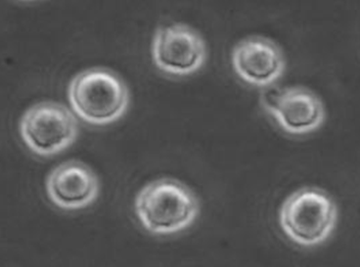
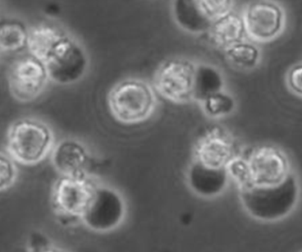
Azacytidine/Gossypol Induced Cell Type-Specific Cell Death: Apoptosis, Necrosis and Autophagy
Control
Percentage of apoptosis-related
cell death by FACS analsis
(a)
(b)
(c)
Marker
Azacytidine

Slide 5
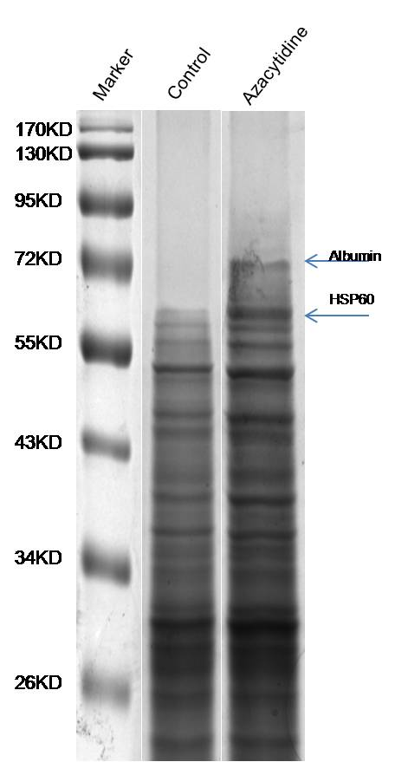
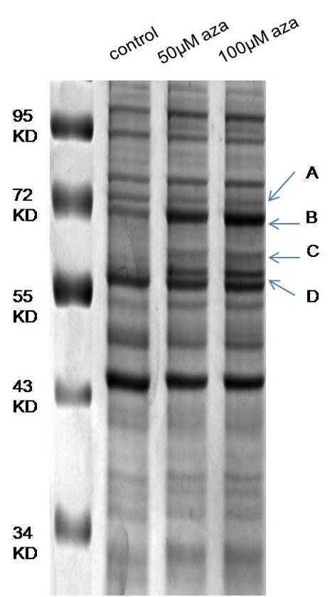
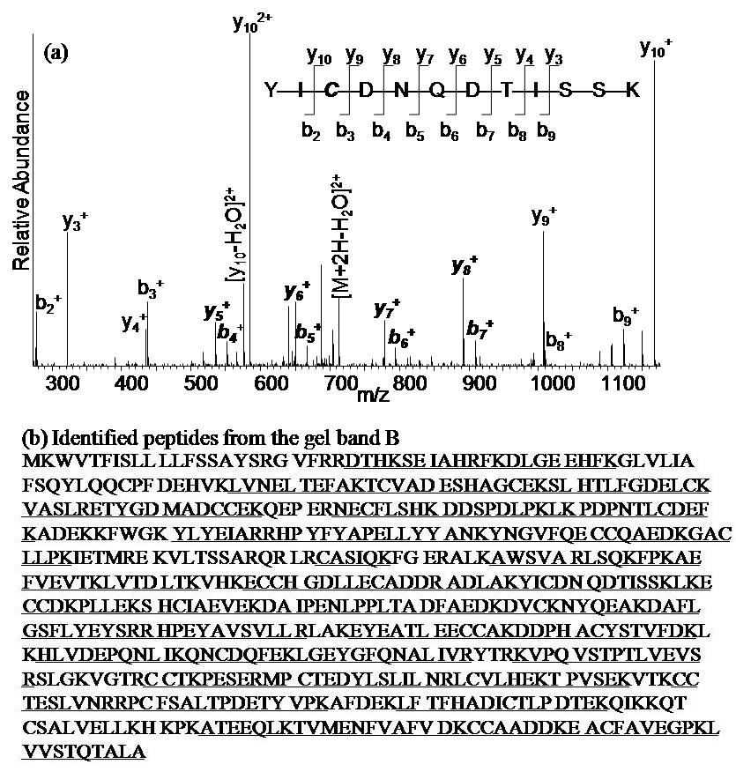
Azacytidine Induced Changes of Protein Expressions
Human Albumin Y—I—C—E—N—Q—D—S—I—S—S--K

Slide 6
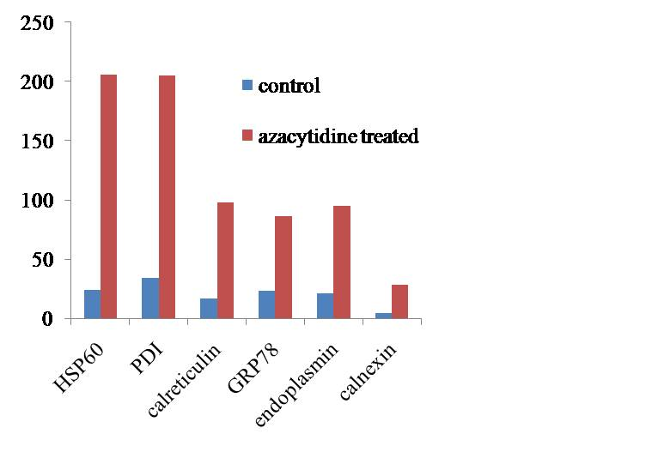
Azacytidine/Gossypol/H₂O₂ Induced Similar Changes of Protein Expressions

Slide 7
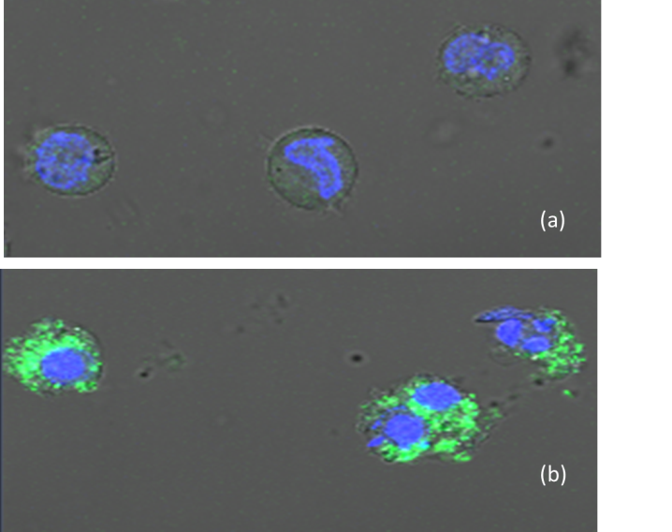
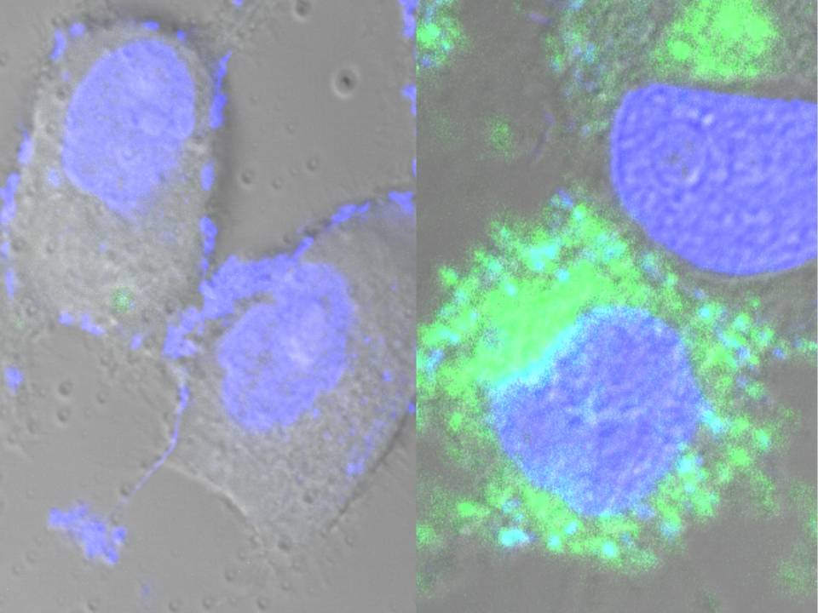
Detection of Reactive Oxygen Species by Fluorescein Labeling
Control
Gossypol treated

Slide 8
Effects of ROS on Cellular Processes
Trachootham et al., Naturee Review Drug Discovery 8 (2009) 579

Slide 9
Metabolomics Analysis of Gossypol-treated Ovarian Cancer Cells

Slide 10
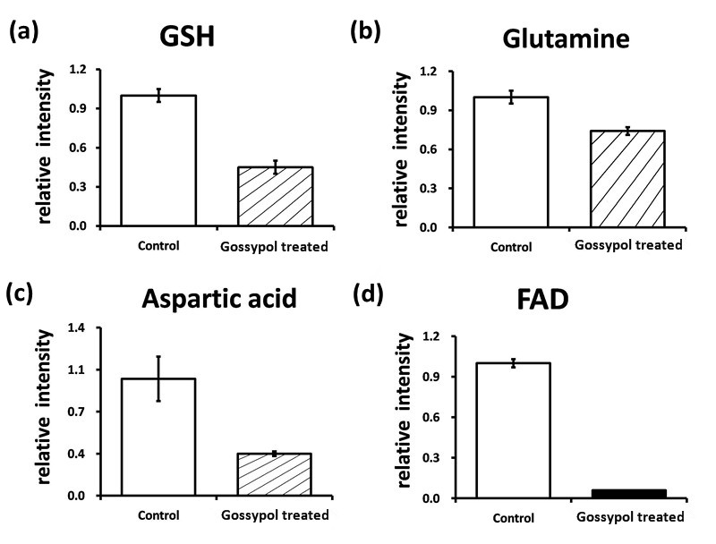

Slide 11
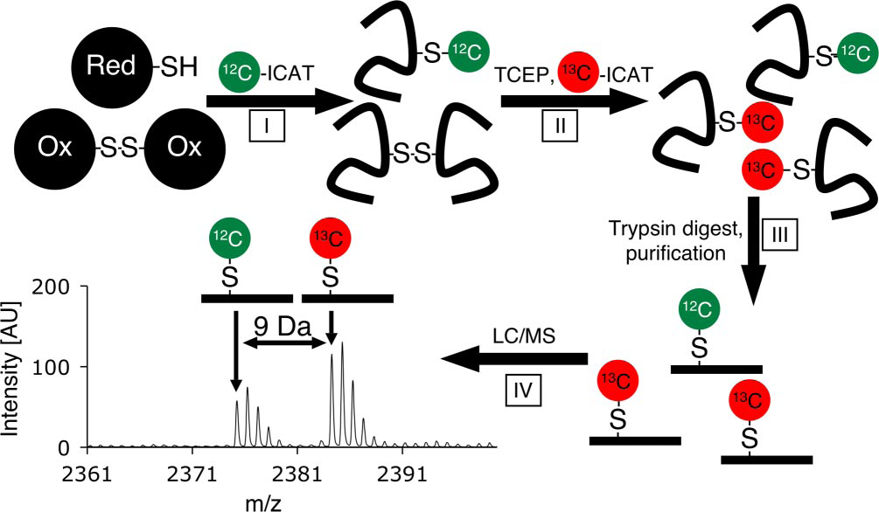
Redox Proteomics Analysis of Gossypol-treated Cells
Leichert et al., PNAS 2008, 105, p8199

Slide 12
Redox Proteomics Analysis of Gossypol-treated Cells
1723 carboxymethylated peptides
Changes of 545 cysteine-containing peptides from 356 proteins
Quantitatio is quite time-consuming
120 unique ICAT-modified peptides with an ion-score of 95% or higher with cICAT

Slide 13
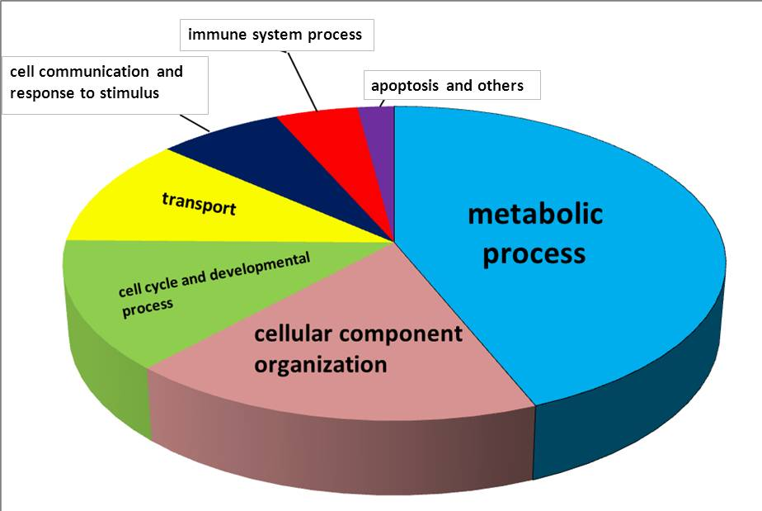
Functional Classification of Differentially Regulated Proteins with PANTHER

Slide 14
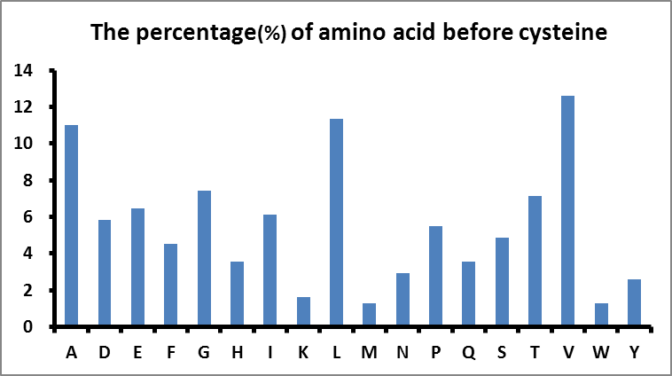
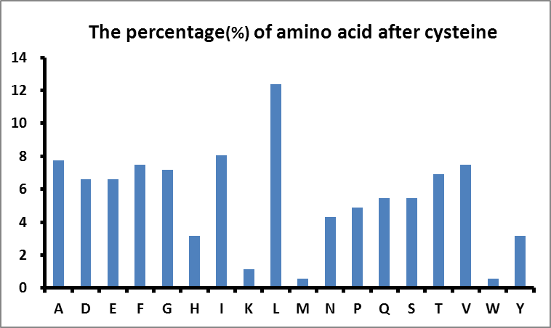
The Occurring Frequency of Amino Acids
Immediately Before or After the Cysteine Residue

Slide 15
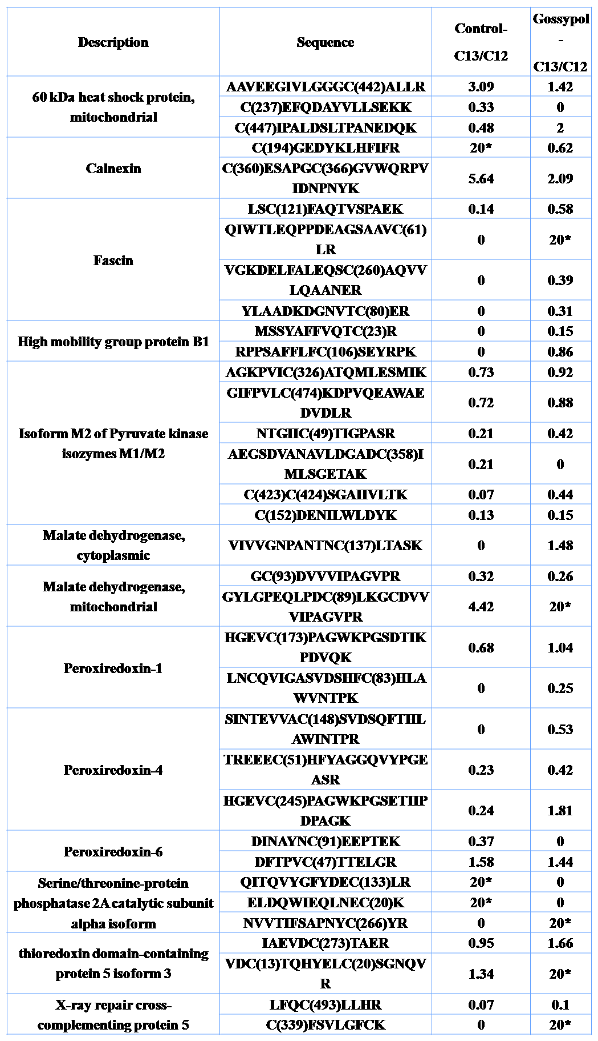
Changes of Redox States of Specific Cysteine Residues

Slide 16
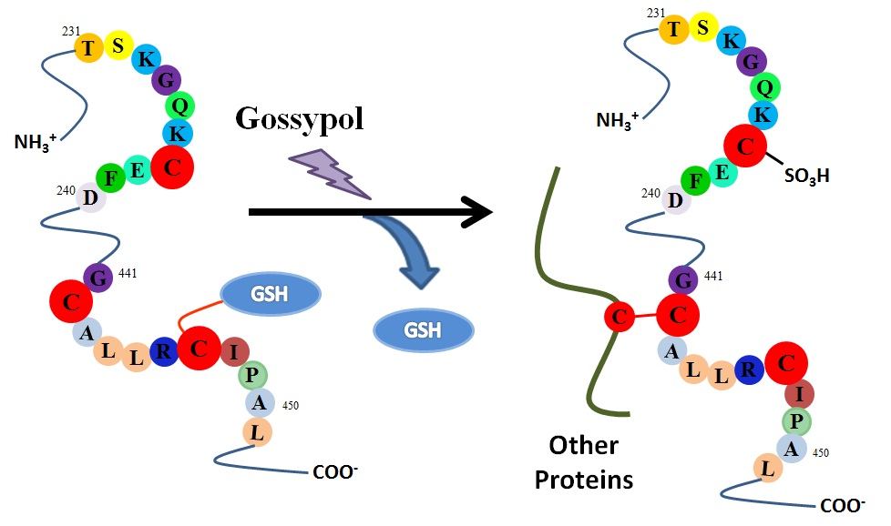
Changes of Redox States of HSP60

Slide 17
Complexes of Flag-tagged HSP60 in 293T Cells Under Reducing and Non-Reducing Conditions
HSP90
HSP70
HSP60
？

Slide 18
Dimitrios Anastasiou et al. Science 334, 1278 (2011);

Slide 19
Effects of ROS on Warburg Effect

Slide 20
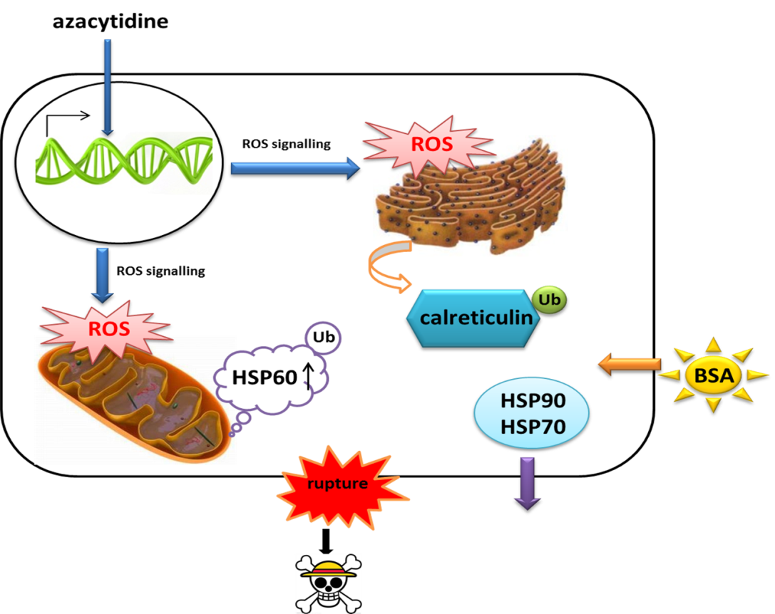
Challenges in Redox Biology
ROS Production and Localization
Signal Transduction
Characterization of Low Abundance Regulatory Proteins

Slide 21
214,000 Cysteine Residues in Human Proteome with Different Oxidations
Physiological
Pathological
Reversible Signaling
Irreversible Damage
Pr-Cys-SH
Pr-Cys-SO₃H
Pr-Cys-SO₂H
Pr-Cys-SOH
Pr-Cys-S-SG
Pr-Cys-SNO
ROS

Slide 22
Acknowledgments
Tang, Haiping
Chen, Yuling
Wang, Jia
Miao Di
Liu, Jieyuan
Gao, Yan
Xie, Yuping
Zou, Haijie

