Slide 1

Data integration across omics landscapes
Bing Zhang, Ph.D.
Department of Biomedical Informatics
Vanderbilt University School of Medicine
bing.zhang@vanderbilt.edu

Slide 2




Omics data integration
DNA
Elephant
mRNA
Protein

Slide 3
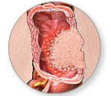

Informatics approaches to integrate genomic and proteomic data
Technology
Data Type
Genomic data
Exome Sequencing
RNA-Seq
Mutations
The Cancer Genome Atlas
Exome Sequencing
RNA-Seq
Sequence variants
Genome
arrayCGH, SNP Array
CNV
TCGA
Improved proteomic data analysis
SNP Array
LOH
EG
Methylation Array
DNA Methylation
Array, RNA-Seq
Exon expression
Genomic data
Proteomic data
Transcriptome
RNA-Seq
Junction expression
CPTAC
Array, RNA-Seq
Gene expression
MS/MS
Protein expression
Proteome
Novel biological insights
MS/MS, protein arrays
Protein PTM
Clinical Proteomic Tumor Analysis Consortium

Slide 4
Informatics approaches to integrate genomic and proteomic data
Using genomic data to improve proteomic data analysis
  Project 1. customProDB: generating customized protein databases to enhance protein identification in shotgun proteomics
  Project 2. NetWalker: prioritizing candidate gene lists for targeted MRM analysis
Integrating genomic and proteomic data to gain novel biological insights
  Project 3. miRNA-mediated regulation: understanding post-transcriptional mechanisms regulating human gene expression
  Project 4. NetGestalt: viewing and correlating cancer omics data within a biological network context

Slide 5
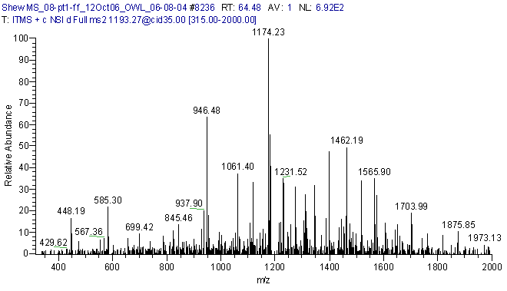
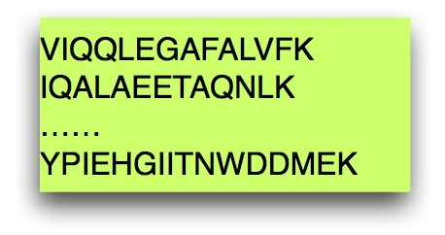
customProDB: motivation
Proteins with sequence variation
Unexpressed proteins
Expressed proteins
commonly used database
Database search

Slide 6
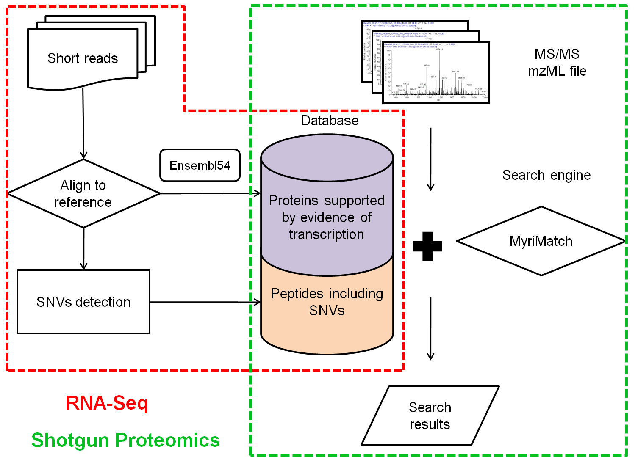

Customized protein database from RNA-Seq data
Increased sensitivity
Reduced ambiguity
Variant peptides
Wang et al., J Proteome Res, 2012

Slide 7
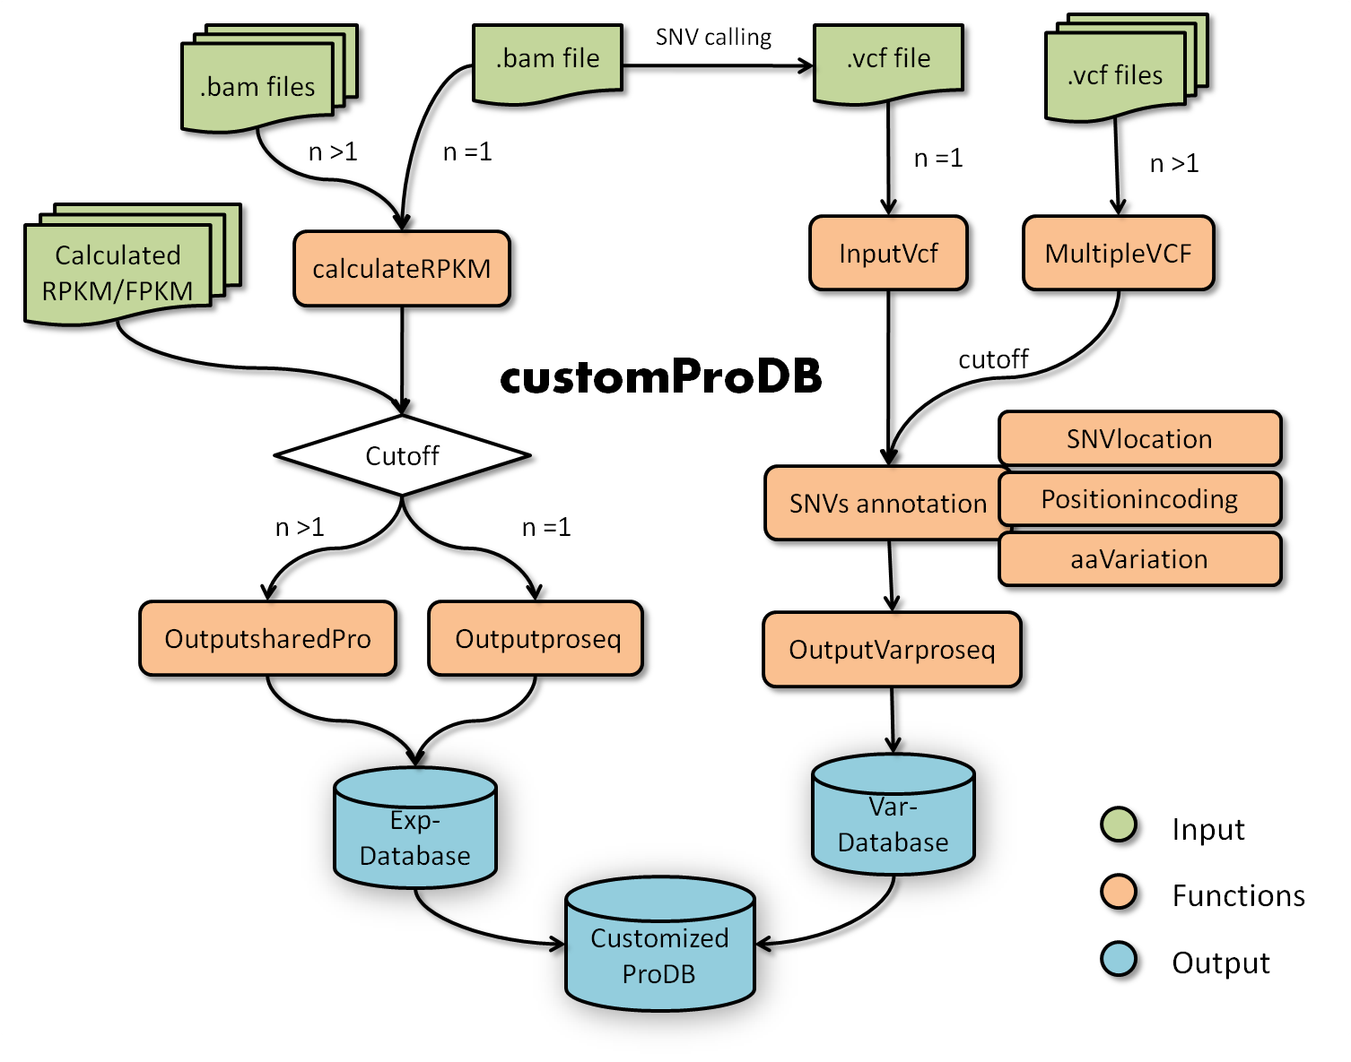
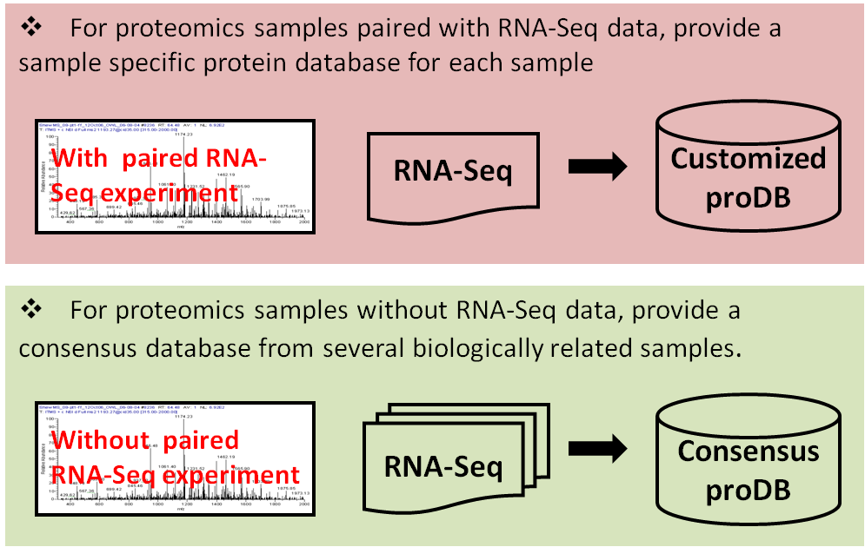
CustomProDB: moving forward
R package
Compatible with both DNA and RNA sequencing data
Sample specific database and consensus database
Application to the CPTAC project
Spectral library
Wang et al., manuscript in preparation

Slide 8
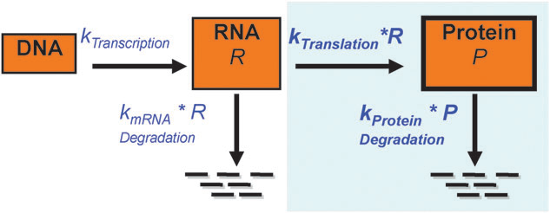


miRNA regulation: motivation
Inverse correlation
mRNA expression
mRNA decay
miRNA expression
Protein/mRNA ratio
Translation repression
Protein expression
Combined effect

Slide 9
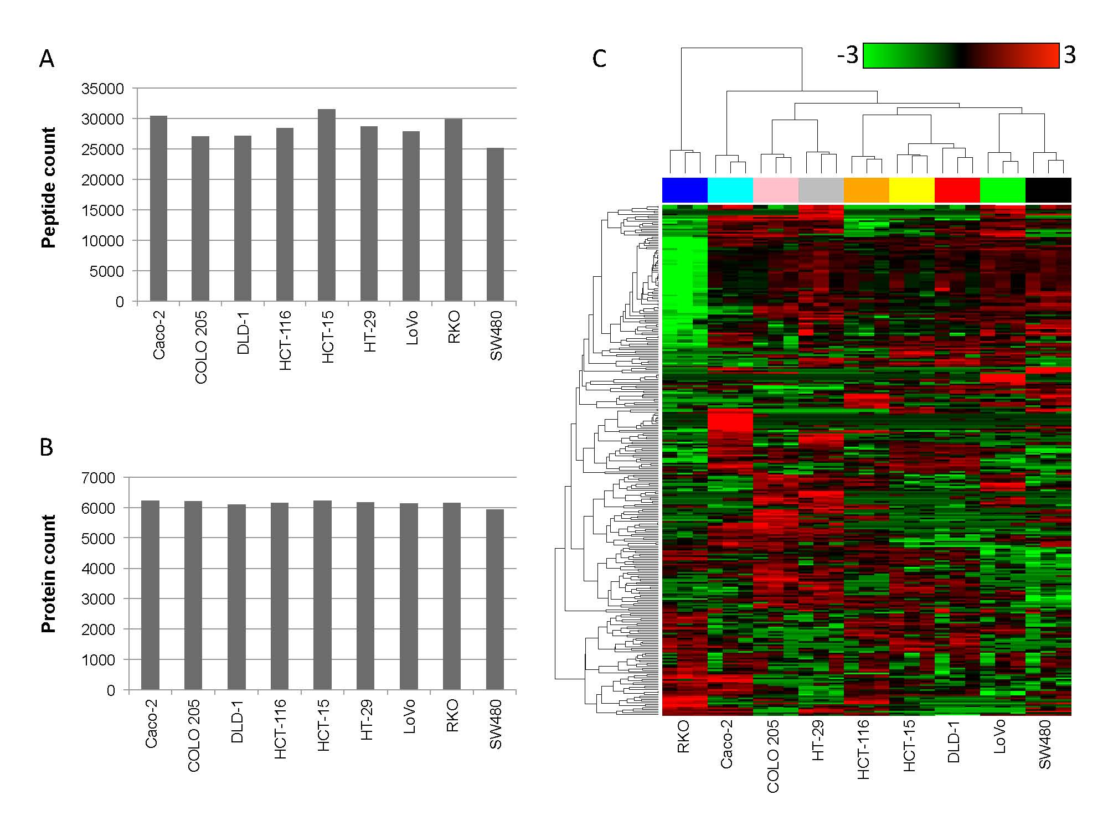
miRNA regulation: data preparation
9 colorectal cancer cell lines
Protein expression data: Current study
mRNA expression data: GSE10843
miRNA expression data: GSE10833

Slide 10

miRNA regulation: data analysis workflow
Liu et al., manuscript in preparation

Slide 11
miRNA regulation: mRNA decay or translational repression?
Early studies suggest a major role of translational repression
  Olsen et al. Dev Biol, 1999; Zeng et al., Molecular Cell, 2001
Recent large-scale studies suggest a predominant role of mRNA decay
  Baek et al., Nature, 2008; Selbach et al., Nature, 2008; Guo et al., Nature, 2010
Our study suggested equally important roles of mRNA decay and translational repression
  Translational repression was involved in 58% and played a major role in 30% of all predicted miRNA-targeted interactions
  Most miRNAs exert their effect through both mRNA decay and translational repression
  Sequence features known to drive site efficacy in mRNA decay were generally not applicable to translational repression

Slide 12
miR-138 prefers translational repression

Slide 13
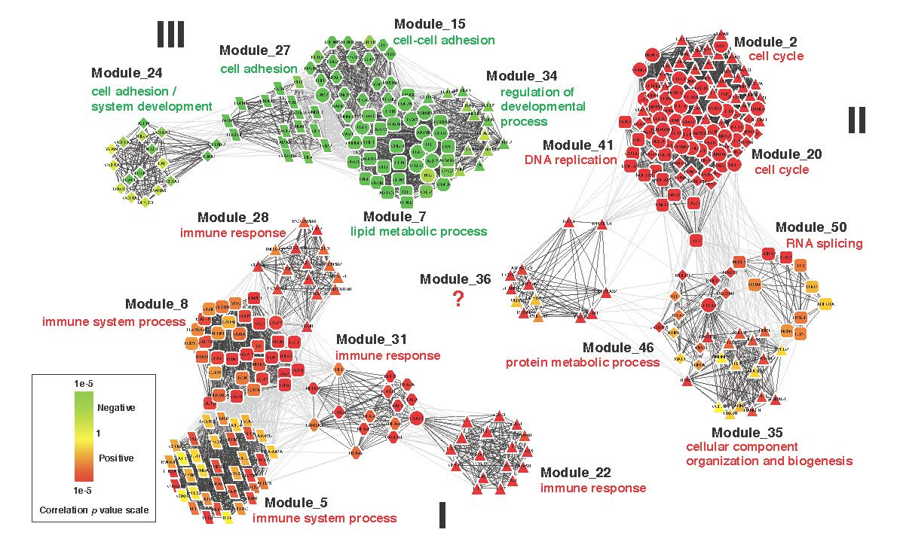
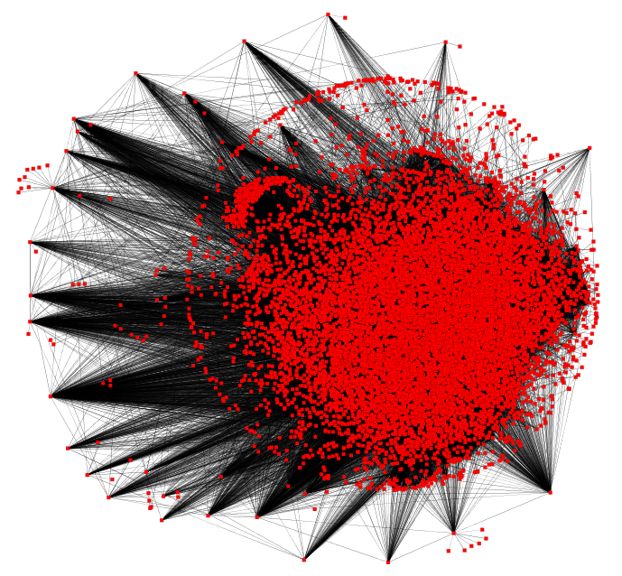
NetGestalt: motivation
DNA
mutation
methylation
Network
mRNA
expression
splicing
Protein
expression
modification
Phenotype

Slide 14
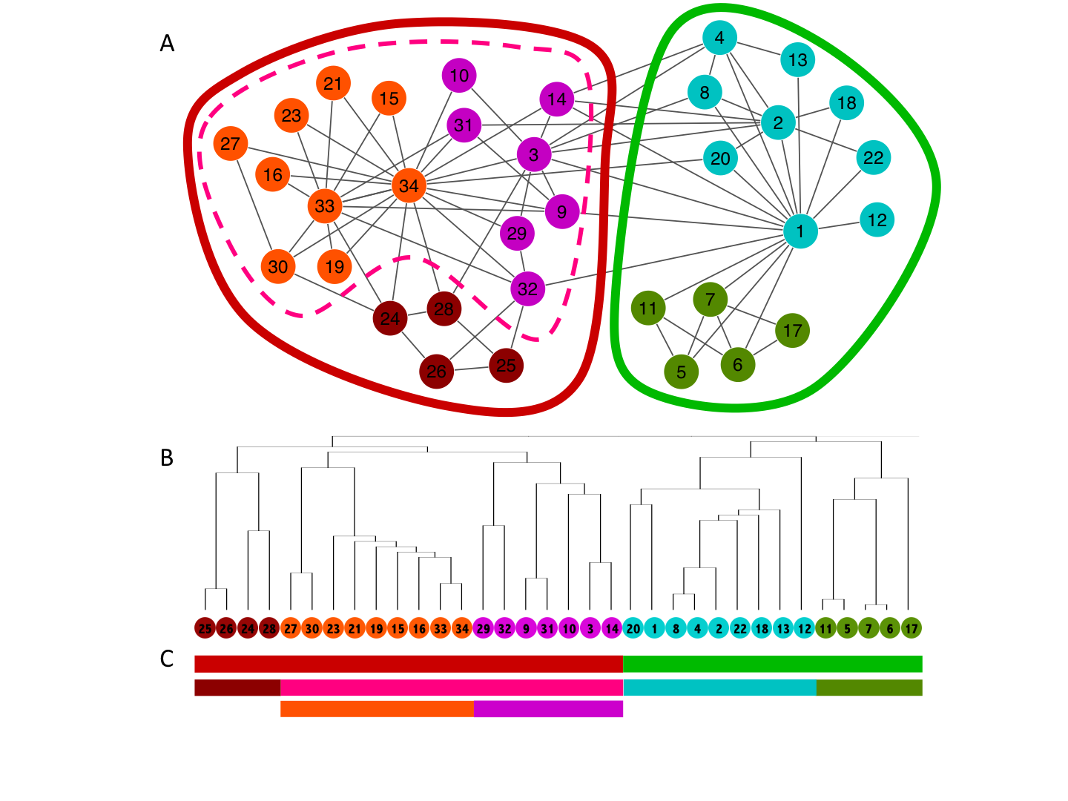
NetGestalt: scalable network representation
Proteins
3
2
1
0
Total number of modules (size >30): 92
Functional homogeneity: 63 (69%)
Spatial homogeneity: 55 (60%)
Dynamic homogeneity: 69 (75%)
Homogeneity of any type: 82 (89%)

Slide 15
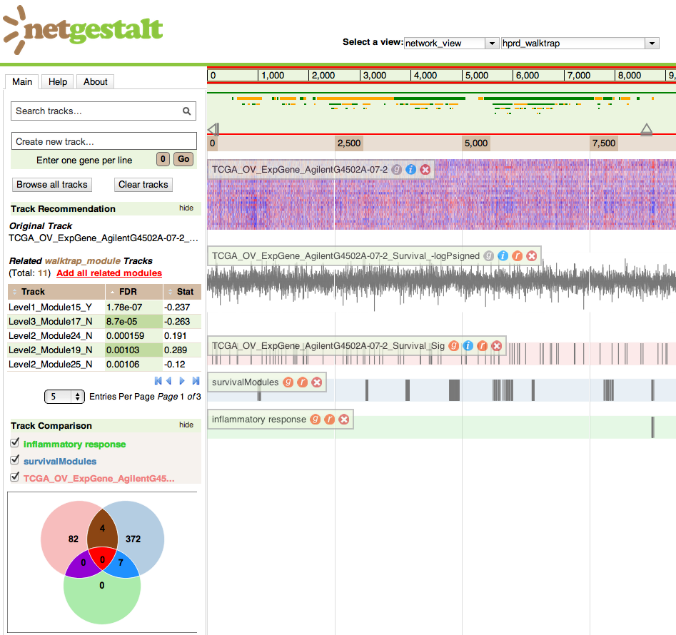
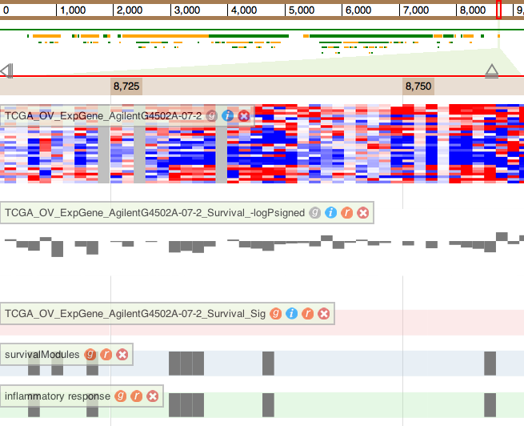
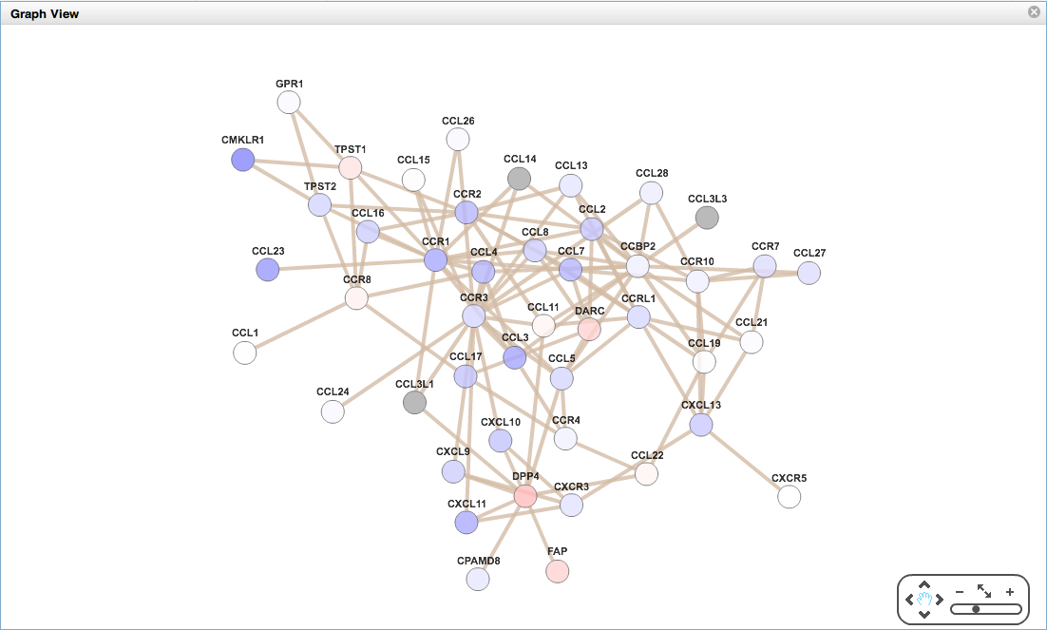


NetGestalt: viewing and cross-correlating data
Viewing data as tracks
  Heat map (e.g. gene expression data)
  Bar chart (e.g. fold changes, p values)
  Binary track (e.g. significant genes, GO)
Comparing binary tracks
  Clickable Venn diagram
Enrichment analysis
  Network modules
  GO terms
  Pathways
Navigating at different scales
  Zoom
  Pan
  2D graph visualization
Shi et al., manuscript under revision

Slide 16
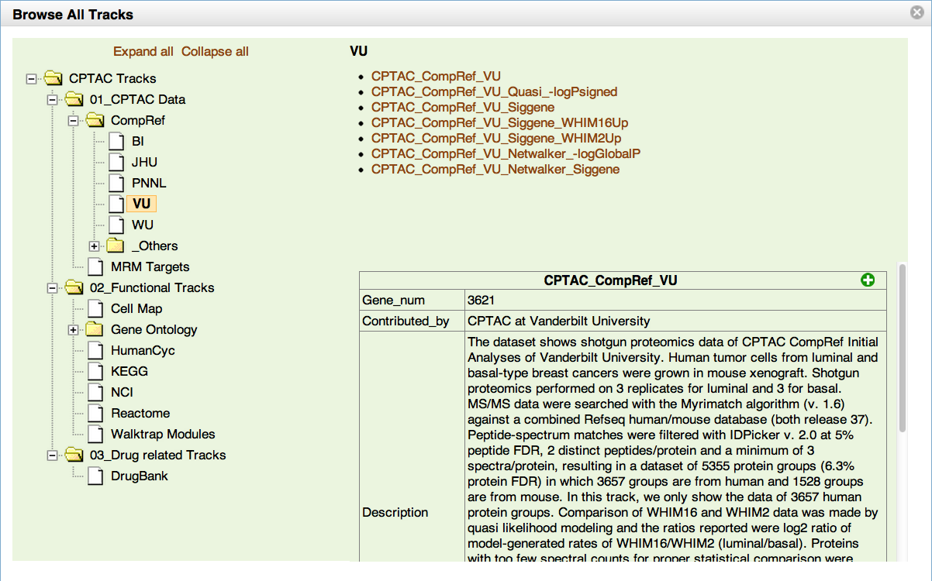
Browsing data sources
Viewing data as tracks
Comparing tracks
Identifying modules
Moving across scales
Annotating modules

Slide 17
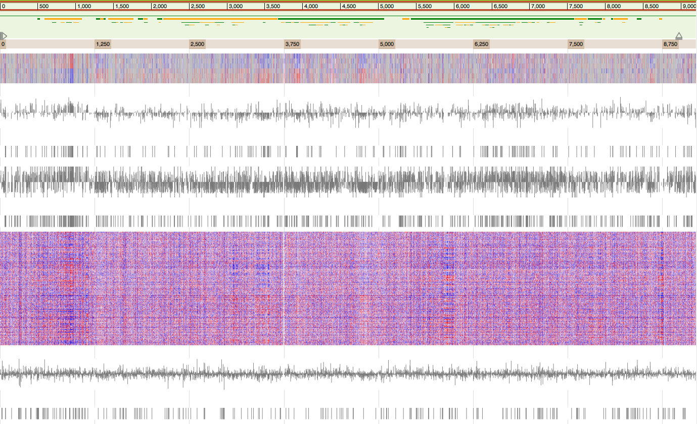
Browsing data sources
Viewing data as tracks
Comparing tracks
Identifying modules
Moving across scales
Annotating modules
Ruler
Network modules
Luminal B
Basal
-log(p) signed
Vandy
Diff proteins
Proteomics
-log(p) signed
PNNL
Diff proteins
Luminal B
TCGA
Basal
Microarray
-log(p) signed
Diff genes
Notes:
Differential genes tend to cluster on the network
Similar patterns observed in the Vandy and PNNL results

Slide 18
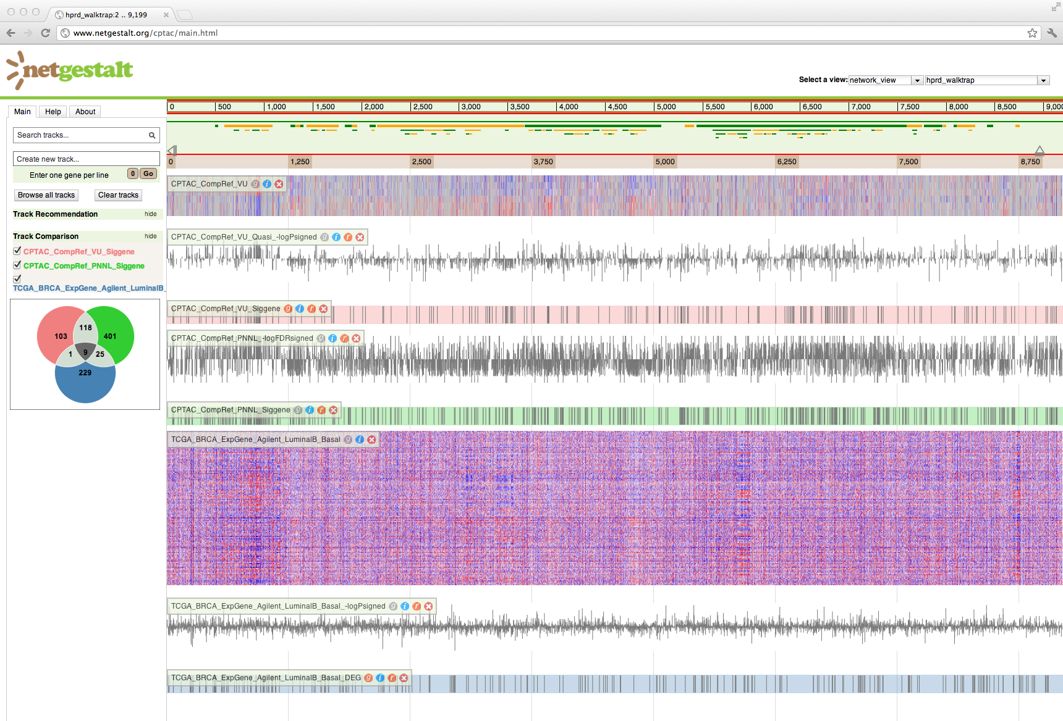
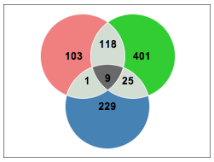
Browsing data sources
Viewing data as tracks
Comparing tracks
Identifying modules
Moving across scales
Annotating modules
Ruler
Network modules
Luminal B
Basal
-log(p) signed
Vandy
Diff proteins
Proteomics
51%
-log(p) signed
45%
PNNL
Diff proteins
4%
Luminal B
0%
TCGA
Basal
Microarray
-log(p) signed
Diff genes
Notes:
Low level of overlap at individual gene/protein level

Slide 19
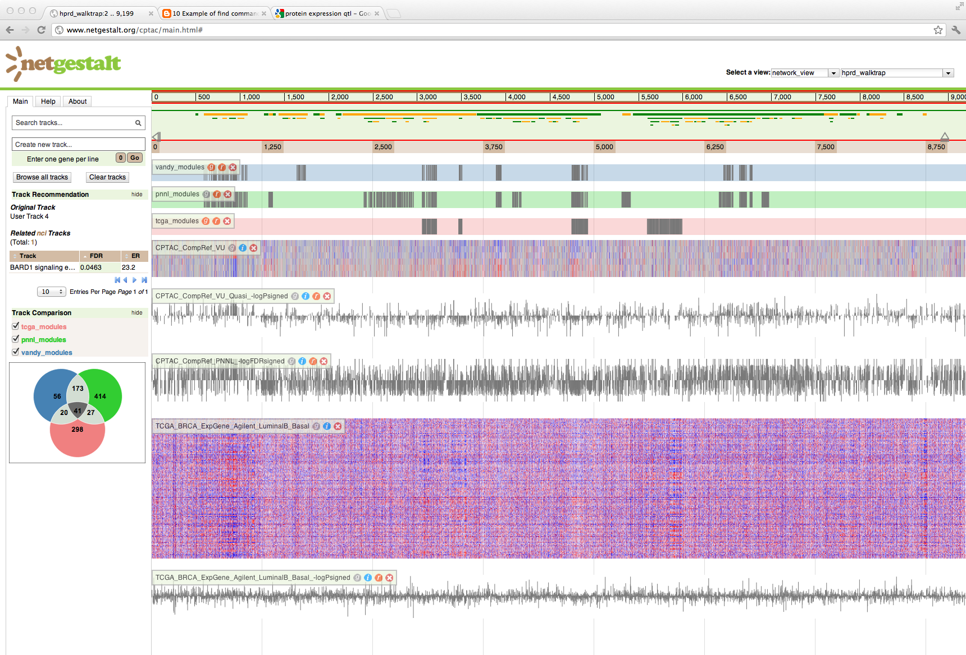
Browsing data sources
Viewing data as tracks
Comparing tracks
Identifying modules
Moving across scales
Annotating modules
Ruler
Network modules
Vandy
Enriched Modules
PNNL
Microarray
Luminal B
Basal
-log(p) signed
-log(p) signed
Luminal B
Basal
-log(p) signed
Notes:
Increased overlap at the module level.
Three out of the four microarray modules were found by proteomics
All except for one vandy modules were supported by either PNNL or microarray

Slide 20
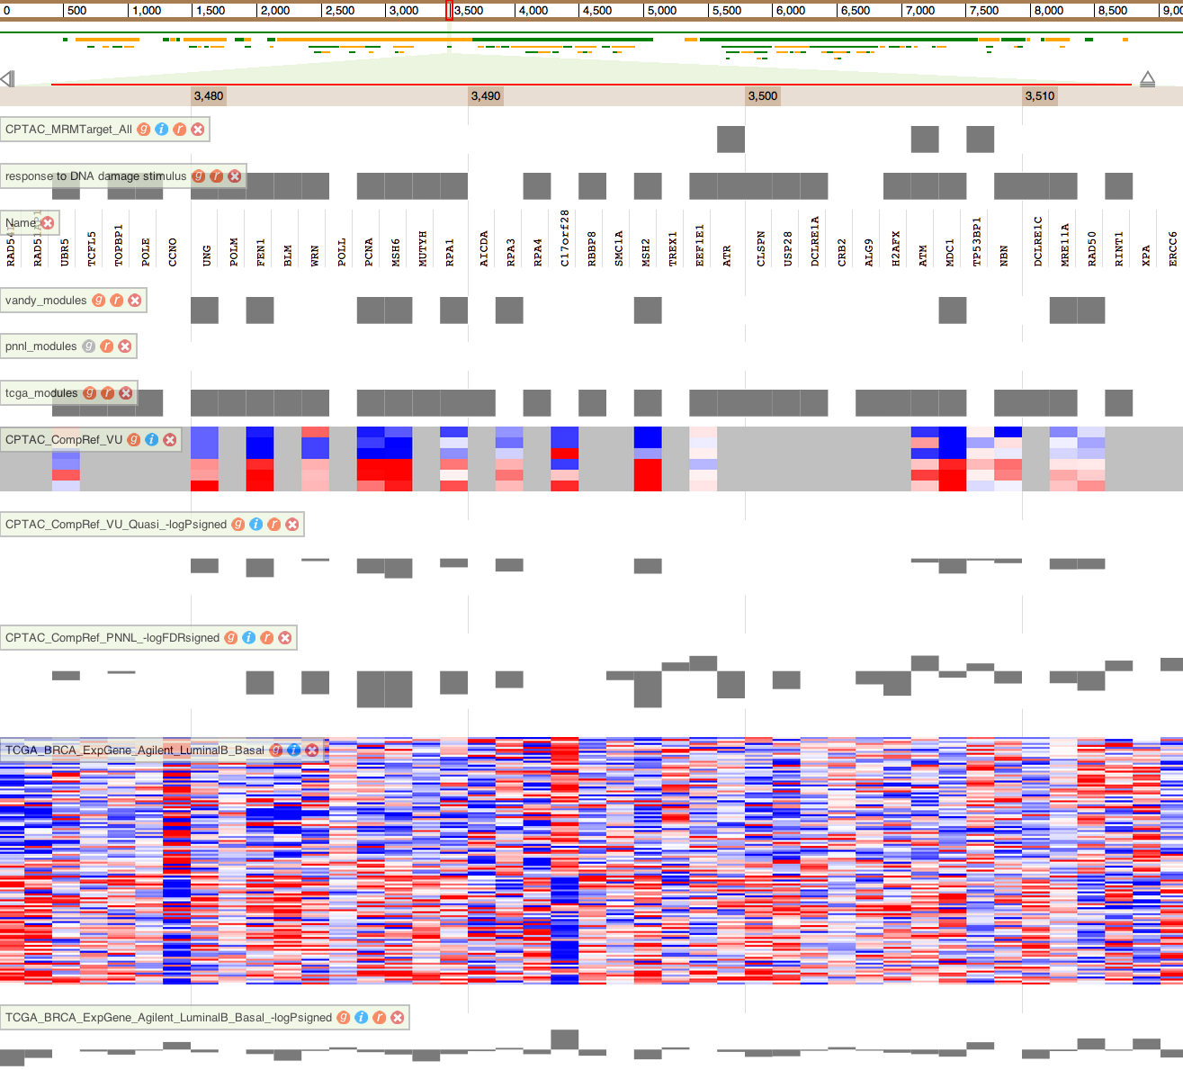
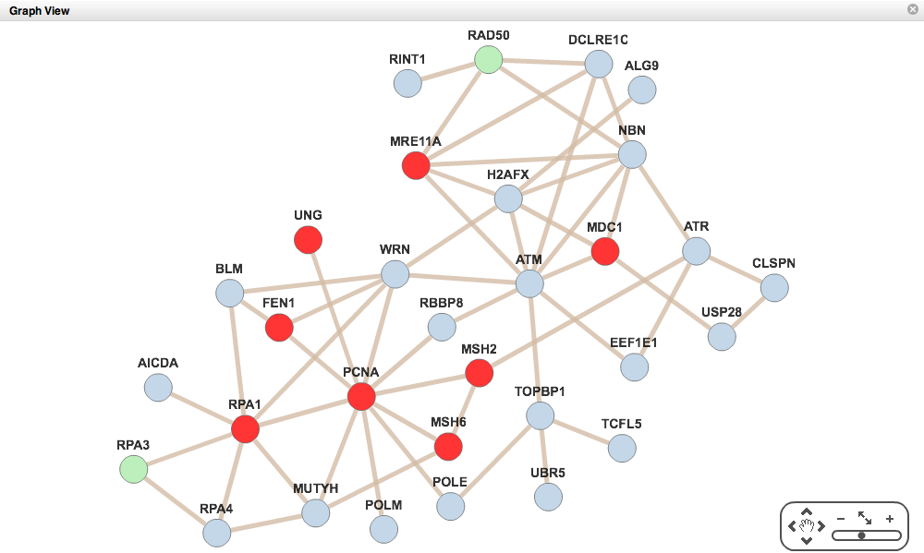
Browsing data sources
Viewing data as tracks
Comparing tracks
Identifying modules
Moving across scales
Annotating modules
Ruler
Network modules
MRM targets
DNA damage response
Gene symbol
Vandy
PNNL
Enriched Modules
Microarray
Luminal B
Basal
-log(p) signed (Vandy)
-log(p) signed (PNNL)
Luminal B
Basal
-log(p) signed
Notes:
A close look of the module identified by Vandy and microarray but not PNNL suggests high consistency between vandy and PNNL observations

Slide 21
Browsing data sources
Viewing data as tracks
Comparing tracks
Identifying modules
Moving across scales
Annotating modules
Ruler
Network modules
MRM targets
DNA damage response
Gene symbol
Vandy
PNNL
Enriched Modules
Microarray
Luminal B
Basal
-log(p) signed (Vandy)
-log(p) signed (PNNL)
Luminal B
Basal
-log(p) signed
Notes:
This module is related to DNA damage response. Only three CPTAC MRM targets are in this module, and ATR might be a good candidate based on PNNL data.

Slide 22
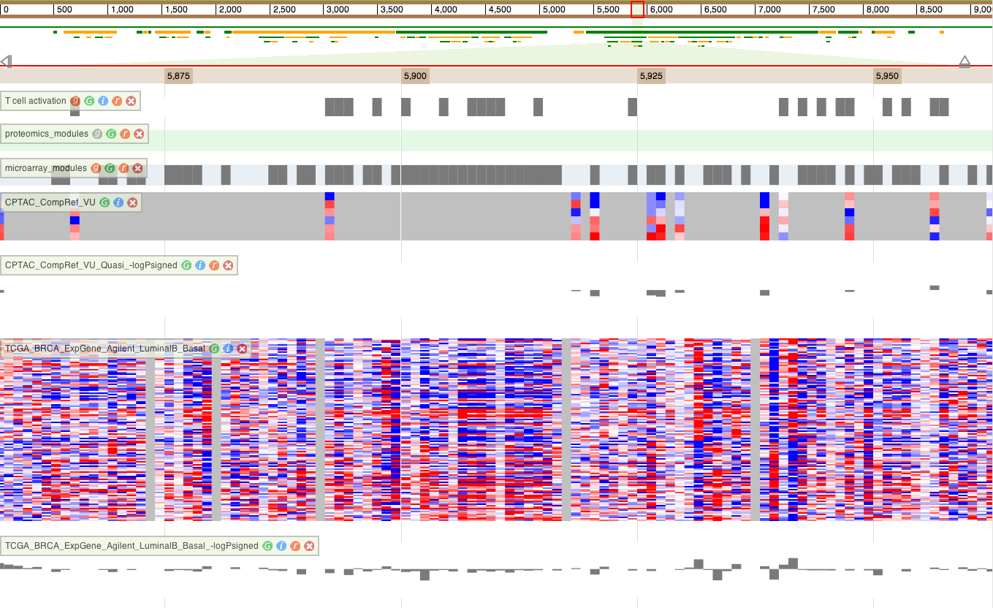
Browsing data sources
Viewing data as tracks
Comparing tracks
Identifying modules
Moving across scales
Annotating modules
Ruler
Network modules
T cell activation
Proteomics
Enriched Modules
Microarray
Luminal B
Basal
Proteomics
-log(p) signed
Luminal B
Basal
Microarray
-log(p) signed
Notes:
The module identified by microarray but not proteomics is related to T cell activation. Most of the highly differentially expressed genes were not detected in proteomics. Is this a difference between protein and mRNA or human tumor and xenograft?

Slide 23
Informatics approaches to integrate genomic and proteomic data
Using genomic data to improve proteomic data analysis
  Project 1. customProDB: generating customized protein databases to enhance protein identification in shotgun proteomics
  Project 2. NetWalker: prioritizing candidate gene lists for targeted MRM analysis
Integrating genomic and proteomic data to gain novel biological insights
  Project 3. miRNA-mediated regulation: understanding post-transcriptional mechanisms regulating human gene expression
  Project 4. NetGestalt: viewing and correlating cancer omics data within a biological network context

Slide 24

Acknowledgement
Qi Liu
Jing Wang
Xiaojing Wang
Jing Zhu
Dan Liebler
Rob Slebos
Dave Tabb
Zhiao Shi
Funding:
NIGMS R01GM088822
NCI U24CA159988
NCI P50CA095103

