Slide 1


An Integrated High-throughput Workflow for Identification of Crosslinked Peptides
Bing Yang
National Institute of Biological Sciences, Beijing
Yan-Jie Wu
Institute of Computing Technology,
Chinese Academy of Sciences
CNCP 2012, Beijing

Slide 2
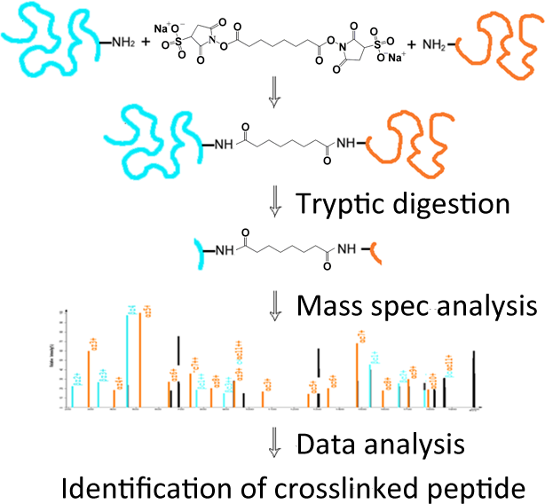
CXMS: Chemical Crosslinking coupled with Mass Spectrometry

Slide 3
Advantages of CXMS
Identify direct binding proteins
P2
P3
P1, P2, P3 can co-IP with the bait by either direct or indirect interaction
P1
bait
Crosslinking of P1 and the bait,
if detected, suggests direct binding
antibody
beads

Slide 4
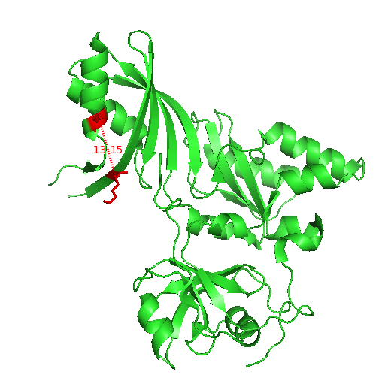
Advantages of CXMS
Identify direct binding proteins
Study protein folding

Slide 5
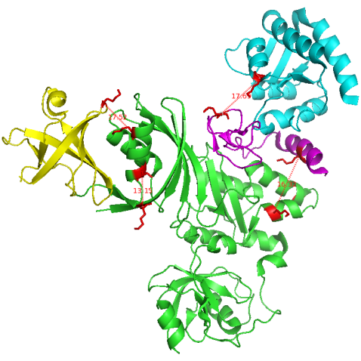
Advantages of CXMS
Identify direct binding proteins
Study protein folding
Analyze protein complex assembly

Slide 6




Major Challenges
Crosslinked samples are extremely complex
Normal sample
Regular
Crosslinked sample
Regular
Mono-linked (Type 0)
Loop-linked (Type 1)
Inter-linked (Type2)

Slide 7
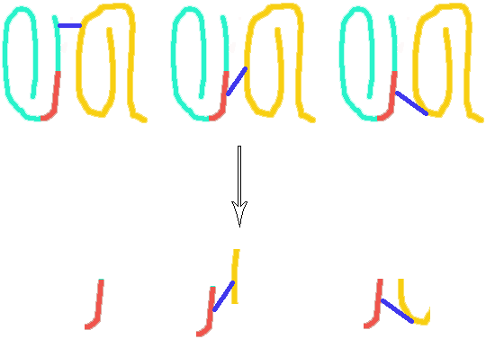
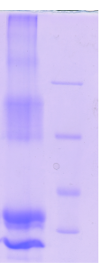
Major Challenges
Low abundance of Inter-linked peptides
Trypsin digestion
116KD
CDK9/Cyclin T1
66.2KD
45KD
CDK9
35KD
Cyclin T1
many a few a few

Slide 8
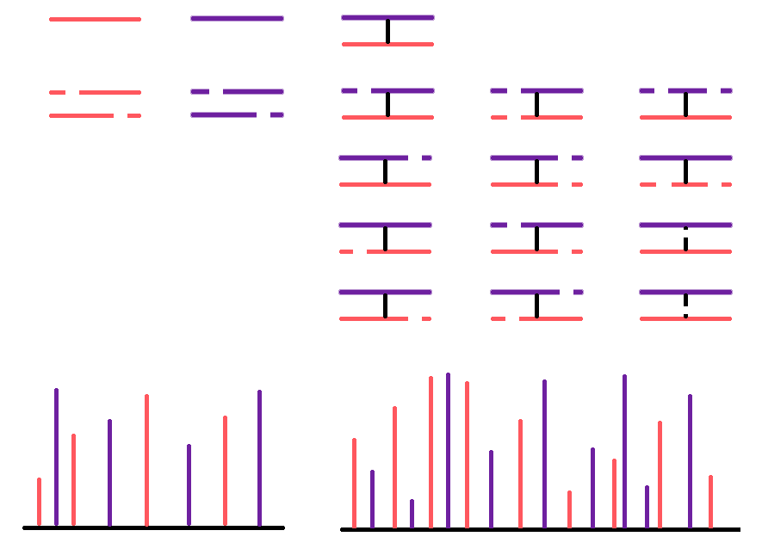
Major Challenges
Highly complex MS2 spectra
Regular peptides
Crosslinked peptides

Slide 9
Major Challenges
Database can be huge
If the routine search space is 100 peptides,
the crosslink search space is 5,050 pairs.
Database | Proteins | Peptides | Peptide Pairs
E. coli | 6126 | 3.35*10⁵ | 5.63*10¹⁰(10⁴ times the human db)
C. elegans | 24652 | 1.18*10⁶ | 6.96*10¹¹

Slide 10
Major Challenges
Crosslinked samples are extremely complex
Low abundance of Inter-linked peptides
Highly complex MS2 spectra
Database can be huge
Difficult to estimate false discovery rates
Limited software

Slide 11
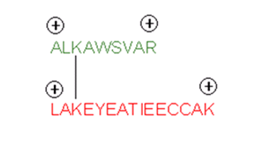
Overcome the Challenges in CXMS
Crosslinked samples are extremely complex
Low abundance of Inter-linked peptides
Select only ≥ +3 charged precursors for MS2

Slide 12
Overcome the Challenges in CXMS
Highly complex MS2 spectra
Huge database
Difficult to estimate false discovery rates
Limited software
Collaborating with the pFind group of ICT, we developed pLink specifically for CXMS data analysis.

Slide 13
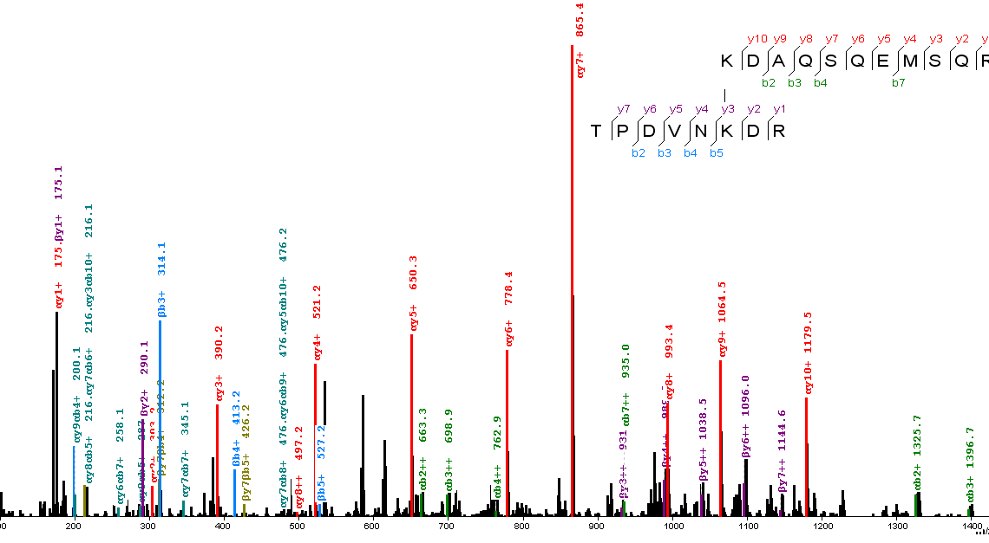
pLabel is Developed to Annotate Crosslink Spectra

Slide 14
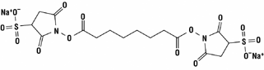
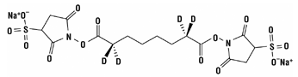
Generating a Standard Dataset for the pLink Software
Synthesized 38 peptides, X…X-K-X…X(K/R), each 5-28 aa long
Crosslinked all possible peptide pairs–741 in total–with an amine specific crosslinker BS3
Light BS3 d0
Heavy BS3 d4

Slide 15

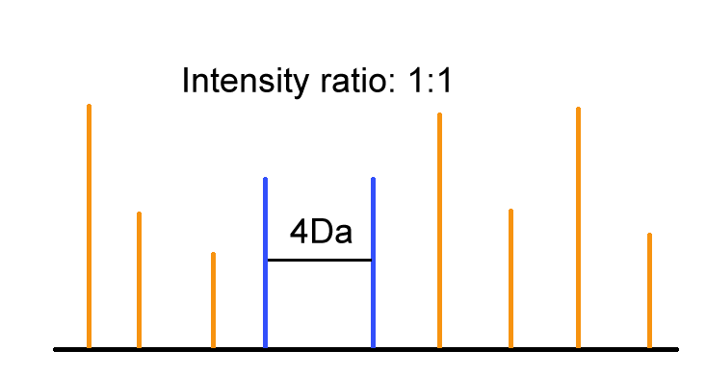
Isotope-coding Helps Recognize Peptides Carrying the Cross-linker
H
H
D
D
H
H
D
D
Light Linker (L)
Heavy Linker (H)
Proteins
Crosslink with L/H (1:1)
Digestion and LC-MS
Xlinked peptides
L/H Intensity ratio 1:1

Slide 16
Generating a Standard Dataset for the pLink Software
Synthesized 38 peptides, X…X-K-X…X(K/R), each 5-28 aa long
Crosslinked all possible peptide pairs–741 in total–with an amine specific crosslinker BS3
Each reaction was analyzed in a 35-min reverse phase LC-MS/MS experiment.
2077 pairs of crosslinked peptides, including isoforms, were identified from HCD spectra.

Slide 17
Each Peptide Pair can be Crosslinked into Different Isoforms

Slide 18
Most Prominent Ions in the HCD Spectra of Crosslinked Peptides
From 2077 Spectra, in descending order of prominence:
y1+
y2+
b1+
yb1+ (including α_{b}β_{y}, α_{y}β_{b}, α_{b}α_{y}, β_{b}β_{y})
b2+
ya1+ (including α_{a}β_{y}, α_{y}β_{a}, α_{a}α_{y}, β_{a}β_{y})
a1+
y3+
αL/βL (α or β with a cleaved linker attached)
b3+
a2+
KLα/KLβ (α or β linked to the immonium ion of K)

Slide 19
Most Prominent Ions in the HCD Spectra of Crosslinked Peptides
Ion types specific for crosslinked peptides
yb1+ (including α_{b}β_{y}, α_{y}β_{b}, α_{b}α_{y}, β_{b}β_{y})
ya1+ (including α_{a}β_{y}, α_{y}β_{a}, α_{a}α_{y}, β_{a}β_{y})
αL/βL (α or β with a cleaved linker
KLα/KLβ (α or β linked to the immonium ion of K)

Slide 20
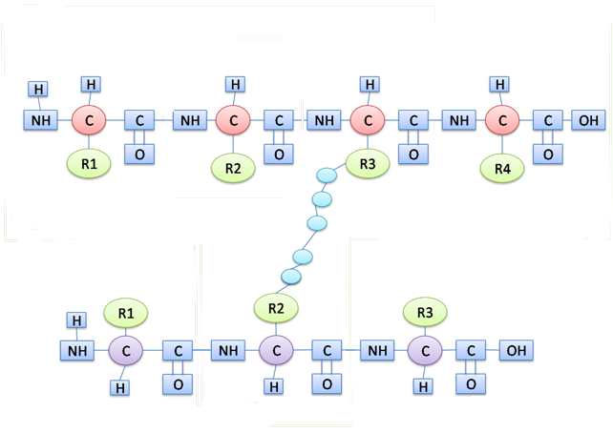
Examples of yb Ions
α_{b3}β_{y2}
α_{b3}α_{y2}

Slide 21
αL or βL Ions
αL3
βL2

Slide 22
KLα/β: K-linked α or β Ions
β_{a2}β_{y2} /KLα

Slide 23
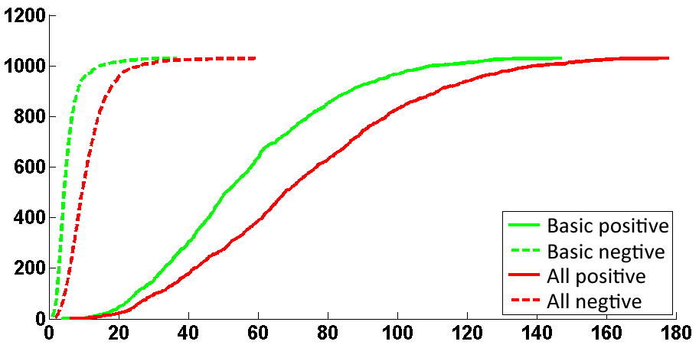
Considering New Ion Types Improved Scoring
In pLink, the scoring function for spectrum-peptide matching is based on the Kernel Spectral Dot Product (KSDP) algorithm developed by Fu et al. in 2004 (the pFind search engine).
#of spectra
–Log₁₀ (E-value)
Experiment | Theoretical ion types
Basic | b1+,b2+,y1+,y2+,a1+,a2+
All | b1+, b2+, y1+,y2+, a1+,a2+, yb1+, ya1+, K^{Lα}(K^{Lβ}),αL(βL) 1+ and αL(βL) 2+

Slide 24
The Open-search Mode for Large Databases
K
K
Open Database Search
K
K
K
…
K
PreScore against peptides w/ mass < precursor
Treat Δmass as modification on K
Pep mass (w/o modification)
≥ or ≤ 0.5*precursor?
Fine scoring against the candidate pairs
≥
≤
α peptides
β peptides
Pair up top 500 α and β peptides:
α + β + linker = precursor
K
K
K
K
…
…
K
K

Slide 25
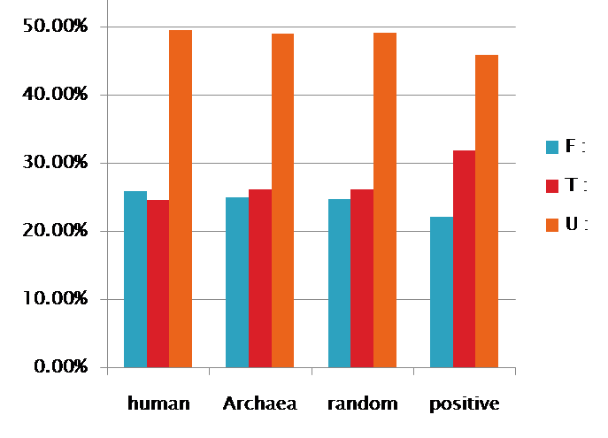
False Discovery Estimation Based on a Modified Reverse Database Strategy
T
U
F
+
Crosslink in silico
F-F
F-R
R-F
R-R
F
R
Randomly matched spectra fall into T, U, and F at a 1:2:1 ratio
No correct seq in DB
Correct seq added & matches to T increased
25.0 %

Slide 26
False Discovery Estimation Based on a Modified Reverse Database Strategy
T
U
F
+
Crosslink in silico
F-F
F-R
R-F
R-R
F
R
1 : 2 : 1
Among the spectra that match to peptide pairs in T, there are two types of false matches:
Both peptide sequences are wrong
this is estimated by # spectra that match to F (NF), while twice as many (2*NF ) are expected to match to U.
• One peptide correct, the other not
estimated by (Nu – 2*NF )
• So, the total # of false matches = NF + (Nu – 2*NF ) = Nu – NF
FDR = (Nu – NF)/NT

Slide 27
Performance of pLink
at 5% FDR, large dataset + large database
sensitivity >90%
accuracy >95%
specificity >95%

Slide 28
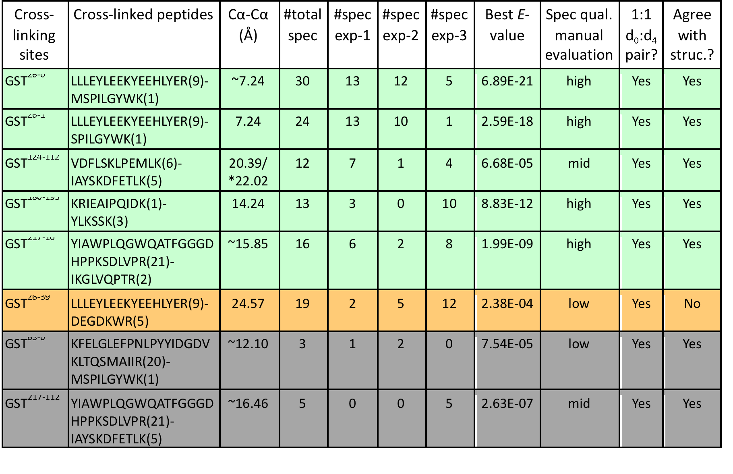
CXMS Analysis of GST

Slide 29
CXMS Result Verified by Crystal Structure
5 out 6 crosslinks are structurally sound (yellow dashed lines)

Slide 30
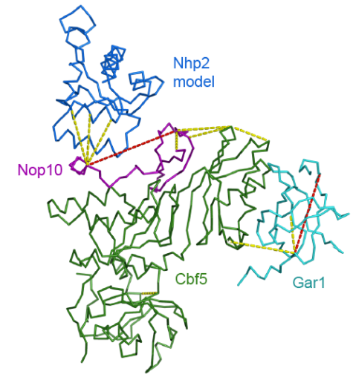
CXMS Helped Confirm the Structure of the CNGP Complex
10 out 12 crosslinks consistent with the structure (yellow lines)

Slide 31
CXMS on a Large Protein Complex of Unknown Structure
UTP-B is a 550 kDa, six-subunit complex involved in ribosome biogenesis, but its structure is unknown.
71 different crosslinked peptide pairs (1337 spectral copies) identified from the purified UTP-B complex
21 between subunits

Slide 32
CXMS Revealed Subunit Interactions within the UTP-B Complex

Slide 33
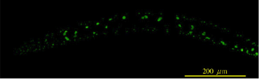

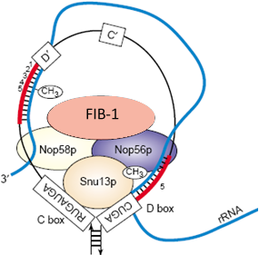
IP with CXMS Identified Direct Binding Proteins of FIB-1
GFP IP + Crosslink
Trypsin Digestion
Mass Spec
FIB-1
MTase
GFP
beads
CD
NTD
CTD
CTD
ce_Nop56
NTD
CD
ce_Nop58
ce_Snu13

Slide 34
CXMS Results Fit Nicely with a Structural Model of the C. elegans FIB-1 Complex

Slide 35
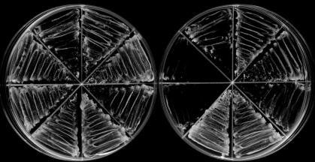
394 Interlinked Peptides were Identified from Crosslinker-treated E. coli Lysate
Inter-molecular
124 (31.5%)
Incompatible
58 (24.5%)
Compatible w/ Structure
179 (75.5%)
Intra-molecular
270 (68.5%)
Structure unavailable
157
5 out of 8 randomly selected inter-molecular crosslinks verified by Y2H
– LW
– LWH
positive control
negative control
AD-AAA97042.1 + BD-NP_416801.2 (#91)
AD-AAC73200.1 + BD-AAC75219.1 (#98)
AD-NP_416518.2 + BD-AAC73708.1 (#115)
AD-YP_026243.1 + BD-AAA58136.1 (#71)
AD-YP_025307.1 + BD-AAA58136.1 (#69)
AD-AAC74522.1 + BD-AAA58136.1 (#70)
4
5
3
6
2
7
1
8

Slide 36
Summary
An integrated workflow to identify crosslinked peptides from a wide range of samples.
Does not require isotope-labeling in crosslinker
Works for K-K, K-C, and K-D/E crosslinks
Ready to use for protein-protein interaction and structural analyses

Slide 37
Acknowledgment
Meng-Qiu Dong (NIBS)
Ming Zhu
Yue-He Ding
Si-Min He (ICT)
Sheng-Bo Fan
Yan-Jie Wu
Kun Zhang
Li-Yun Xiu
Ke-Qiong Ye (NIBS)
Jing-Zhong Lin
Shu-Ku Luo
Shuang Li
She Chen (NIBS)
Andreas Huhmer (Thermo)
Zhiqi Hao
David Horn

