Slide 1
CanProVar 2.0 : Updated Database of Human Cancer Proteome Variation
第二届中国计算蛋白质组学研讨会
CNCP 2012, Beijing
Jing Li
jing.li@sjtu.edu.cn
Department of Bioinformatics& Biostatistics, SJTU
November 2012

Slide 2

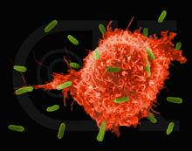
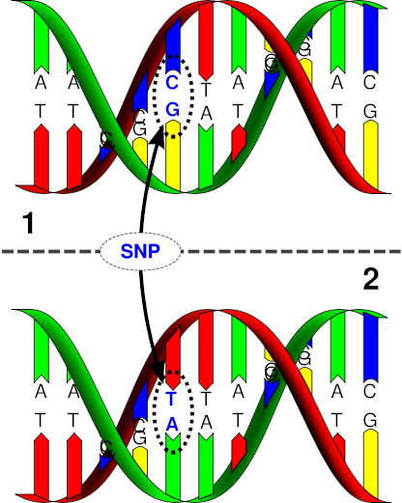
Human Cancer Proteome Variation
Cancer patient
Cancer cell
Sequence abnormality
Non-coding
SNPs
Synonymous
Coding
Nonsynonymous variations ( nsVARs)

Slide 3
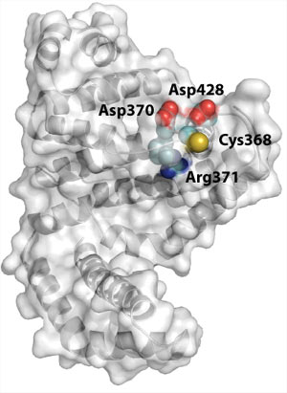
Human Cancer Proteome Variation
Cancer patient
Cancer cell
Sequence abnormality
Proteome Variation

Slide 4

CanProVar
Human Cancer Proteome Variation Database
Aim 1
Store and display single amino acid alterations including both germline and somatic variations in the human proteome, especially those related to the genesis or development of human cancer based on the published literatures and sources.
Aim 2
Build a searchable database with proteome variations for detecting mutant peptide/protein by shotgun proteomics.

Slide 5
Workflow
Database Design
Data Collection & Integration
Data refinement
Database Setup (MySQL)
Web-based interface (HTML &PHP)
Database Applications

Slide 6
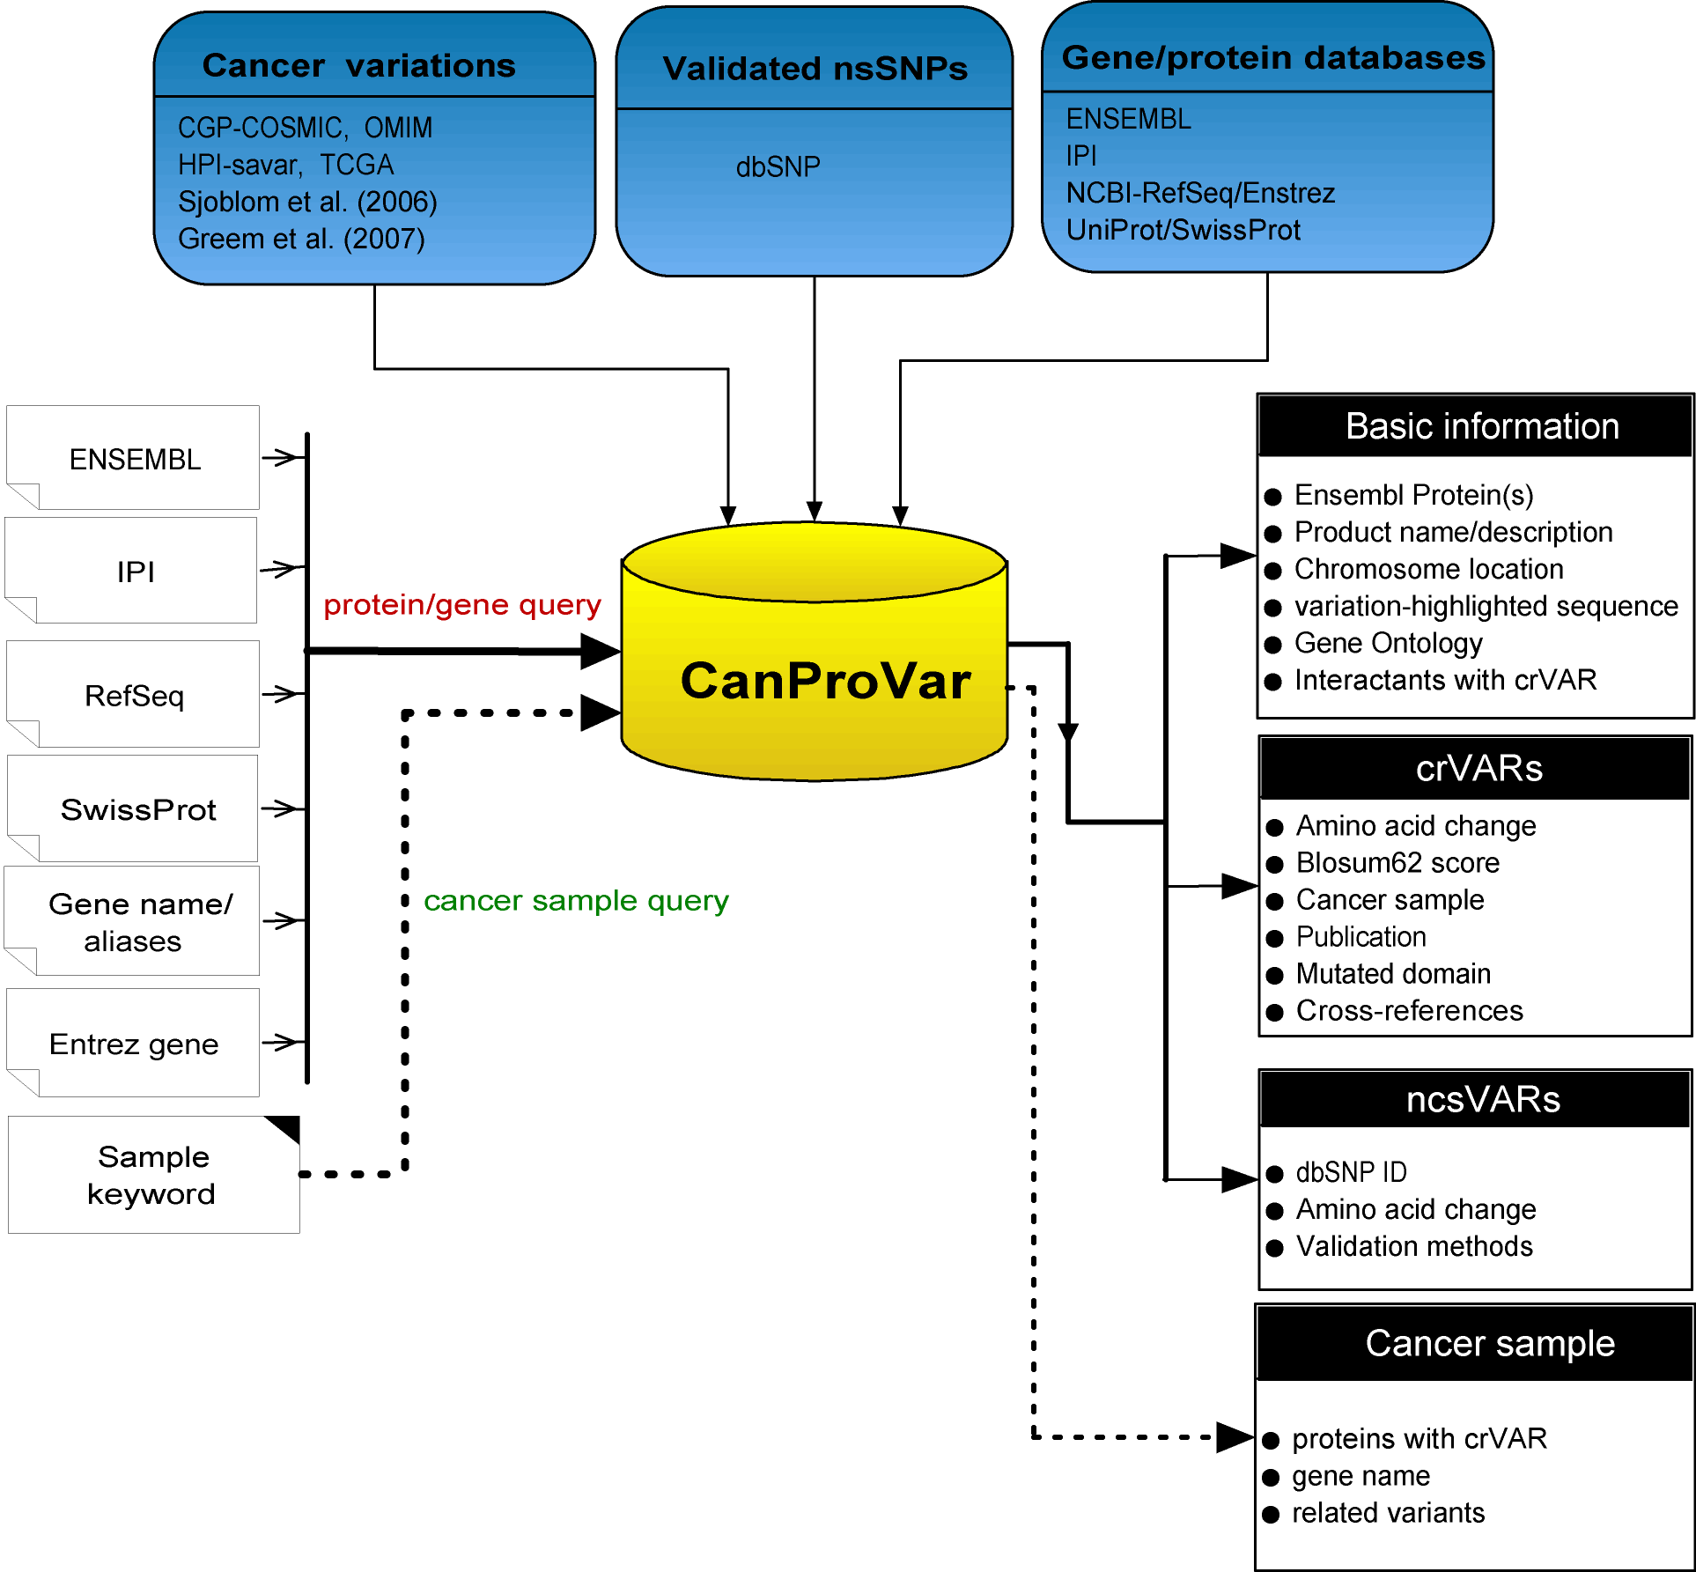
Structure of CanProVar in old version
URL: www.bioinfo.vanderbilt.edu/canprovar
Two query ways: protein/gene, cancer sample
Searching results: basic information, crVARs, ncsVARs
Li et al. Human Mutation. 31(3):219-228，2010

Slide 7
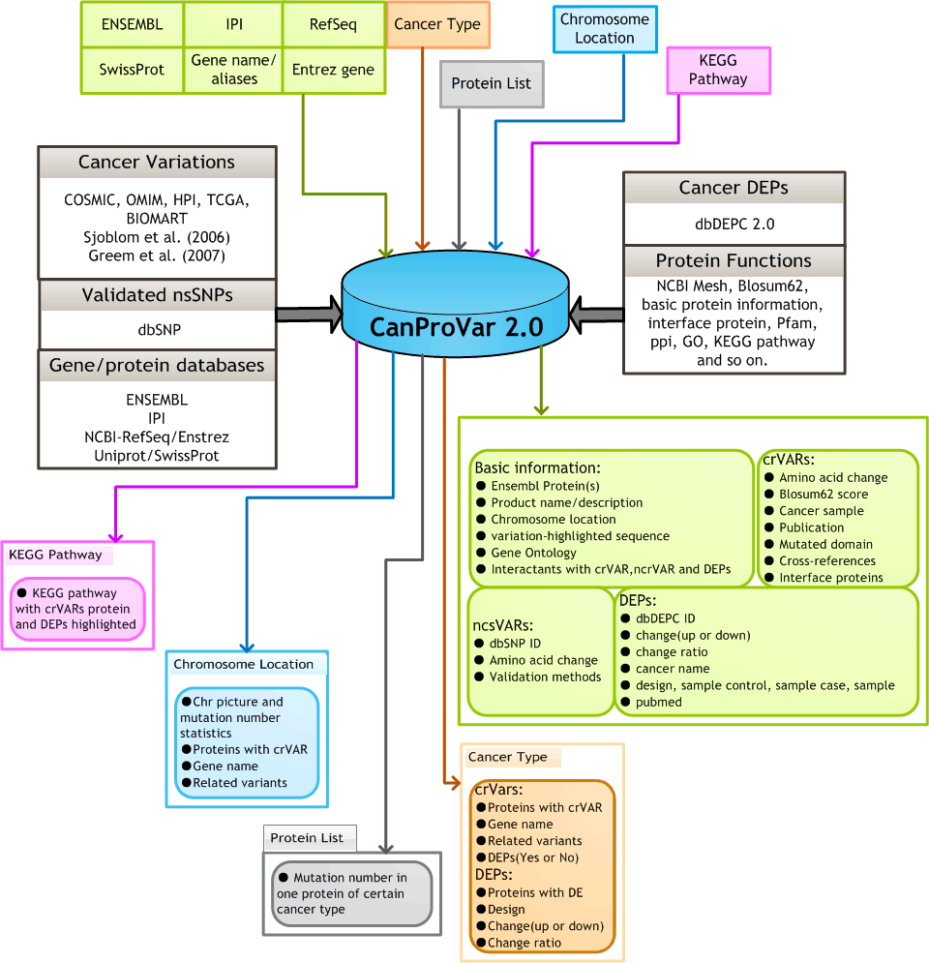
Achitecture of CanProVar 2.0
Besides much more somatic and germline variations, now we have further data annotation, friendly display, more query ways

Slide 8
Data update in CanProVar 2.0
http://lifecenter.sgst.cn/CanProVar/
Currently CanProVar contains 69,834 cancer-related variation , 825,106 non-cancer related variation.

Slide 9
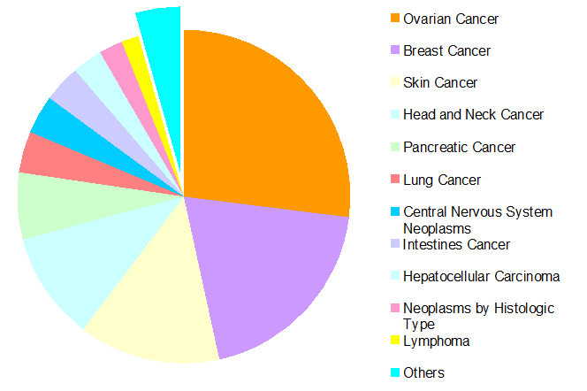

What’s new in CanProVar 2.0
Standard cancer names/types (NCBI MeSH)
Differentially Expression in Cancers
PPI network analysis & interaction interface
Data query by protein list, chromosome location, pathway
Notes:
MeSH: Medical Subject Headings

Slide 10
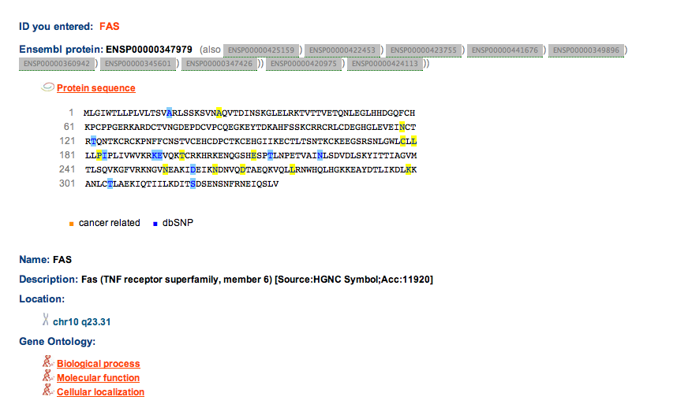
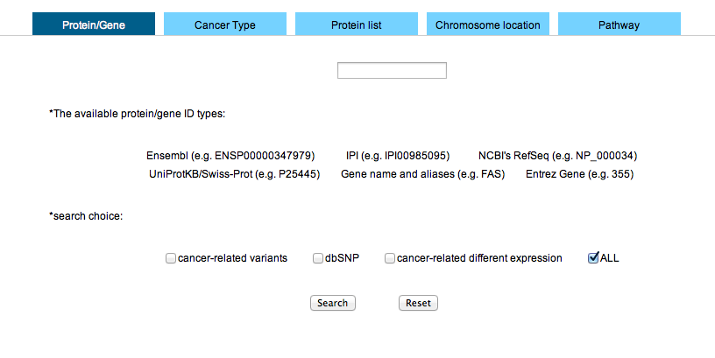
Database search
Gene/Protein

Slide 11
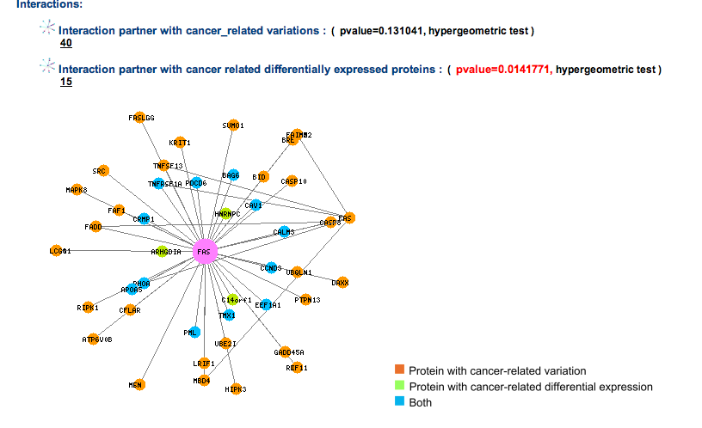
Database search
Gene/Protein

Slide 12
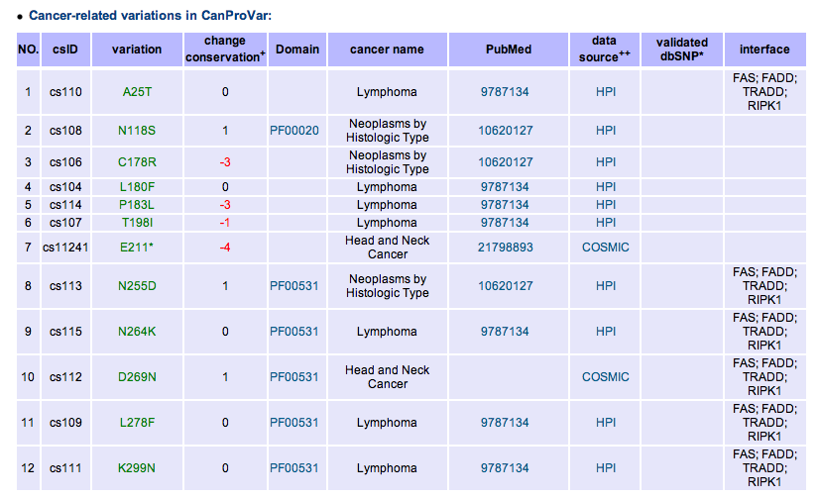
Database search
Gene/Protein

Slide 13
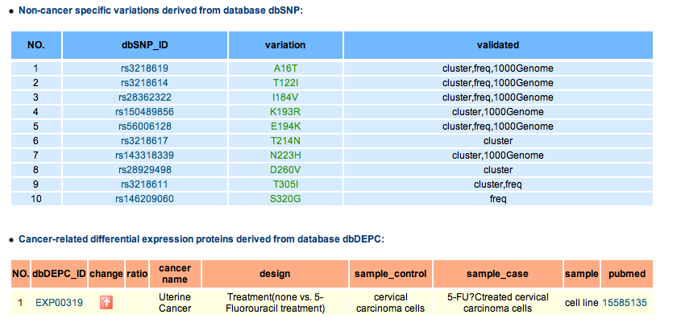
Database search
Gene/Protein

Slide 14
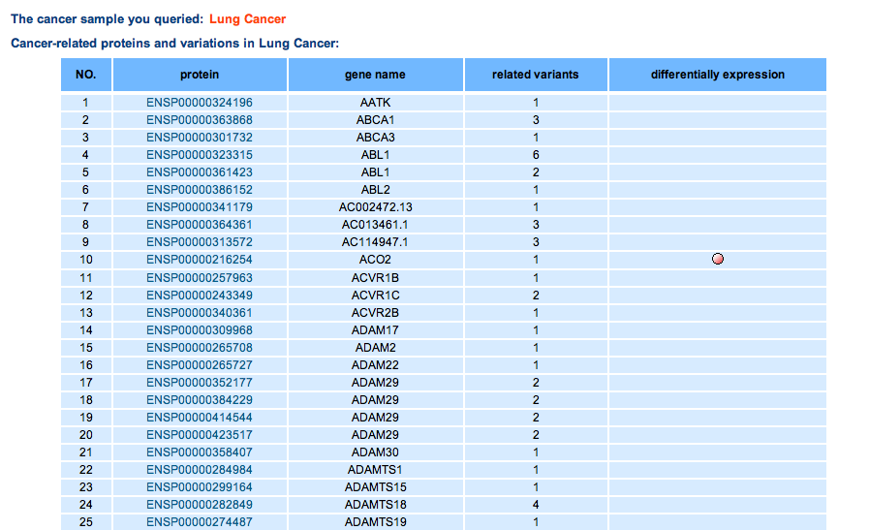
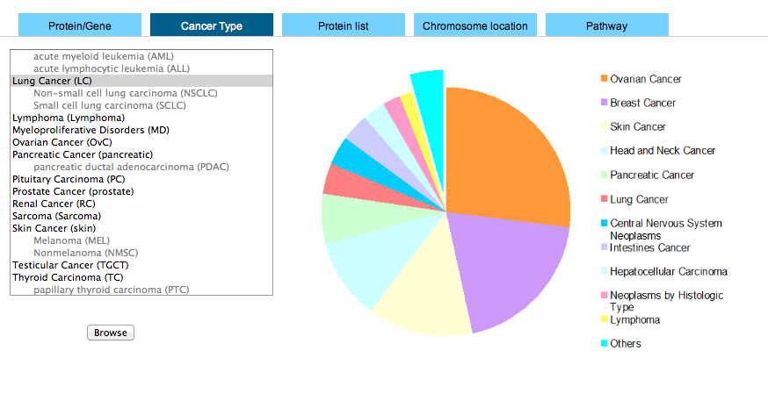
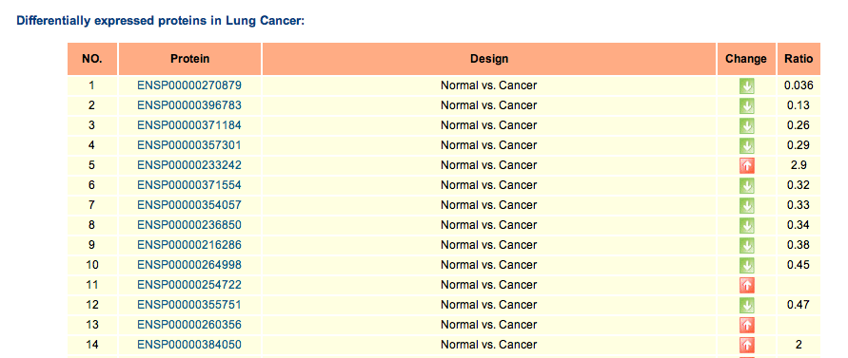
Database search
Cancer sample

Slide 15
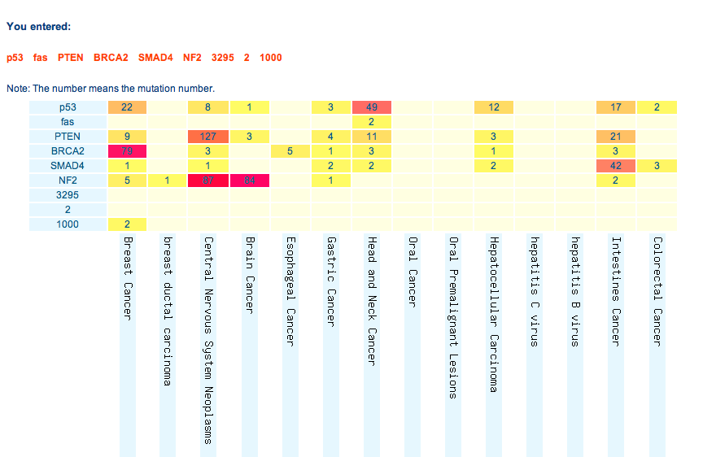
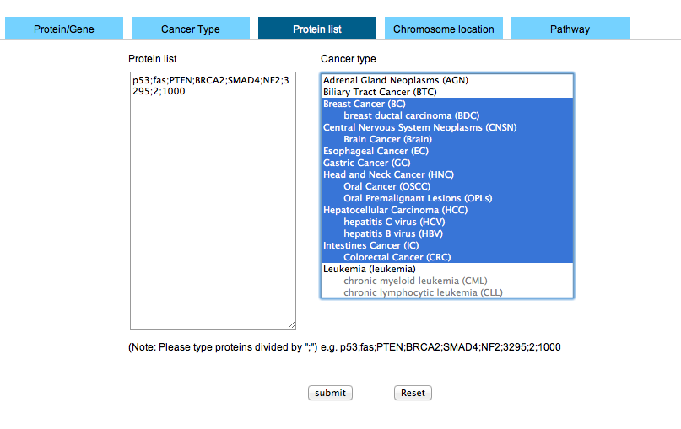
Database search
Protein list

Slide 16
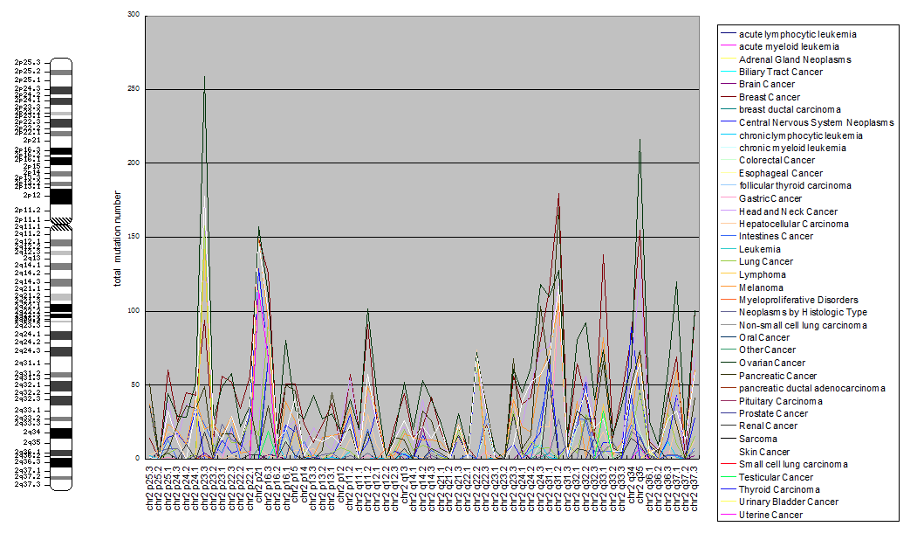
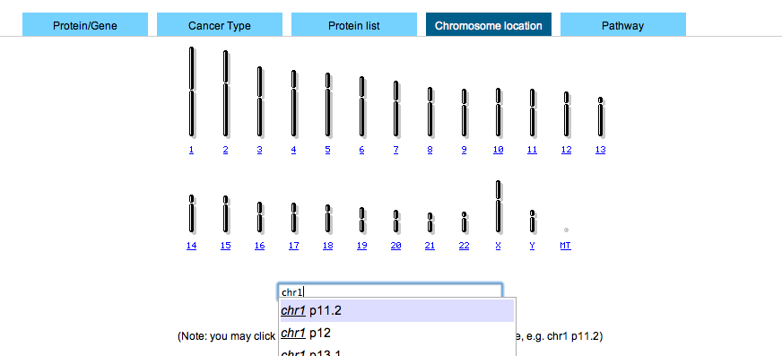
Database search
Chromosome location

Slide 17
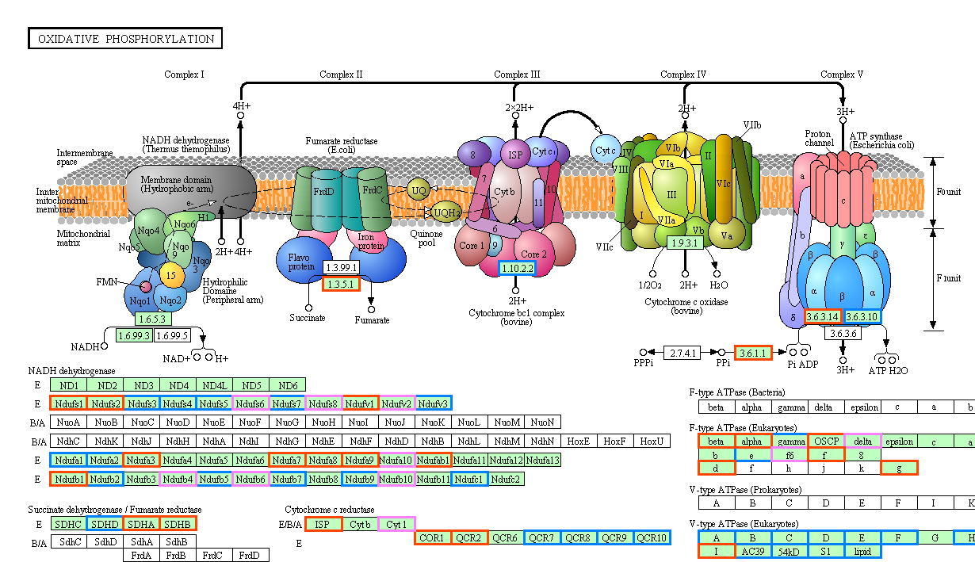
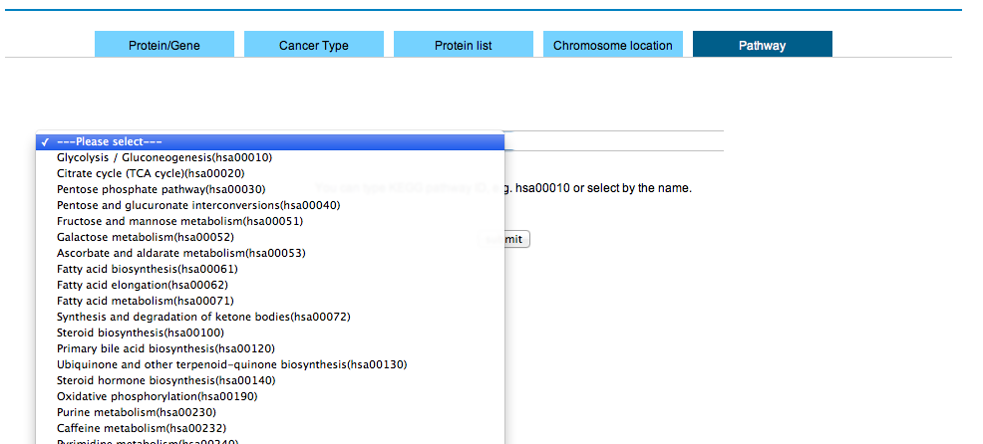
Database search
Pathway

Slide 18
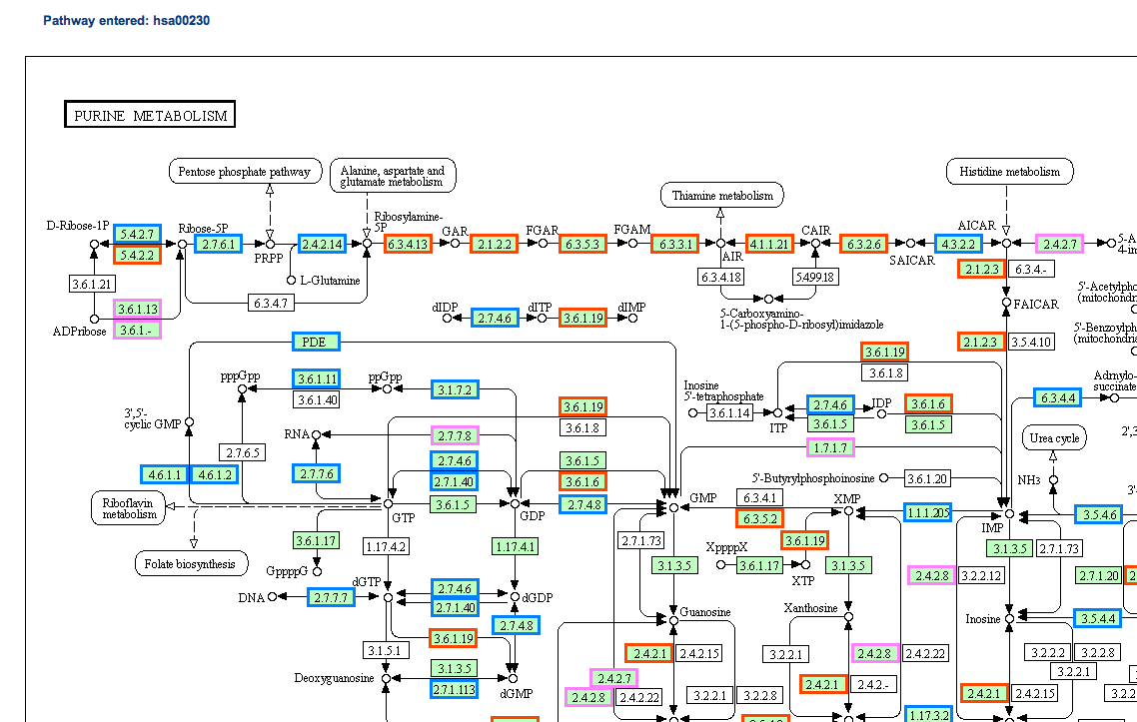
Database search
Pathway

Slide 19
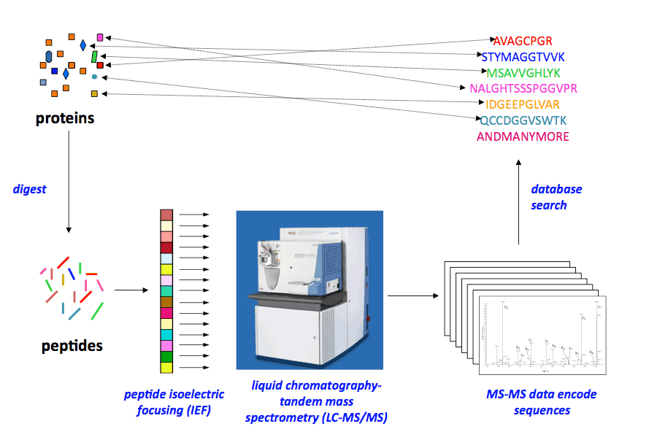
Database application- mutant peptide/ protein detection
Regular protein sequences
?
Mutant proteins
http://www.vicc.org/jimayersinstitute/technologies/

Slide 20
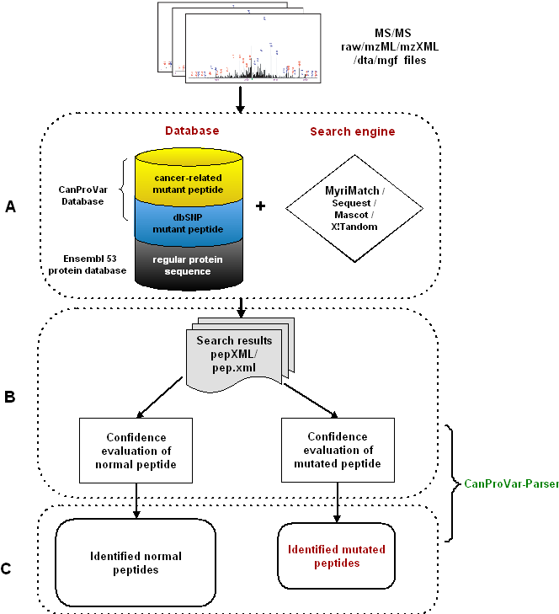
Shotgun data database searching
Searchable database setup & database search
Confidence evaluation
Output generation
J. Li, et al. MCP. 10:M110.006536, 2011
Notes:
CanProvar database provide us an opportunity to identify mutated peptides in cancer samples by doing shotgun proteomics data search against CanProvar. Database searching includes tree steps: 1) the set up of searchable protein database and database search 2) do confidence evaluation to all detected spectra or peptides. Finally summarize the results and generate output files.

Slide 21
Searchable database setup
Mutant proteins
>ENSP00000379387|420-432|#rs11710965:Y428C
HFRMSSHHCDYKK
>ENSP00000288602|445-475|#cs4102:G466E;#cs4072:G469A
DSSDDWEIPDGQITVGQR IGSESFATVYK GK
In CanProVar 1.0, increase tryptically digested peptides by 6.6% (188,299) and 3.4% without mutations combination
Normal proteins
Notes:
To setup variation-contained protein database, we included both normal protein in ensemble protein database and mutant proteins in canprovar. For each single amino acid alteration, the enclosing tryptic peptide as well as its two-sides flanking tryptic peptides was taken as an independent entry in fasta format. Adding the flanking peptides is for identifying peptides with missed cleavage. For each new peptide entry, the mutation information was recorded in the sequence header together with its starting and ending positions. Combination of two mutations within a tryptic peptide was also included. Normal proteins were added in original fasta format . The reverse sequences were appended as decoy database for FDR estimation. Compare to all possible normal peptides, the variations in Canprovar increase peptide candidates by 6.6% and 3.4% with and without mutations combination.

Slide 22
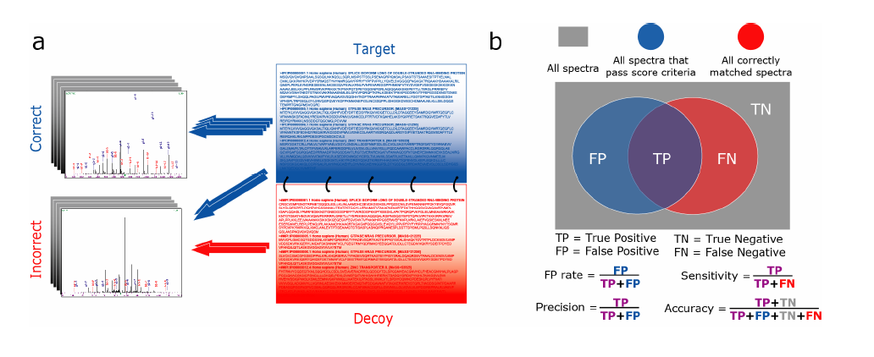
False discovery rate estimation
Elias and Gygi, Nature Methods 4, 207 - 214 (2007)

Slide 23
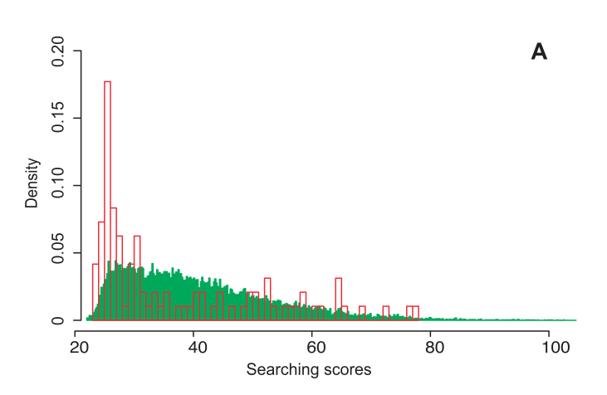
Searching score distribution
SW480 sample (FDR <0.05)
Joint evaluation
Fig. Search score distributions for the variant (red) and wild- type (green) peptides identified with FDR < 0. 05 in the SW480 dataset.
Bunger et al. J Proteome Res 2007, 6 (6): 2331-40

Slide 24
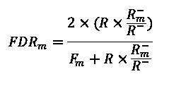
Revised confidence evaluation
Method : ratio-based separated evaluation
Assumption: Decoys of normal and mutant proteins are likely
Normal
rev_normal
Mutated
rev_mutated
Notes:
To address this problem, we proposed a new FDR estimation method for identifying mutant peptide. regularly, false positive is estimated by doubling passing decoy. Instead of using mutant decoy alone, we estimated it by total decoy multiple the fraction of mutant decoy. Our assumption here is normal and mutant decoys are no different as negative control. New approach could give more stable and reliable estimation for the false positive.

Slide 25
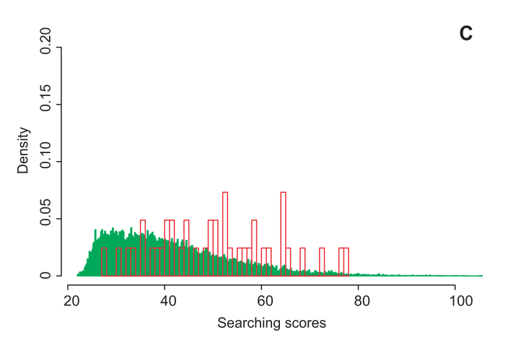
Revised confidence evaluation
B
Joint evaluation
ratio-based separated evaluation

Slide 26
Sequencing validations
SW480
No. | Peptide | Gene | Mutations | count | Protein | fdr 0.1 | fdr .05 | Sep_ fdr.05 | Ratio_sep .05
1 | GTETFEPEDK | CD3EAP | rs735482:K259T | 4 | ENSP00000310966 | * | * | * | *
2 | LDSTDFTSTIK | TFRC | rs3817672:G142S | 3 | ENSP00000353224 | * | * | * | *
3 | SDSELNNEVAAR | CYBRD1 | rs10455:S266N | 3 | ENSP00000319141 | * | * | * | *
4 | AGKGGTGVMMCAYLLHR | PTEN | cs7492:R130G;cs7277:I135M | 1 | ENSP00000361021 | * | * | *
5 | QLVNMCMNPDPEK | NEK7 | cs2511:I275M | 1 | ENSP00000356355 | * | * | *
6 | EILDEAYAMAGVGSPYVSR | ERBB2 | cs34:V773A | 1 | ENSP00000269571 | *
7 | LAAETGEGEGEPLSR | DIDO1 | rs910148:T1568A | 3 | ENSP00000266070 | * | * | * | *
8 | DPAEPMSPGEATQSGARPADR | MYBBP1A | rs3809849:Q8E | 1 | ENSP00000254718 | * | * | * | *
9 | LAVDDFR | KRT13 | rs9891361:A175V | 2 | ENSP00000157775 | * | * | * | *
10 | ASSSILINESEPTTNIQIR | NSFL1C | rs9575:D179N | 1 | ENSP00000202584 | * | * | *
11 | AGTDSPVSCASITEER | CDCA2 | rs4872318:V717I | 1 | ENSP00000328228 | * | * | * | *
12 | AMAIYKQSHHMTEVER | TP53 | cs5306:Q167H; cs5945:V173E | 1 | ENSP00000269305 | * | * | *
13 | ICDFGLAQAIMSDSNYVVR | FLT3 | cs455:R834Q;cs440:D835A | 1 | ENSP00000241453 | * | * | *
14 | FAALDDEEEDKEEEIIK | ABCF1 | rs6902544:N198D | 1 | ENSP00000313603 | * | * | * | *
15 | ELFQTPGPSEESMSDEK | MKI67 | rs11016074:T760S | 1 | ENSP00000357642 | *
 |  |  |  |  |  | 7/15 | 7/13 | 7/13 | 7/8

Slide 27
Sequencing validations
HCT-116
9/10
No. | Peptide | Gene | Mutations | count | Protein | New_fdr .05
1 | KDEGEGAAGAGDHQDPSLGAGEAASK | AKAP12 | rs3734799:K216Q | 2 | ENSP00000253332 | *
2 | FVSSSSSGGYGGGYGGVLTASDGLLAGNEK | KRT19 | rs4602:A60G | 2 | ENSP00000355124 | *
3 | IIIEDLLEATR | GCN1L1 | rs3864938:Y2155D | 1 | ENSP00000300648 | *
4 | GQVPENEANVVNTTLK | CDH1 | rs34466743:I393N | 1 | ENSP00000261769 | *
5 | DVDGLTSINAGR | MTHFD1 | rs1950902:K134R | 1 | ENSP00000216605 | *
6 | PSQAAGDNQGDEVK | THRAP3 | rs6425977:A201V | 1 | ENSP00000346634 | *
7 | SALFAQINQGESITHALK | CAP1 | rs6665944:S255A | 1 | ENSP00000361888 | *
8 | LDSTDFTSTIK | TFRC | rs3817672:G142S | 1 | ENSP00000353224 | *
9 | LVVVGAGDVGK | KRAS | cs98:G13D | 1 | ENSP00000256078 | *
10 | DSEDVSER | AKAP12 | rs10872670:K117E | 1 | ENSP00000253332 | *

Slide 28
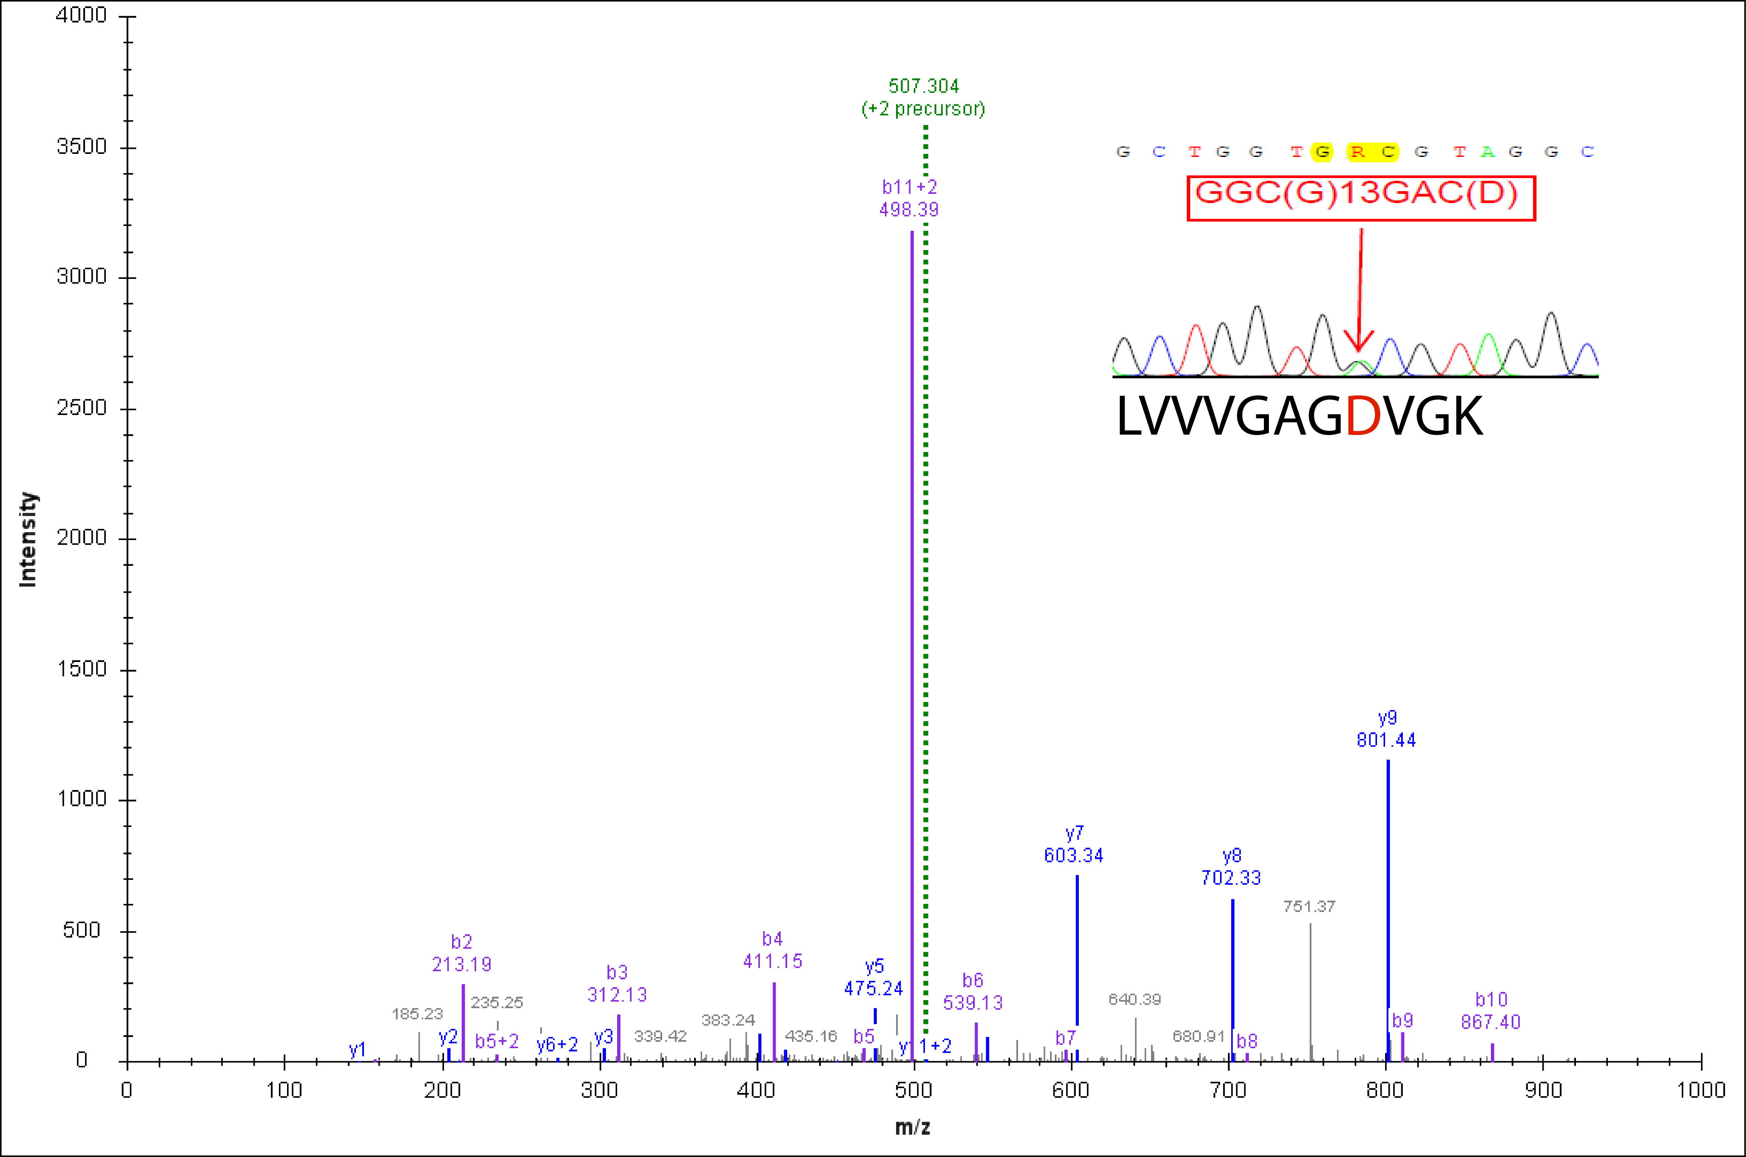
KRAS G13D

Slide 29
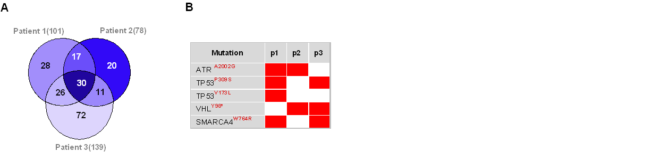

Identification of mutated peptide
Colorectal cancer patients
rs, cs, cancer genes
J. Li, et al. MCP. 10:M110.006536, 2011

Slide 30
Ongoing and future works
Further mining and test of new CanProVar data
Identify pQTL by protein expression profiles using shotgun proteomics
Prioritize gene/mutation by integrating sequencing, mRNA/protein expression and biological networks.

Slide 31
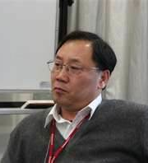

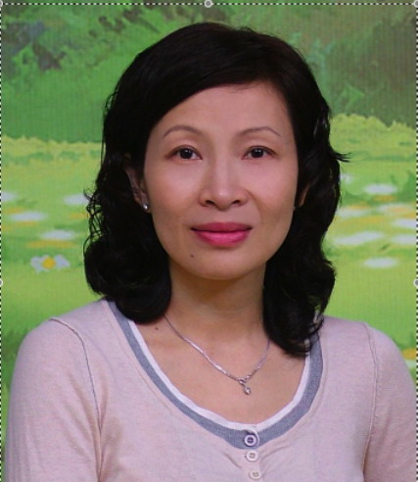
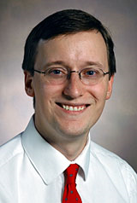
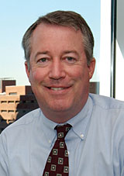
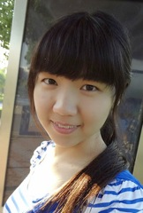

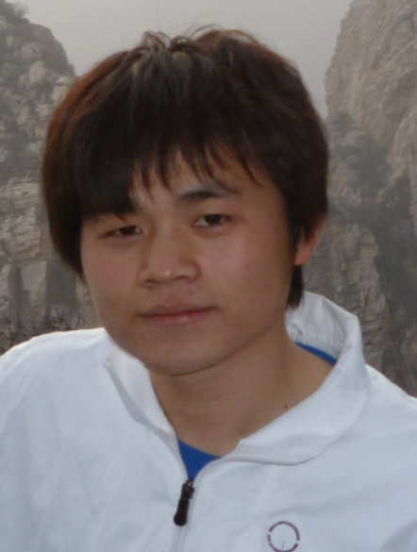
Acknowledgements
SIBS & SCBIT
Vanderbilt University
Yixue Li Ph.D.
Lu Xie Ph.D.
Quoqing Zhang Ph.D.
Bing Zhang Ph.D
David Tabb Ph.D.
Daniel Liebler Ph.D
William Pao Ph.D.
Zengliu Su Ph.D.
SJTU
Menghuan Zhang Ph.D. student
Jia Xu M.Sc. student
Qing Wang M.Sc. student

Slide 32
Thank you

