Slide 1
Share the ppb level accuracy in common LC-MS analysis
Zhang Jiyang
School of Mechanical Engineering and Automatization, National University of Defense Technology
November 14, 2012

Slide 2
Outline
Background
  Proteomics goes to the high-high age
  Instrument calibration and data re-calibration
FTDR 2.0: implement ppb level re-calibration
  Workflow
  Algorithms
  Results
Discussions
  How to utilize the high accuracy?

Slide 3
Background
Proteomics: the discovery loop
Dreams and stories
Technology needs
Low-Low
Insights on the technologies and biological stories
Proteomics
Advances on instrument and experiment protocol
High-Low
Data analysis algorithms and tools
High-High

Slide 4
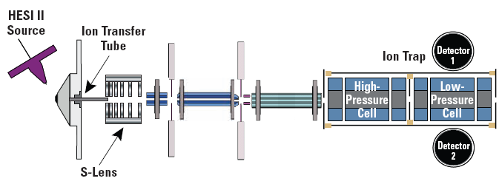
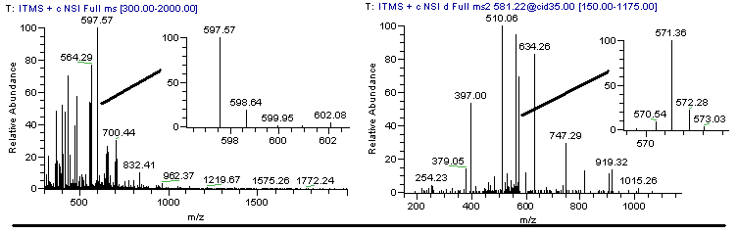
High sensitivity LTQ
MS and MS/MS
Low-Low
Very fast scan speed
MET: 3Da
No obvious isotopic profiles
MET: 0.6Da
Few isotopic profiles only for very high signals

Slide 5
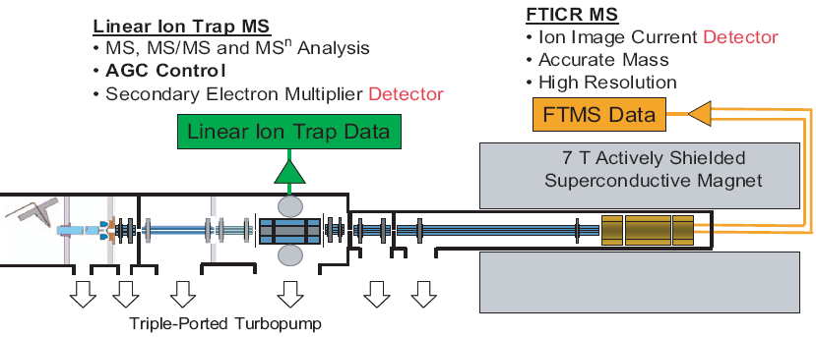
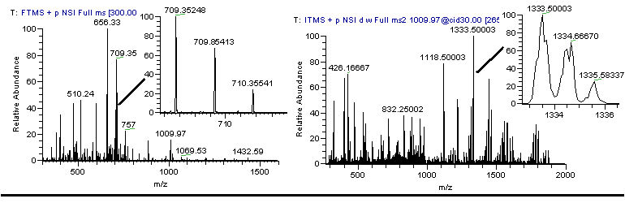
LTQ/FT
High-Low
Scan speed vs. spectrum quality
MS/MS scan
MS scan
Isotopic profile
(not so good)
Isotopic profile

Slide 6
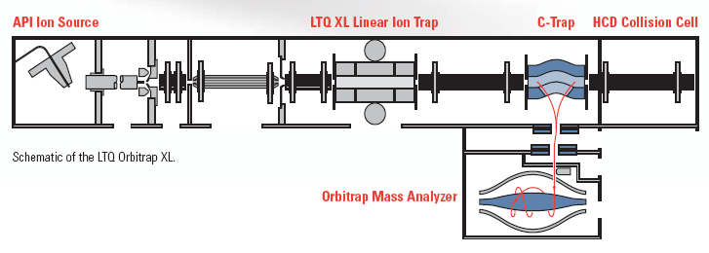
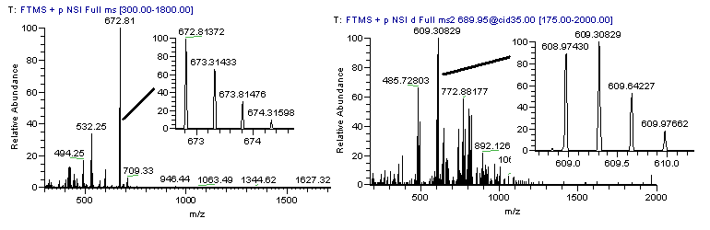
LTQ/Orbitrap
Ion storage
Store and CID fragment
MS and MS/MS scan
Scan speed vs. spectrum quality
Isotopic profile
Isotopic profile

Slide 7
Some literatures
Cox J, Mann M. Quantitative, high-resolution proteomics for data-driven systems biology. Annu Rev Biochem. 2011 Jun 7;80:273-99.
Mann M, Kelleher NL. Precision proteomics: the case for high resolution and high mass accuracy. Proc Natl Acad Sci U S A. 2008 Nov 25;105(47): 18132-8.
Nilsson T, Mann M, Aebersold R, Yates JR 3rd, Bairoch A, Bergeron JJ. Mass spectrometry in high-throughput proteomics: ready for the big time. Nat Methods. 2010 Sep;7(9):681-5.
Altelaar AF et al. Database independent proteomics analysis of the ostrich and human proteome. Proc Natl Acad Sci U S A. 2012 Jan 10;109(2):407-12. Epub 2011 Dec 22.
Lamond AI, Uhlen M, Horning S, et al. Advancing cell biology through proteomics in space and time (PROSPECTS). Mol Cell Proteomics. 2012 Mar;11(3):O112.017731. Epub 2012 Feb 6.
More dreams with high accuracy and high resolution instruments: Top-down, cross-link based PPI, PTM identification and discovery, real time state monitor of cells…

Slide 8
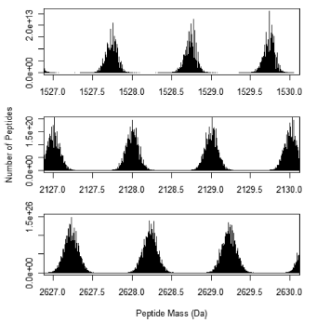
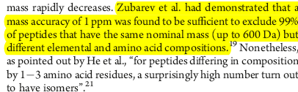
What can be benefited from high accuracy?
Database search: less candidates
De Novo: less possible
XIC based quantification: less noise?
PTM: less false positives
blank
Yu L, Xiong YM, Polfer NC. Periodicity of monoisotopic mass isomers and isobars in proteomics. Anal Chem. 2011 Oct 15;83(20):8019-23.
Mitra I, Nefedov AV, Brasier AR, Sadygov RG.
Improved mass defect model for theoretical tryptic peptides.
Anal Chem. 2012 Mar 20;84(6):3026-32.

Slide 9
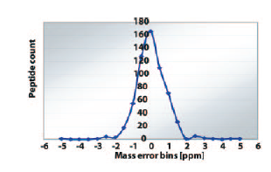
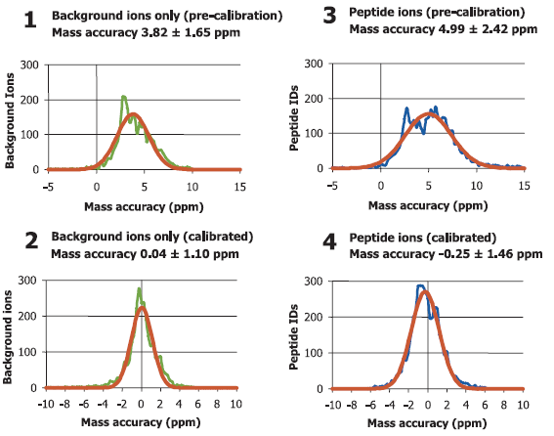
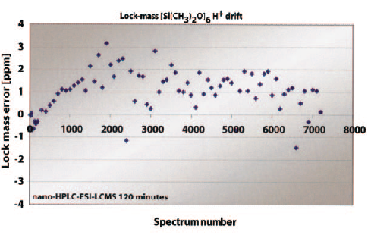
Accuracy in control and common experiments
Haas W, Faherty BK, Gerber SA, Elias JE, Beausoleil SA, Bakalarski CE, Li X, Villén J, Gygi SP. Optimization and use of peptide mass measurement accuracy in shotgun proteomics. Mol Cell Proteomics. 2006 Jul;5(7):1326-37.
<2ppm in well controlled experiments
Olsen JV, de Godoy LM, Li G, Macek B, Mortensen P, Pesch R, Makarov A, Lange O, Horning S, Mann M. Parts per million mass accuracy on an Orbitrap mass spectrometer via lock mass injection into a C-trap. Mol Cell Proteomics. 2005;4(12):2010-21.

Slide 10
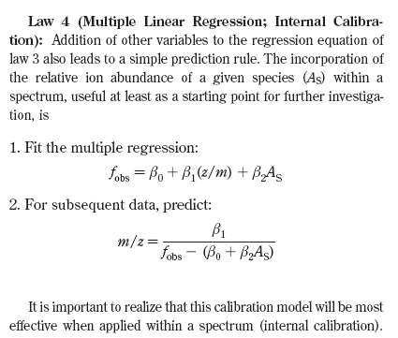
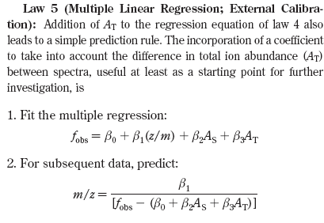
Instrument calibration
Internal calibration and external calibration
Muddiman DC, Oberg AL. Statistical evaluation of internal and external mass calibration laws utilized in fourier transform ion cyclotron resonance mass spectrometry. Anal Chem. 2005 Apr 15;77(8):2406-14.
Regress a formula from frequency and charge space effect to m/z.

Slide 11
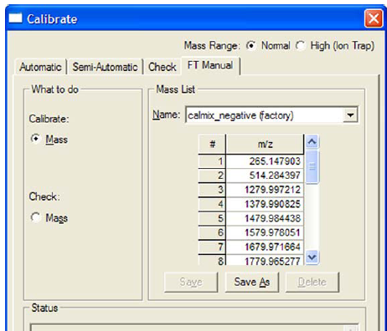
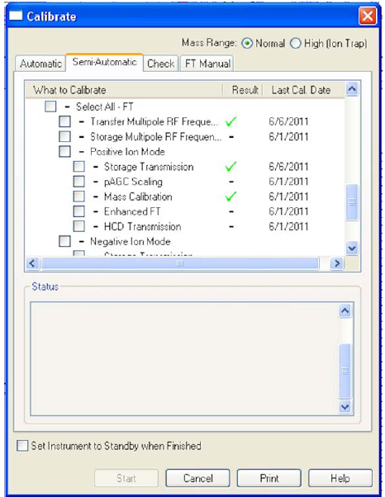
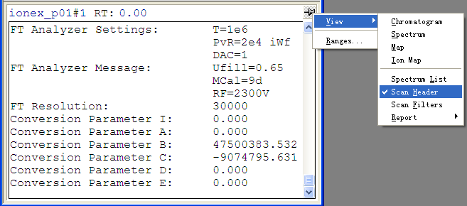
Instrument calibration
Automatically performed on Orbitrap and FT
Parameters can be viewed in raw files

Slide 12
Data re-calibration
Question: why the m/z measurement errors vary
with time?
Question: Can we calibrate the m/z values after the data collections?
Which (parameters) are relative to the m/z measurement errors?
If possible

Slide 13
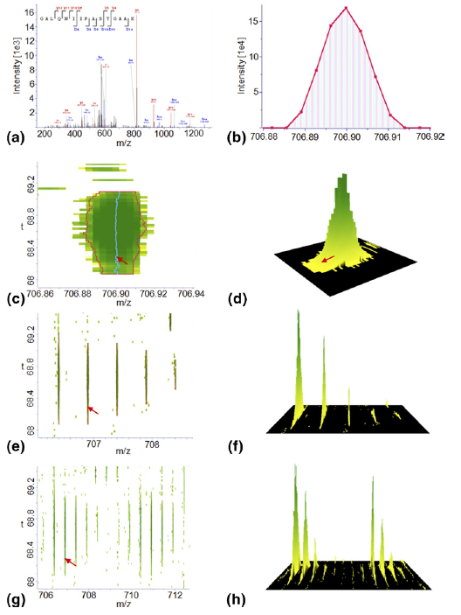
Data re-calibration
Nat Biotechnol. 2008 Dec;26(12):1367-72.
MaxQuant enables high peptide identification rates, individualized p.p.b.-range mass accuracies and proteome-wide protein quantification.
Cox J, Mann M.
J Am Soc Mass Spectrom. 2009 Aug;20(8):1477-85.
Computational principles of determining and improving mass precision and accuracy for proteome measurements in an Orbitrap.
Cox J, Mann M.
J Proteome Res. 2011 Apr 1;10(4):1794-1805. Epub 2011 Feb 22.
Andromeda: A Peptide Search Engine Integrated into the MaxQuant Environment.
Cox J, Neuhauser N, Michalski A, Scheltema RA, Olsen JV, Mann M.

Slide 14
Data re-calibration
Our work:
J Proteome Res. 2009 Feb;8(2):849-59.
Mass measurement errors of Fourier-transform mass spectrometry (FTMS): distribution, recalibration, and
application.
Zhang J, Ma J, Dou L, Wu S, Qian X, Xie H, Zhu Y, He F.
Simple Calibration
J Proteome Res. 2010 Jan;9(1):393-403.
MSQuant, an open source platform for mass spectrometry-based quantitative proteomics.
Mortensen P, Gouw JW, Olsen JV, Ong SE, Rigbolt KT, Bunkenborg J, Cox J, Foster LJ, Heck AJ, Blagoev B,
Andersen JS, Mann M.
Nonlinear calibration：
Mol Cell Proteomics. 2010 Mar;9(3):486-96. Epub 2009 Dec 17.
DtaRefinery, a software tool for elimination of systematic errors from parent ion mass measurements in
tandem mass spectra data sets.
Petyuk VA, Mayampurath AM, Monroe ME, Polpitiya AD, Purvine SO, Anderson GA, Camp DG 2nd, Smith RD.
Application: Search with large MET, filteration with little MET:
Comparison of Database Search Strategies for High Precursor Mass Accuracy MS/MS Data
Edward J. Hsieh, Michael R. Hoopmann, Brendan MacLean and Michael J. MacCoss
J. Proteome, 2010, 9 (2):1138–1143

Slide 15
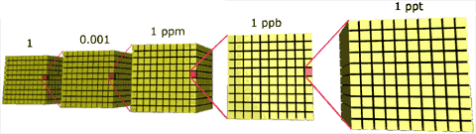
FTDR: ppb level calibration
Reduce the system error of m/z measurement, share the ppb level accuracy in common LTQ/FT and LTQ-Orbitrap experiments
Is it possible?

Slide 16
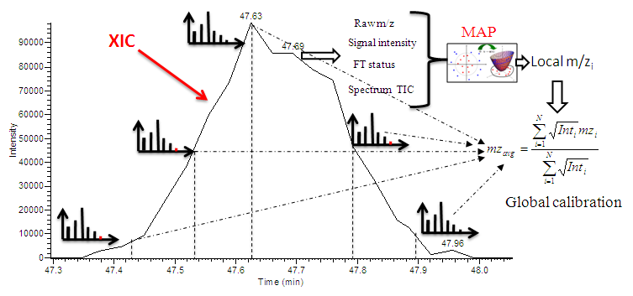
Workflow: Local to global
XIC (or EIC) : extracted ion chromatogram

Slide 17
Key Algorithms in FTDR
Parameters extraction and selection
XIC extraction
Parent ion re-selection
Local calibration models

Slide 18
Parameters for local model
Basic: observed m/z , RT, TIC, parent ion intensity (log transform), relative parent ion intensity.
Status: FT 83, Orbitrap：107，RF voltage，temperature of ICR.
Operation: Ion Injection time, Scan time et al.
isotopic profile: goodness of fitting, number of isotopic peaks.

Slide 19
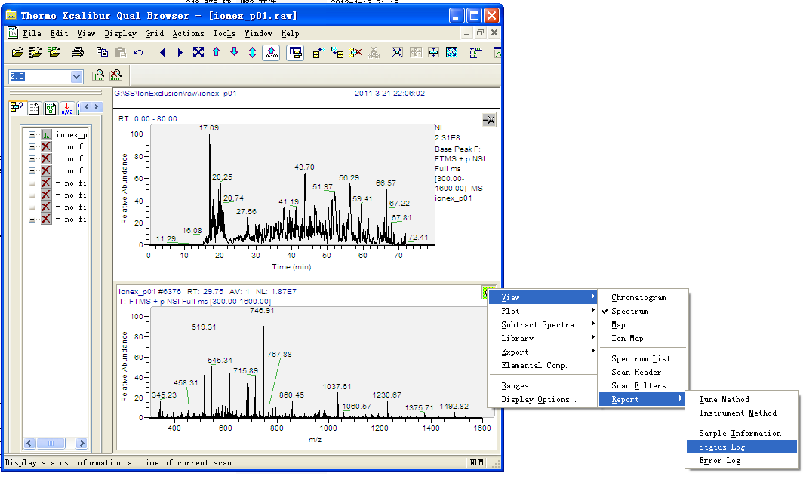
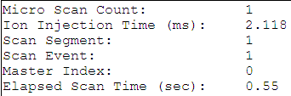
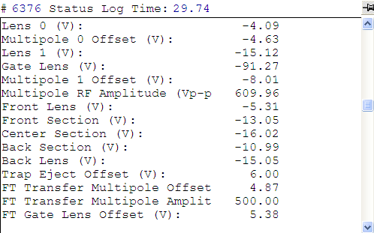
How to obtain these parameters?
RT
m/z, intensity

Slide 20
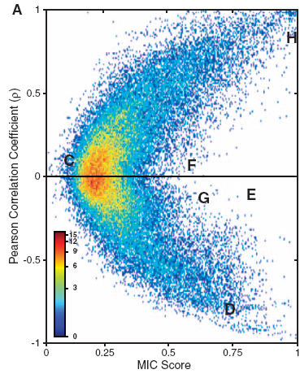

Parameter selection
Nonlinear relations: mRMR, minimum Redundancy Maximum Relevance Feature Selection
Chris Ding, and Hanchuan Peng .
Minimum redundancy feature selection from microarray gene expression data.
Journal of Bioinformatics and Computational Biology, 2005 , 3(2):185-205.
Recent works used this kind of method:
Reshef DN, et al. Detecting novel associations in large data sets. Science. 2011 Dec 16;334(6062):1518-24.

Slide 21
Parametee selection
FT：15
MI: Mutual information
MI Parameter
0.6767 mz experiment
0.5389 Retention time
0.0573 FT IOS +275 Supply (V)
0.3203 IsoNum
0.2836 FT RF1 Amp. Temp. (C)
0.4637 Ambient Temp. (C)
0.0441 Gate Lens (V)
0.3682 FT EA Temp. (C)
0.2030 Nitrogen (%)
0.5298 Source Current (uA)
0.0446 FT EA -32 Supply (V)
0.1401 RF Detector Temp (C)
0.3620 RF Generator Temp (C)
0.0567 Relative PInt
0.0348 Front Section (V)
MI Parameter
0.6767 mz experiment
0.5389 Retention time
0.3203 IsoNum
0.2836 FT RF1 Amp. Temp. (C)
0.4637 Ambient Temp. (C)
0.3682 FT EA Temp. (C)
0.2030 Nitrogen (%)
0.5298 Source Current (uA)
0.1401 RF Detector Temp (C)
0.3620 RF Generator Temp (C)
Remove the little MI

Slide 22
Parametee selection
Orbitrap：15
MI Parameter
0.1792 mz experiment
0.0639 Abs PInt
0.0512 -28V Supply Voltage (V)
0.0417 FT IOS -275 Supply (V)
0.0393 FT Deflector Measure Voltage (V)
0.0818 IsoNum
0.0362 FT TMPC HS Temp. (°C)
0.0434 FT Main RF Amplitude (Vp-p)
0.0329 FT HV Lens 3 (V)
0.0581 Relative PInt
0.0304 Front Lens (V)
0.0466 FT HV Ion Energy (V)
0.0392 Gate Lens (V)
0.0382 FT Storage Multipole Offset (V)
0.0286 IsoMGD
m/z experiment
Retention time
Elapsed Scan Time
Relative PInt
IsoMGD
+24V Supply Voltage (V)
MI>0.05

Slide 23
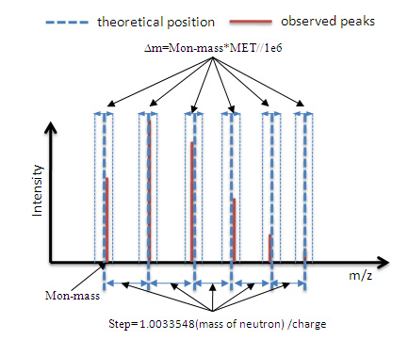
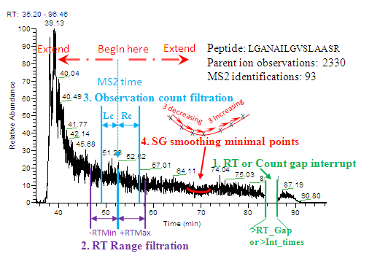
XIC Extraction
Isotopic profile match in each MS
4 kind of XIC trunked methods were used in FTDR : 1st –RT or count gap, 2nd RT range, 3rd MS signal count, 4th Savitzky–Golay (SG) smoothing and local minimal points detection.
The 1st is used in any XIC searching step in FTDR. The 2nd is only used in the calibration step and will be automatically disabled when the 4th rules was used. The 3rd is used to limited the volume of training datasets by counting the observations.
MET: m/z error tolerance

Slide 24
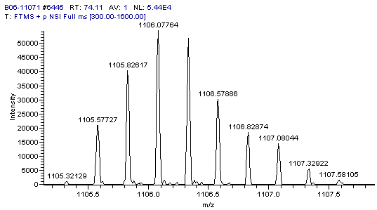
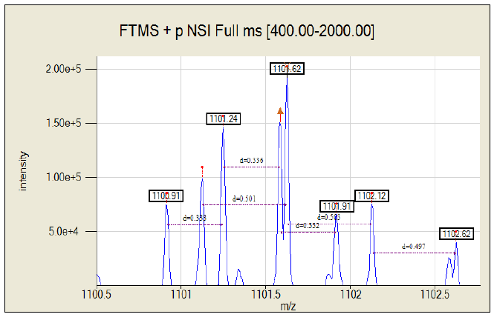
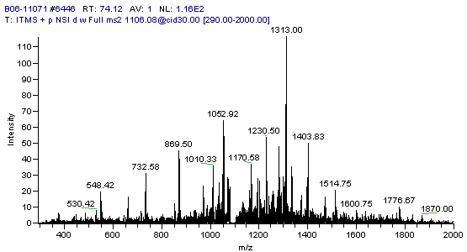
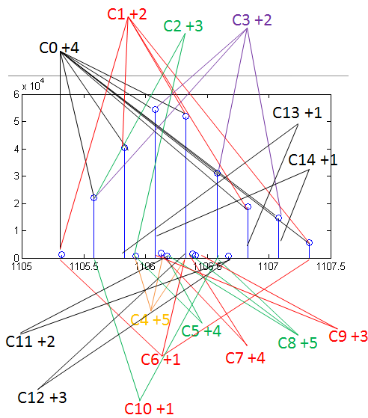
Parent ion re-selection
Incorrect position
Monoisotopic peak
overlap
All possible interpretations
Absent
Multiple possibility

Slide 25
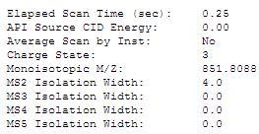
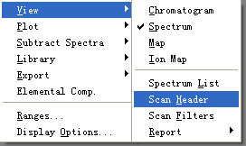
Parent ion re-selection
Extract all peaks
Segment into different isotopic profile group
Fitting to the predict distribution
+2
+1
+
C2
Assign back to the MS/MS spectrum
C1
+
+2
C3
Decompose each isotopic profile group
Result: one MS/MS spectrum may generate multiple targets

Slide 26


Local models (try and implement)
Linear model: parameter transform
Local linear: multivariate(hard to implement)
Local Linear：piecewise on RT
Nonlinear：SVM regression (using LIBSvm source code)
Robustness and Accuracy.

Slide 27
Result & discussion
Local calibration and global calibration on ISB_FT dataset
Global calibration on the Yeast_FT_dataset
Compare with MaxQuant
Try on the label free quantification dataset

Slide 28
Performance comparison
Dataset: ISB_FT Mix 3, original MET 5ppm
Ref: Klimek J et al. The standard protein mix database: a diverse data set to assist in the production of improved Peptide and protein identification software tools. J Proteome Res. 2008 Jan;7(1):96-103.
Model types | Linear | Multivariate Linear | Local regression | SVM
MET(ppm) | 2.46 | 2.13 | 2.19 | 1.56
Note: (1) not XIC global calibration,
(2) linear models: mz², TIC*mz²tansform , SVM dose not use
(3) MET is estimated by the residual distribution.

Slide 29
Performance of Global Calibration
Model：SVR
MET：0.46ppm
Signal intensity relative MET is more reasonable!
a=0.429970
b=0.058963
Breitwieser FP, et al. General statistical modeling of data from protein relative expression isobaric tags. J Proteome Res. 2011 Jun 3;10(6):2758-66.

Slide 30
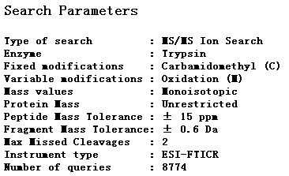
Database search results
Liu K, Zhang J, Wang J, Zhao L, Peng X, Jia W, Ying W, Zhu Y, Xie H, He F, Qian X. Relationship between Sample Loading Amount and Peptides Identification and Its Effect on Quantitative Proteomics. Anal Chem. 2009;81(4):1307-14.
Dataset: Yeast_FT_RP10
Search: Mascot V 2.1
Conclusion: The m/z error filtration can affect the database search and result validation model.
+/-1.3ppm, 15ppm,
Different for different mgf
Test | Submitted MS/MS spectrum | Total PSMs | Validated PSMs* | ppb level | MET min | MET max
Before calibration 15ppm | 59828 | 45813 | 29400 | 2371 | -4.321589 | 12.939775
After calibration 1.3ppm | 91430# | 47128 | 14299 | 14255 | -1.011142 | 1.139910
After calibration 15ppm | 91430# | 58245 | 24071 | 23900 | -1.099507 | 1.178323
After calibration 15ppm | 91430# | 58245 | 37225 | 36104 | -3.2@ | 3.2@
# 91430: with parent ion re-selection, @ max range given by Intensity model
*Validate method: 2d cutoff model, FDR=1%, ref to: Ma J, et al. Proteomics. 2010;10(23):4293-300.

Slide 31
FTDR performance on 6 datasets
Datasets |  | Database Search MET (ppm) | Validate m/z error range (ppm) | Validated PSMs | ppb level PSMs | Percent of ppb level PSMs (%)
D1 | B | 20 | [-1.52, 5.09] | 10,783 | 3,277 | 30.39
 | A | 20 | [-0.65, 0.63] | 10,507 | 10,507 | 100.00
D2 | B | 20 | [-9.16, 2.15] | 5,980 | 478 | 7.99
 | A | 20 | [-1.70, 1.59] | 6,817 | 6,264 | 91.89
D3 | B | 20 | [-4.80, 17.82] | 16,715 | 560 | 3.35
 | A | 20 | [-1.74, 1.72] | 27,182 | 24,492 | 90.10
D4 | B | 20 | [-6.13, 6.08] | 19,758 | 8,325 | 42.13
 | A | 20 | [-1.00, 0.93] | 34,008 | 34,008 | 100.0
D5 | B | 10 | [-5.18, 8.78] | 14,290 | 4,525 | 31.67
 | A | 10 | [-1.15, 1.20] | 35,126 | 33,283 | 94.75
D6 | B | 20 | [-1.67, 8.89] | 44,382 | 1,974 | 4.45
 | A | 20 | [-1.41, 1.49] | 53,017 | 50,534 | 95.32
D1&D2: Klimek J et al. The Standard Protein Mix Database: A Diverse Data Set To Assist in the Production of Improved Peptide and Protein Identification Software Tools. J. Proteome Res. 2008, 7 (1): 96-103.
D3: Chen M et al. Analysis of human liver proteome using replicate shotgun strategy. Proteomics, 2007. 7(14): 2479-88.
D4: Cox, J.; Mann, M., MaxQuant enables high peptide identification rates, individualized ppb-range mass accuracies and proteome-wide protein quantification. Nature Biotechnology 2008, 26 (12):1367-1372.
D5: Jedrychowski M et al. Evaluation of HCD- and CID-type fragmentation within their respective detection platforms for murine phosphoproteomics. Mol Cell Proteomics 2011, 10 (12):M111 009910.
D6: Liu K et al. Relationship between Sample Loading Amount and Peptide Identification and Its Effects on Quantitative Proteomics. Anal. Chem. 2009, 81: 1307-1314.
Database search: Mascot 2.3

Slide 32
Different search engines
 |  | m/z error range (ppm) | Validate PSMs | ppb level PSMs (%) | FDR_{Act} (%)
Sequest | B | [-1.45, 5.17] | 11,581 | 31.18 | 0.61
 | A | [-0.68, 0.72] | 11,625 | 100.00 | 0.57
Mascot | B | [-1.52, 5.09] | 10,783 | 30.39 | 0.49
 | A | [-0.65, 0.63] | 10,507 | 100.00 | 0.40
X!Tandem | B | [1.78, 5.48] | 8,299 | 37.06 | 1.04
 | A | [-1.23, 1.04] | 8,188 | 98.24 | 0.66
MassMatrix | B | [-1.35, 4.88] | 6,492 | 32.10 | 0.92
 | A | [-0. 61, 0.67] | 8,224 | 100.00 | 0.73
Parameters: 2ppm, 0.6Da
Dataset: ISB_control_FT Mix 3
B: Before re-calibration
A: After re-calibration

Slide 33
In common experiments
Liu K, Zhang J, Wang J, Zhao L, Peng X, Jia W, Ying W, Zhu Y, Xie H, He F, Qian X. Relationship between Sample Loading Amount and Peptides Identification and Its Effect on Quantitative Proteomics. Anal Chem. 2009;81(4):1307-14.
Dataset: Yeast total, 10 repeat LC-Runs
LC-Run | Original m/z error mean | Original m/z error std | Calibrated m/z error mean | Calibrated m/z error std | Total calibrated MS2 spectrum | (Predicted*) on ppb level
Yeast_FT_01 | 4.473023 | 3.086881 | 0.000000 | 0.352747 | 5145 | 2189
Yeast_FT_02 | 4.403325 | 3.051344 | 0.000000 | 0.357674 | 5237 | 2312
Yeast_FT_03 | 4.379363 | 3.033093 | 0.000000 | 0.347622 | 5283 | 2643
Yeast_FT_04 | 4.379597 | 2.991206 | 0.000000 | 0.350134 | 5387 | 2591
Yeast_FT_05 | 4.232066 | 2.900684 | 0.000000 | 0.352454 | 5347 | 2763
Yeast_FT_06 | 4.332880 | 2.946208 | 0.000000 | 0.334838 | 5322 | 2899
Yeast_FT_07 | 4.260813 | 2.879833 | 0.000000 | 0.346009 | 5301 | 2578
Yeast_FT_08 | 4.244320 | 2.855727 | 0.000000 | 0.352397 | 5358 | 2742
Yeast_FT_09 | 4.263944 | 2.858887 | 0.000000 | 0.329935 | 5427 | 2961
Yeast_FT_10 | 4.259115 | 2.801903 | 0.000000 | 0.367498 | 5412 | 1589
*The ppb level record is conservatively predicted by the signal intensity model.

Slide 34
Compare with MaxQuant
Label free search on Yeast_FT_dataset
*Dose not provide the m/z errors for the records after calibration.
Test | Submitted MS/MS spectrum | Total PSMs | Validated PSMs* | ppb level | MET min | MET max
After calibration 15ppm (FTDR) | 91430 | 58245 | 37225 | 36104 | -3.2@ | 3.2@
MaxQuant | 63629 | 26982 | 21817 | 20037 | -5.4939 | 10.4580

Slide 35
For label free dataset
Dataset: Yeast total, 10 repeat LC-Runs
Database search : X!Tandem
Quantification: MassChroQ
Liu K, Zhang J, Wang J, Zhao L, Peng X, Jia W, Ying W, Zhu Y, Xie H, He F, Qian X. Relationship between Sample Loading Amount and Peptides Identification and Its Effect on Quantitative Proteomics. Anal Chem. 2009;81(4):1307-14.
B. Valot, O. Langella, E. Nano, and M. Zivy, “Masschroq: A versatile tool for mass spectrometry quantification,” Proteomics, vol. 11, no. 17, pp. 3572–3577, 2011.
No obvious improvement on the CV

Slide 36
XIC is robust to MET?
Smoothing and other filtration can reduce the noise signal?
The high resolution instrument provide the “clean” signals?
No preponderant signals in a large range

Slide 37
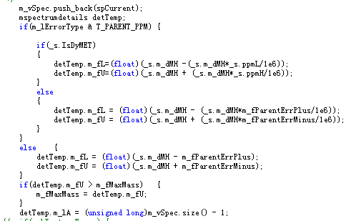
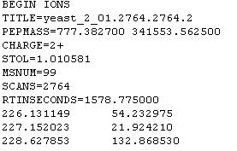
Discussion
Implement specific MET search for each spectrum? Like Andromeda.
Only can be tried on open source database search engine: X!Tandem, Inspect and Crux.
Initial result: no obvious difference on speed and results for X!Tandem.
Possible reasons: X!Tandem is so fast, and provide less results than Sequest or Mascot.
Modified mgf header
Modified source code

Slide 38
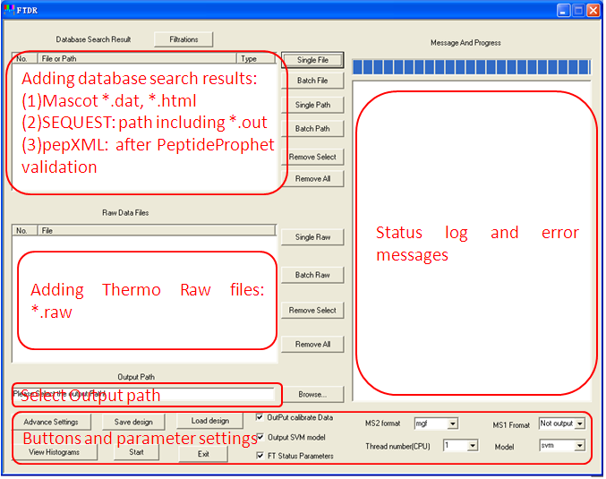
Software design
GUI
Multiple Threads
Output: mzXML, mzML, or mgf
Quick result view
Workspace save and load
Advance parameters

Slide 39
Other applications under considering
PTM search
LC-MS^{E} data processing
Label free quantification with UPLC(narrow XIC)?

Slide 40
Acknowledgement
ISB: control dataset
Dr. Jie Ma, BPRC
Prof. Yunping Zhu, BPRC
Prof. Xiaohong Qian, BPRC
Our team: Prof.Hong wei Xie, Wei Zhang, Changming Xu.

Slide 41
Thank you for your attention!

