Slide 1


Improved proteomic analysis pipeline for LC-ETD-MS/MS
Xie Liqi

Slide 2
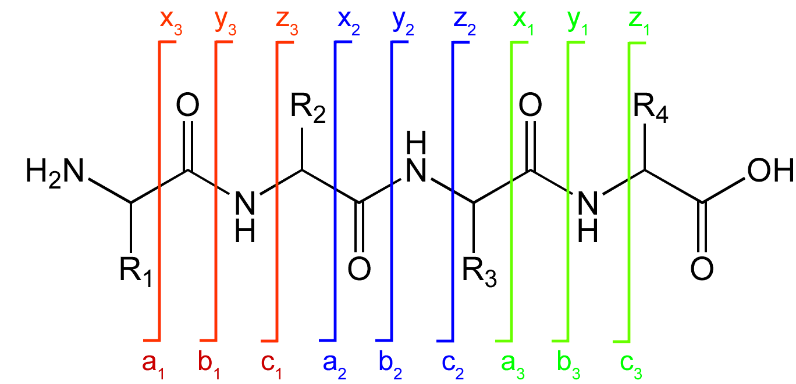



Fragmental pattern of Protein backbone in MS
b, y products are formed by the lowest energy backbone cleavage of protein ions.
c, z cleavage occurs between almost any combination of amino acids, except for cyclic N of Pro.
radical site reaction based c, z cleavage require less energy than b, y cleavage.
International Journal of Mass Spectrometry (1999) 787–793
Notes:
EA of a protonated nitrogen (amine, amide) is 4 eV versus 6 eV for a protonated carbonyl,1,2 suggesting a radical site reaction (eq 2) that should require less energy than b, y cleavage.
C,Z cleavage occurs between almost any combination of amino acids, except for that to the cyclic N of Pro.

Slide 3
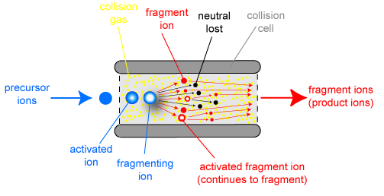
Common dissociation techniques
CxD
Collision-induced dissociation (CID), also known as collisionally activated dissociation (CAD). Molecular ions are collided with inert gas molecules, causing the ions to fragment into smaller pieces: b/y ions.
ExD
Electron capture dissociation (ECD) and Electron transfer dissociation (ETD). Soft fragmentation technique that can generate a complete series of ions and preserve neutral and labile groups, hence, it provides better sequence coverage : c/z ions
ECD: uses low-energy electrons to fragment molecular ions. FT-MS
ETD: uses free radical anions to fragment molecular ions.
ExD produce complimentary sequence to CxD

Slide 4
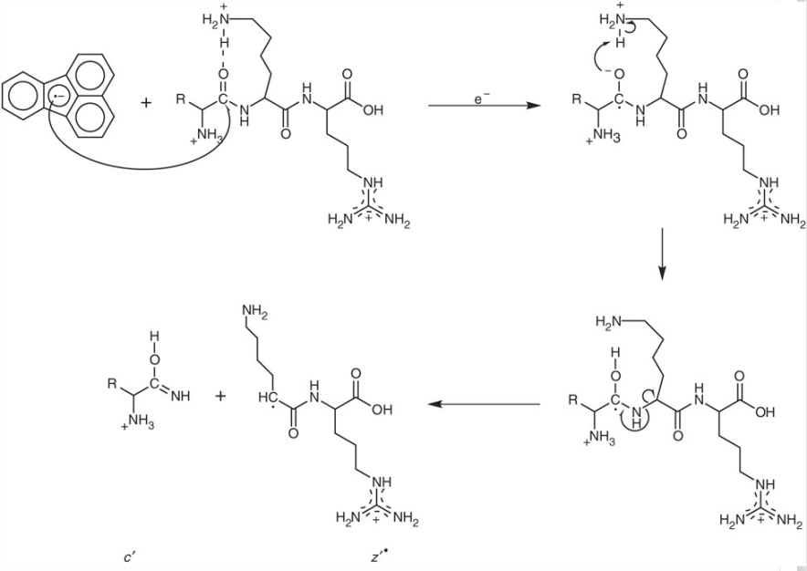
Electron Transfer Dissociation
Anion attachment Proton transfer
Anions were used as vehicles for electron delivery to multiply-protonated peptides in ion trap mass spectrometry.
International Journal of Mass Spectrometry (2004) 33–42
Notes:
Cations and anions can, however, be contained concurrently in radio frequency (rf) electrostatic trapping fields. By exploitation of this attribute, we recently reported the use of anions as vehicles for electron delivery to multiply-protonated peptides in an rf quadrupole linear (QLT) ion trap mass spectrometer

Slide 5
Strong
Enhanced protein identification and sequence coverage using bottom-up approaches
Improved identification of the location of PTM
Enhanced MS/MS of basic peptides and proteins such as histones
Much improved MS/MS of large peptides and proteins
Weak
ETD fails to identify larger amounts of peptides than CID, although it provides higher sequence coverage.
Insufficient fragmentation especially for 1+ and 2+ ions: High-intensity unreacted precursor and electron transfer no dissociation (ETnoD) products.
ETD – centric search algorithms. Commonly used search algorithms were designed and trained for CID data of tryptic peptides.
Notes:
The electron transfer reaction deposits sufficient excitation energy, only lowered by the electron affinity (EA) of the radical anion (0.5–1.5 eV, depending on the radical anion), for hydrogen atom liberation. Therefore, one can speculate that less energy is available for peptide fragmentation in ETD than in ECD. This may explain why several studies report on reduced fragmentation efficiency and limited sequence coverage for doubly charged peptides in ETD.

Slide 6
To improve ETD identification:
ETD fragmentation efficiency can be improved by increasing peptides’ charge state.
  Use proteases which generated longer peptides (etc. Lys C, Arg C)
  chemically modifying the peptides to make them carry more charges or become more basic.
  adding small amounts of compounds with low-volatility and high surface tension to ESI solution.
Optimized search algorithms
  Consider other ion types other than c, z’-ions.
  Remove additional ETD specific features: peaks belonging to precursor, ETnoD products and neutral loss species.
  Design ETD applicable score standards (Peaks 5.1)
  Accurate prediction charge state of precursor ions.
Notes:
ETD was found to be better at identifying peptide ions with charge states higher than 2+.
Most of them are chiefly used to search for c- and z0-ions, however, a0-, b-, y- and z-ions and hydrogenrearranged
fragment ions that are frequently observed in ETD spectra are also informative for peptide identification.17
To make the most of the ETD spectra, ZCore searches for a0-,y-, c- and z0-ions,18 while pFind takes into account the
hydrogen-rearranged fragment ions to identify 63–122% more non-redundant peptides

Slide 7
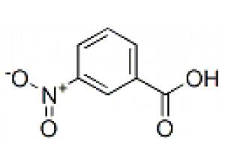
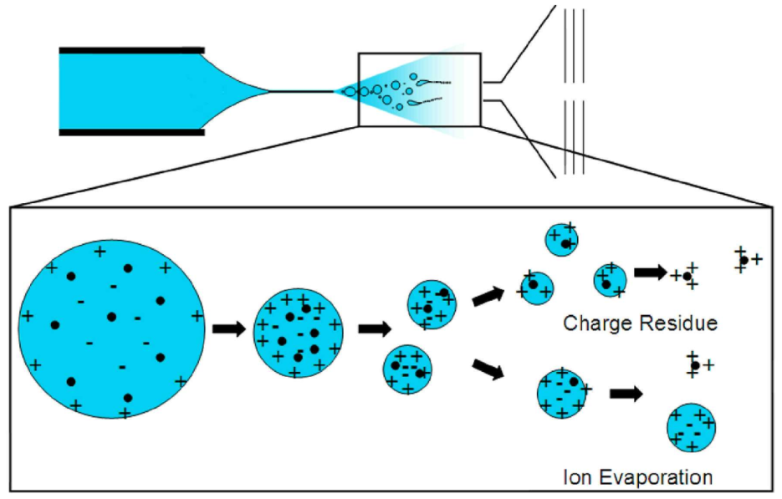
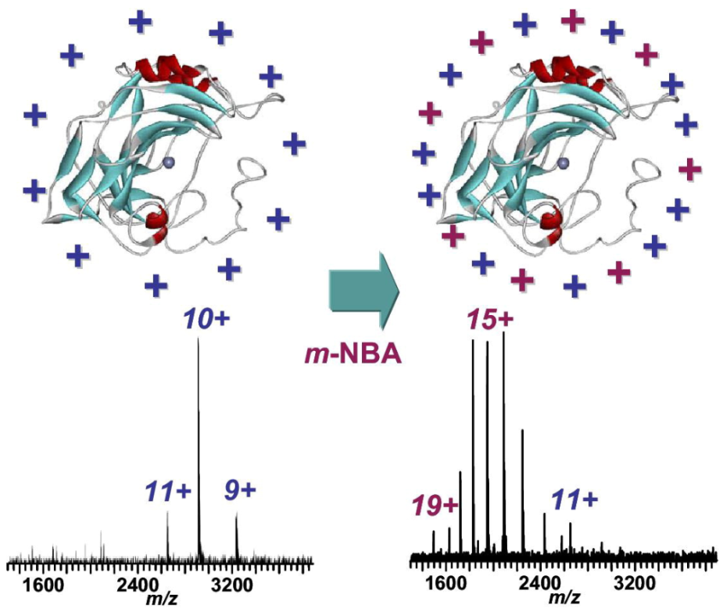
Supper charge reagent
Applying high surface tension, low relative volatility solvents could shift the ESI charge state distribution (CSD) to higher charge.
Anal. Chem. 2007, 79, 9243-9252

Slide 8
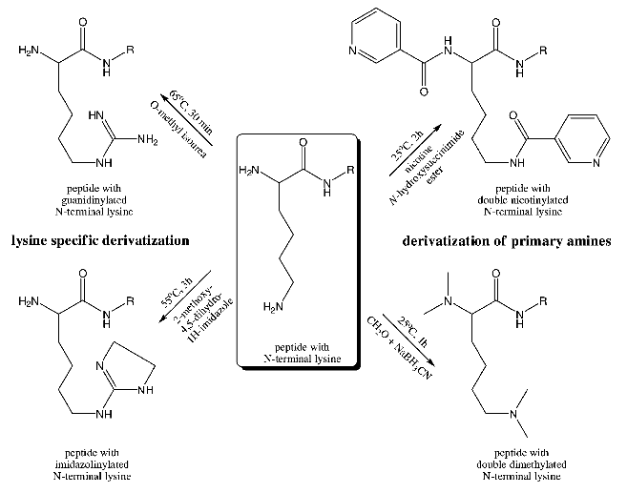
Dimethylation and guanidinationof doubly charged Lys-N peptides resulted in a significant increase in peptide sequence coverage of ETD sequences.
Anal. Chem. 2009, 81, 7814–7822
Notes:
This may be rationalized by the increased basicity and resulting positive charge at the N-termini of these peptides.

Slide 9
To improve ETD identification:
ETD fragmentation efficiency can be improved by increasing peptides’ charge state.
  Use proteases which generated longer peptides (etc. Lys C, Arg C)
  chemically modifying the peptides to make them carry more charges or become more basic.
  adding small amounts of compounds with low-volatility and high surface tension to ESI solution.
Optimized search algorithms
  Consider other ion types other than c, z’-ions.
  Remove additional ETD specific features: peaks belonging to precursor, ETnoD products and neutral loss species.
  Design ETD applicable score standards (Peaks 5.1)
  Accurate prediction charge state of precursor ions.
Notes:
ETD was found to be better at identifying peptide ions with charge states higher than 2+.
Most of them are chiefly used to search for c- and z0-ions, however, a0-, b-, y- and z-ions and hydrogenrearranged
fragment ions that are frequently observed in ETD spectra are also informative for peptide identification.17
To make the most of the ETD spectra, ZCore searches for a0-,y-, c- and z0-ions,18 while pFind takes into account the
hydrogen-rearranged fragment ions to identify 63–122% more non-redundant peptides

Slide 10
The frequencies of different fragment ion types in ETD data
ZCore searches for a’-, y-, c- and z’-ions.
pFind & X!Tandem takes into account the hydrogen-rearranged fragment ions to identify 63–122% more non-redundant peptides.
W.S.Noble developed precursor charge state prediction for ETD Spectra
Peaks 5.1 proposed the generating function approach (MS-GF) to design ETD-specific scoring function
Removal of additional ETD specific features via spectral processing increased total search sensitivity by 20% in Coon’s paper.

Slide 11
To improve ETD identification:
ETD fragmentation efficiency can be improved by increasing peptides’ charge state.
  Use proteases which generated longer peptides (etc. Lys C, Arg C)
  chemically modifying the peptides to make them carry more charges or become more basic.
  adding small amounts of compounds with low-volatility and high surface tension to ESI solution.
Optimized search algorithms
  Consider other ion types other than c, z’-ions.
  Remove additional ETD specific features: peaks belonging to precursor, ETnoD products and neutral loss species.
  Design ETD applicable score standards (Peaks 5.1)
  Accurate prediction charge state of precursor ions.
Most of charge enhancing techniques have not been applied to complex biological samples. The most adaptable technique for ETD based peptide sequencing is unclear.
System comparison between ETD-centric optimized search algorithms is needed.
Notes:
To improve the efficiency of ETD identification in largescale proteomics analysis in terms of comparing these methods,
we investigated the effects of charge enhancing methods commonly used for ETD fragmentation of peptides from
BSA and AMJ2 cell lines. Dimethylation, guanidination, m-NBA and Lys-C were investigated, and five search algorithms
(Mascot, Sequest, OMSSA, pFind, X!Tandem) were compared for their performance in ETD spectra searching and
to find the optimal charge enhancing methods and database search algorithms.

Slide 12
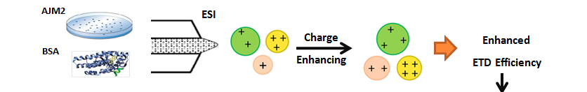
To find the optimal combination of charge enhancing methods and database search algorithms for ETD analysis
Charge enhancing method:
Dimethylation, Guanidination.
Add 0.1% m-NBA in ESI Solution
Lys-C Digestion
Complex sample
Standard protein
Multi-algorithms Database Search
Mascot ,Sequest, OMSSA, pFind, X!Tandem

Slide 13
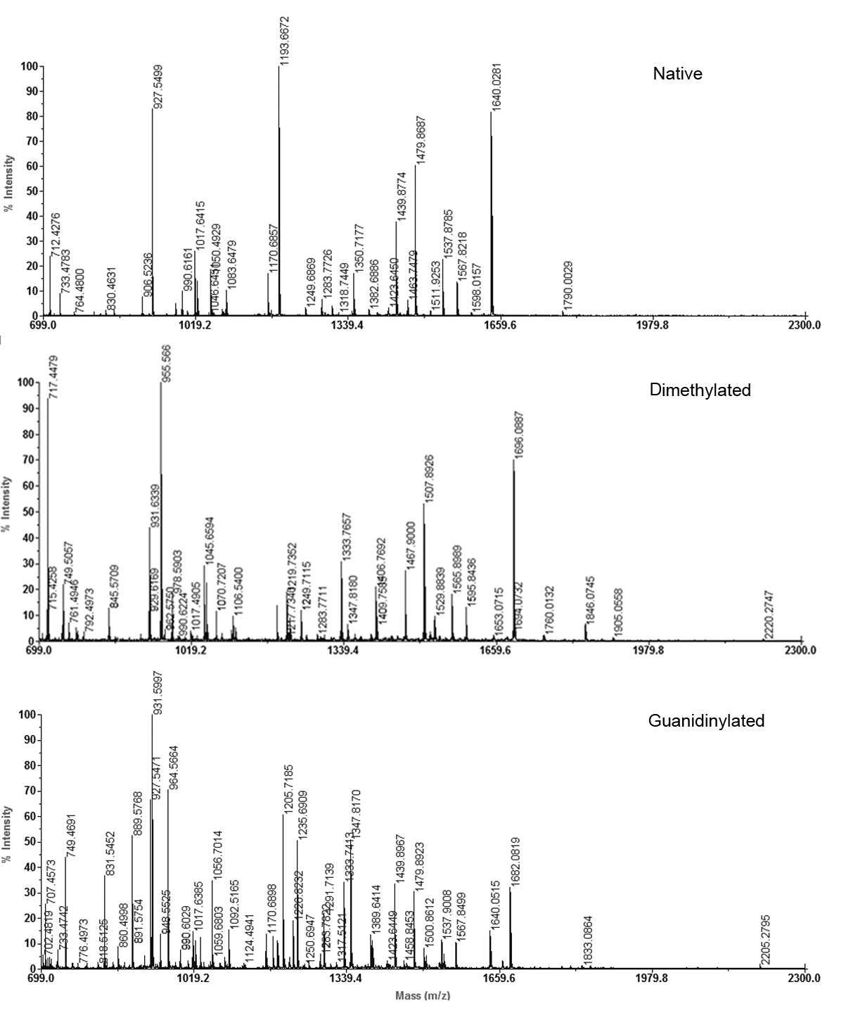
Chemical labeling of tryptic BSA peptides
画+28的峰+42的峰
oringinal
Dimethylation +28KD
Increased ion intensity
High reaction efficiency
A few byproduct
Guanidinylation +42KD
+42 KD

Slide 14
Peptide charge-state increment with chemical labeling and m-NBA treatment (Simple sample)
 | Untreated | Dimethylation | Guanidinylation | m-NBA
GRAVY | -0.14 | 0.17 | 0.08 | -0.2
pI | 5.33 | 6.04 | 5.74 | 5.18
( -)% | 14.40 | 11.00 | 8.60 | 15.50
(+)% | 11.20 | 8.00 | 7.50 | 11.20
Average Charge | 2.12 | 2.06 | 2.10 | 2.64
Average Length（aa） | 10.80 | 11.20 | 10.84 | 11.05
Sequence Coverage(%) | 35.58 | 27.68 | 36.08 | 38.06
20% guanidinylated and 50% of peptides in m-NBA containing solvent displayed increased charge, dimethylation seemed irrelevant to ion charging.
Both m-NBA or chemical labeling experiments increase spectra complexity.
m-NBA treated peptides got the highest ion charge and sequence coverage.

Slide 15
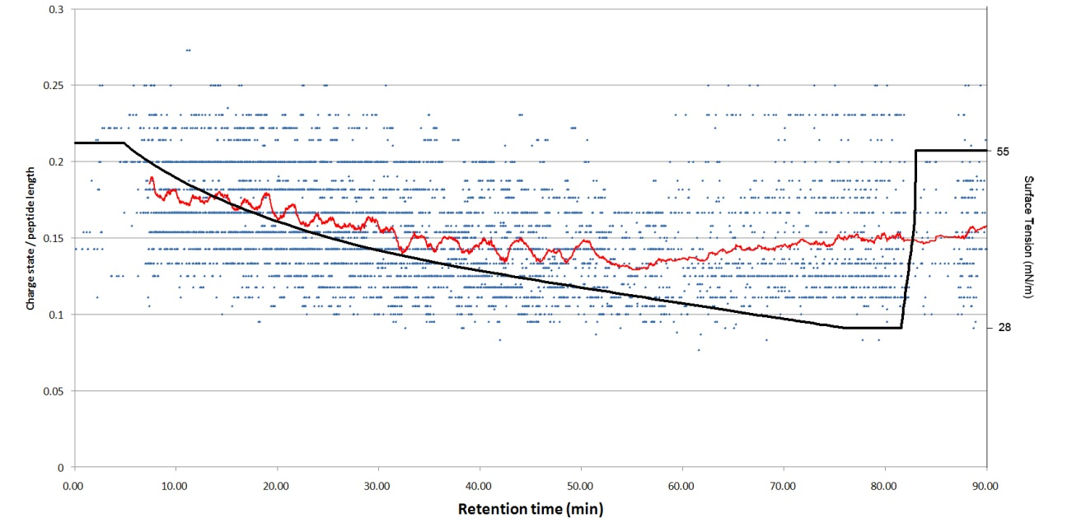
Speculated mechanism of m-NBA induced charge enhancement
Real-time surface tension are correlated with charge state by peptide length (Z/L) dynamic during LC gradient.
Notes:
The solid black line represents surface tension changes along with chromatography elution gradient. Red line indicates moving average ratio of

Slide 16
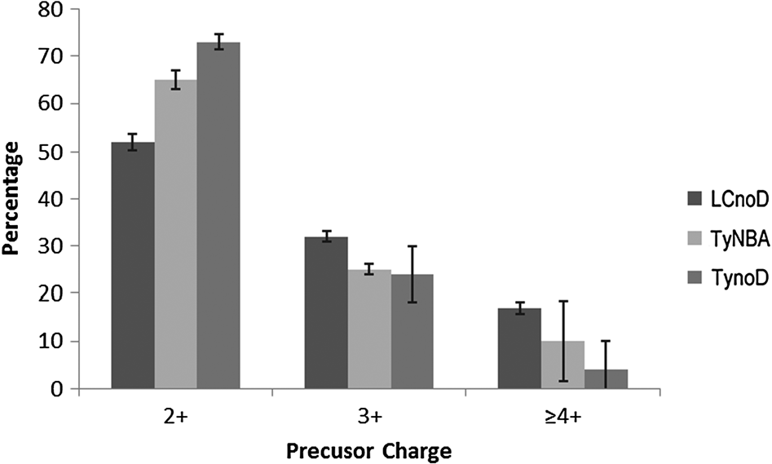
Charge enhancing ETD analysis of AMJ2 cell line (complex sample)
LCnoD ：Lys-C digestion without further derivatization
TynoD ：trypsin digestion without further derivatization
TyNBA ：trypsin digestion and m-NBA treatment
Highly Charged ions increase in an order of
TynoD < TyNBA < LCnoD
m-NBA could enhance ion charging in complex biosystems.
Notes:
Charge distribution of AMJ2 precursor ions：

Slide 17
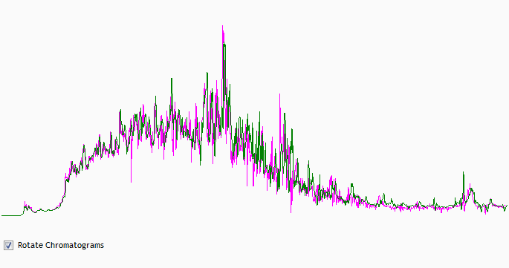
Quality control of LC replication
 | No.MS/MS | No.MS peaks | Total ion intensity
TyNBA | 6599 6688 6744 | 2819310 2776604 2778265 | 2.895e+10 3.028e+10 3.087e+10
TynoD | 6187 6191 6060 | 2570170 2619559 2690441 | 1.670e+10 1.693e+10 1.576e+10
LysC | 5682 5597 5685 | 3705791 3640280 3596867 | 1.223e+10 1.208e+10 1.191e+10
Retention time
Peak area
Replicates of TyNBA data
Nonlinear Progenesis LC-MS

Slide 18
TyNBA
TynoD

Slide 19
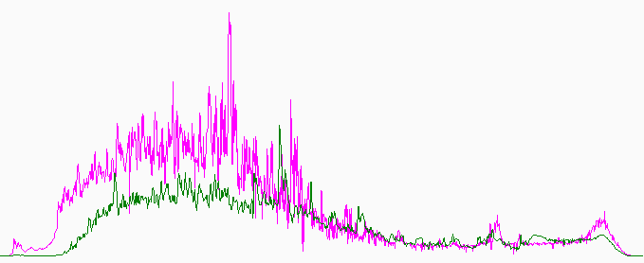
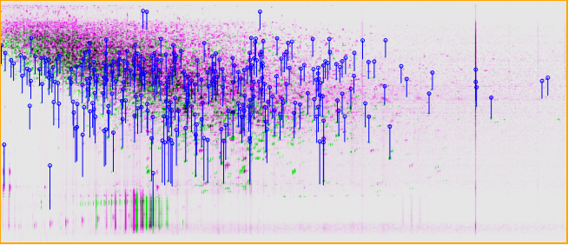
TIC of TyNBA & TynoD
Blue lies indicate mass peaks with different retention time between TyNBA and TynoD
Retention time
m/z
Retention time of different types of peptides has been changed by m-NBA

Slide 20
Working environment of search algorithms
Name | Author or Co. LTD | Vision | Format | 2V software
MASCOT | Matrix Science, Westminster, UK | 2.3.0.2 | dat | Scaffold3
SEQUEST | Thermo Scientific,USA | v.22 | srf | Scaffold3
pFind | ICT-CAS, Beijing, China | 2.6 | txt | pBuild
X!Tandem | The Global Proteome Machine Organization | CYCLONE 2010.12.01 | xml | Scaffold3
OMSSA | The National Library of Medicine | 2.1.9 | omx | OMSSA Parser

Slide 21
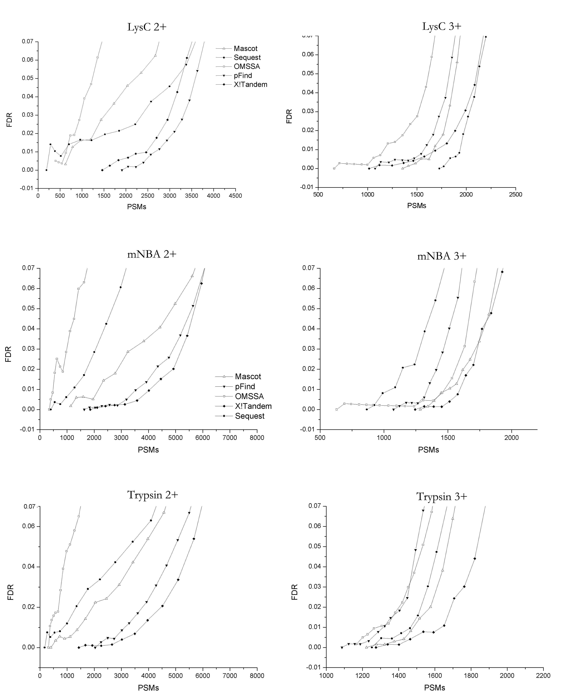
Establishing thresholds for peptide identifications
Compute individual FDR for all charge states：positive matches with higher charge states tended to receive higher scores than false hits.
chose peptide spectrum match (PSM) to be the only identification criterion to avoid bias in protein assembling.
Mascot

Slide 22
Establishing thresholds for peptide identifications using charge dependent FDRS
Sequest

Slide 23
Establishing thresholds for peptide identifications using charge dependent FDRS
OMSSA

Slide 24
Establishing thresholds for peptide identifications using charge dependent FDRS
X!Tandem

Slide 25
Establishing thresholds for peptide identifications using charge dependent FDRS
pFIND

Slide 26
Discrepancy between different algorithms
There was a great discrepancy between different algorithms in identification of doubly charged PSMs.
OMSSA and sequest had quite low amounts of doubly charged PSMs.
pFind and X!Tandem (considering c+H, z-H) had a significant advantage of 2+ peptide identification over all algorithms.

Slide 27
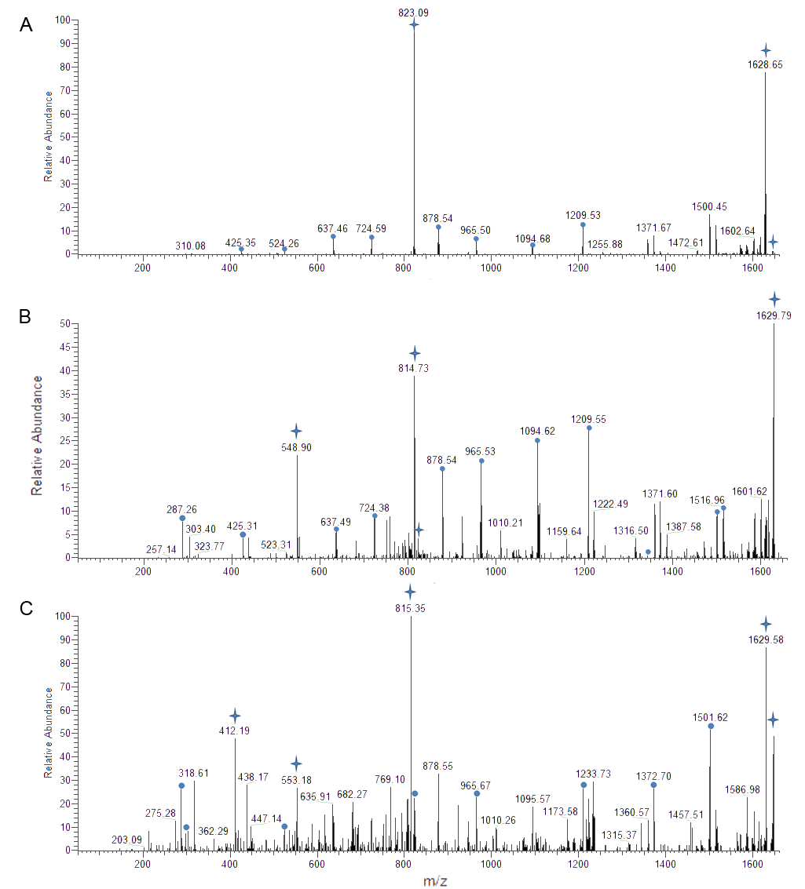
additional ETD specific features : precursor, charge reduced products and neutral loss species
hydrogen-rearranged fragment ions.
ETD spectra of doubly (A), triply (B) and quadruply (C) charged “K.QEYDESGPSIVHRK.C”.

Slide 28
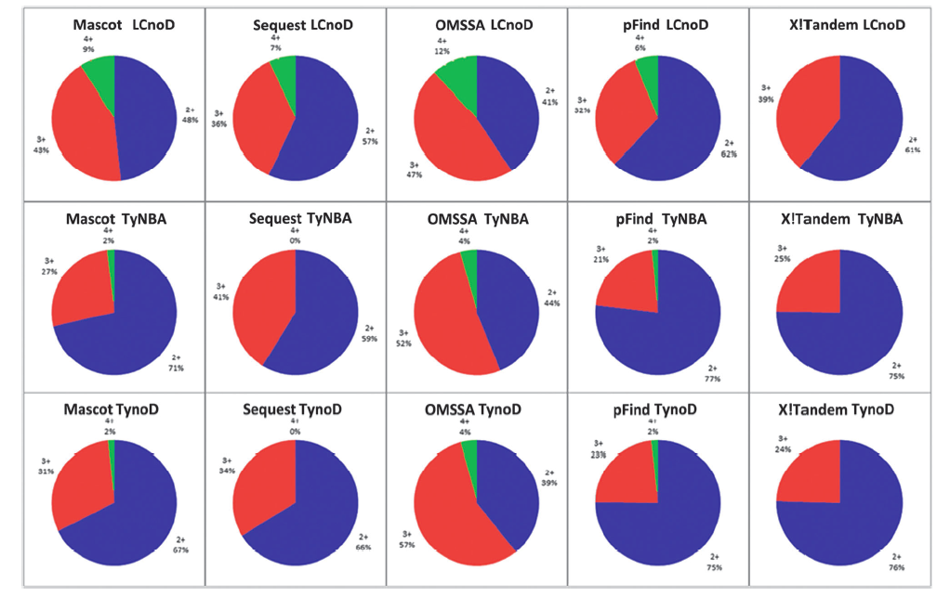
Search algorithms exhibited distinctly for identifying differently charged peptides
High charge
2+ ions

Slide 29
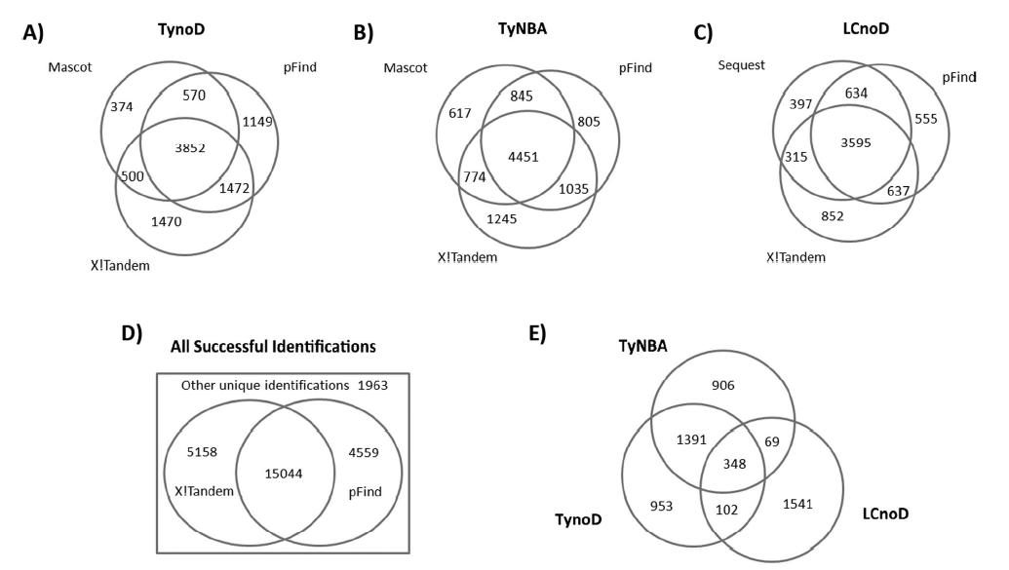
X!Tandem and pFind performed well in all strategies
Top three search optimal search algorithms for each strategy
Combining pFind and X!Tandem results can cover 92.65% of all identifications

Slide 30
Successful identification rate (pFind + X!Tandem) of Amj2 data
 | 2+ | 3+ | 4+ | Overall
Trypsin
Spectra No. | 13090 | 4258 | 502 | 17850
Spectra No.(FDR<5%) | 7012 | 2002 | 109 | 9123
Successful Identification (%) | 53.57 | 47.01 | 21.7 | 51.11
m-NBA
Spectra No. | 13581 | 5245 | 787 | 19506
Spectra No.( FDR<5%) | 7118 | 2036 | 125 | 9279
Successful Identification (%) | 52.41 | 38.81 | 15.88 | 47.57
Lys-C
Spectra No. | 8725 | 5304 | 1722 | 15751
Spectra No.( FDR<5%) | 4271 | 2323 | 364 | 6958
Successful Identification (%) | 48.95 | 43.8 | 21.14 | 44.17
Achieved ~ 50% successful identification
Interpretation of ETD spectra from > 4 + ions remain a challenge.

Slide 31
Physical and chemical properties of AMJ2 data
 | TynoD | TyNBA | LCnoD
Average Charge (identified/all) | 2.22/2.30 | 2.27/2.35 | 2.35/2.63
Peptide length | 13.1 | 13.51 | 13.6
Average GRAVY Score | -0.044 | -0.069 | -0.251
Average pI | 4.91 | 4.62 | 6.02
(positively charged residue)% | 11.9 | 11 | 14.6
(negatively charged residuw)% | 13.3 | 13.7 | 14.3
ETD probably optimal for dissociation of 13-14 aa peptides.

Slide 32
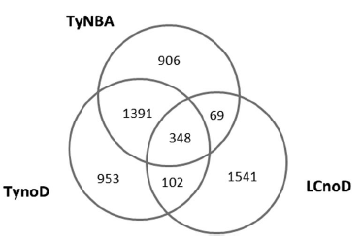
Improvement of peptide identification by combined LCnoD and TyNBA strategy
32.74%
9.75%
Large difference and great synergy between Lys-C and m-NBA strategies on a peptide level.

Slide 33
Conclusion
Charge enhancing method:
Dimethylation, Guanidination.
Add 0.1% m-NBA in ESI Solution
Lys-C Digestion
Charge enhancing method:
Dimethylation, Guanidination.
Add 0.1% m-NBA in ESI Solution
Lys-C Digestion
Complex sample
Standard protein
Multi-algorithms Database Search
Mascot ,Sequest, OMSSA, pFind, X!Tandem
Multi-algorithms Database Search
Mascot ,Sequest, OMSSA, pFind, X!Tandem
Charge enhancing methods (m-NBA etc.) could increase spectra number and identification efficiency of ETD data.
Combined pFind and X!Tandem search could greatly improve ETD identification.
Notes:
在标准蛋白和实际样本的实验中我们发现：
提高肽段电荷数的方法如添加m-NBA可以有效提高谱图数量及其鉴定率；
pFind结合X!Tandem搜库能够得到最高的ETD谱图鉴定率

Slide 34
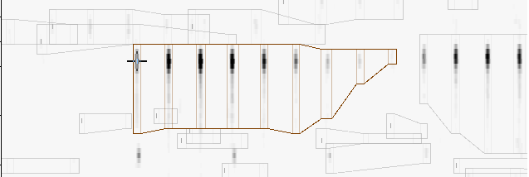
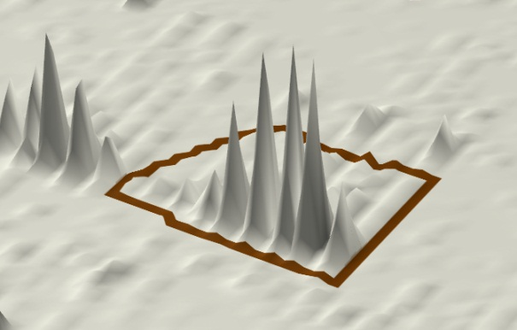
Problem：Identify high charge peptide
Charge distribution of PMF
The higher the charge ,the lower the intensity of zero isotope peak.
Miss Match

Slide 35
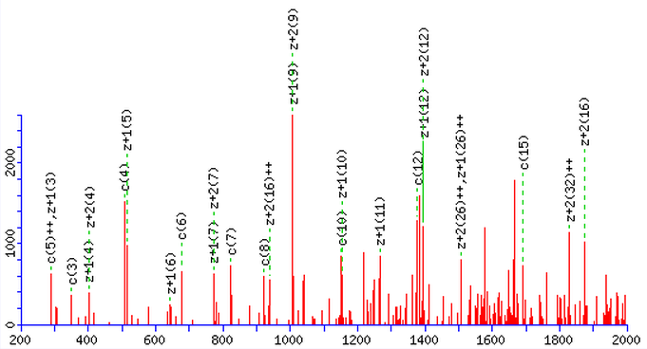
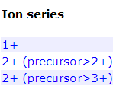
Problem：Identify high charge peptide
2. Complex MSMS spectra with low match property.
3. Most search algorithms mainly recognize 1+ and 2+ fragmental ion,
Wildly used mass analyzer has mass range limitation (typically lower than 2000 U)
Notes:
常规MS/MS鉴定只有1+，2+碎片容易进行鉴定，而LTQ只能容纳400-2000核质比的碎片

Slide 36
Thank you for attention!

